Slide 1
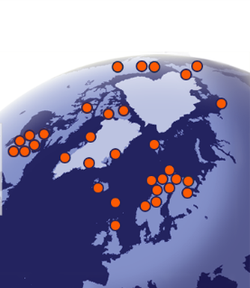
Geographic Information Technology in the Arctic
Research in a rapidly changing environment
www.eu-interact.org
Assoc. Professor Tomas Thierfelder
Dept. of Energy & Technology
Swedish University of Agricultural Sciences

Slide 2


Geographic Information Technology in the Arctic
Research in a rapidly changing environment
Topics for this talk
International Network for Terrestrial Research and Monitoring
in the Arctic
  INTERACT – Mega-project (7.4 MEUR) for establishment of communicative infrastructure in support of environmental research and monitoring in the Arctic.
INTERACT demands for standardised map-services across the Arctic
  What may standardised map services across the Arctic add to research and monitoring activities?
  INTERACT production of geographic information covering the Arctic
  How may INTERACT contribute to a standardised repository of environmental/geographic information covering the Arctic?
  Prospects of collaboration across INTERACT and Arctic SDI
  Does INTERACT and Arctic SDI share any interests that may be collaboratively pursued?
Notes:
SDI = Spatial Data Infrastructure

Slide 3
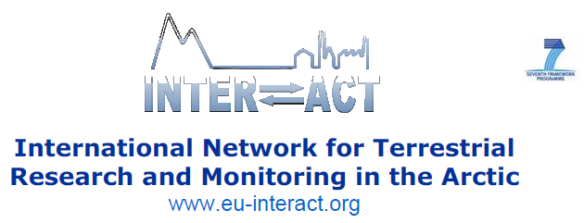

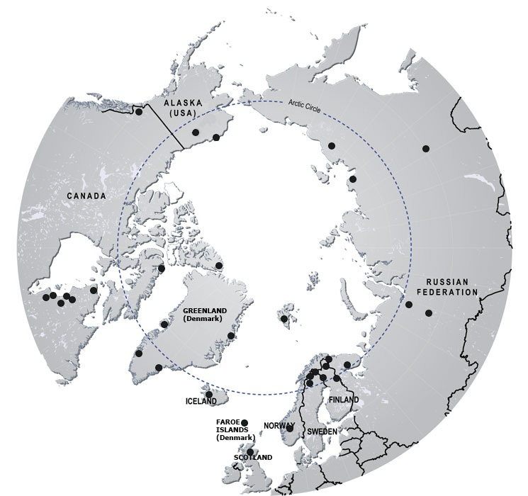
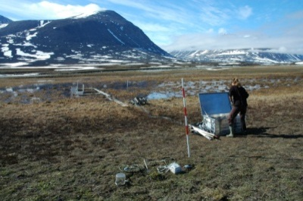
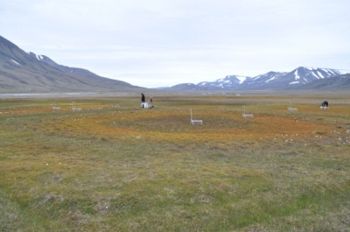
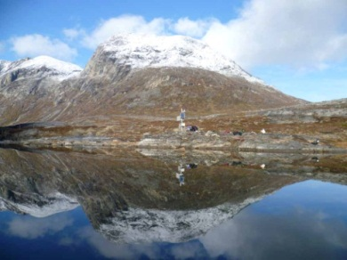
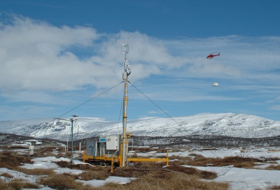
Notes:
INTERACT was proposed by the existing SCANNET network of field stations situated in all eight Arctic countries. The cooperation has a long history especially between the European members, resulting from EU-funding in 2001-2004 within the 5th Framework Programme. However the bottom-up network has expanded during the last 6 years with new members from Russia and North America to become a true circumarctic network of terrestrial field stations. These developments without resources, together with a greatly increasing demand for information on environmental change in the North as exemplified by IASC activities and also the Arctic Council’s SAON project, require a new initiative with appropriate resources

Slide 4
The INTERACT project
7.4 MEUR for 2011 - 2014
33 partners in 19 countries
45 research stations joined in so far
-Biodiversity
-Glaciology
-Permafrost
-Climate
-Hydrology
-Ecology
-Biogeochemistry
-Human dimension
Transnational Access, 3900 days granted to 68 user groups so far
Station Managers’ Forum. Meta-database for monitoring and
research, station catalogue
Joint Research Activities. Effects of infrastructure, intelligent sensors
Outreach
International Networking
TRANSNATIONAL ACCESS
Access to the Arctic
Notes:
Visa hemsidan på www.eu-interact.org
Kolla Success Story på http://ec.europa.eu/research/infrastructures/index_en.cfm?pg=success

Slide 5

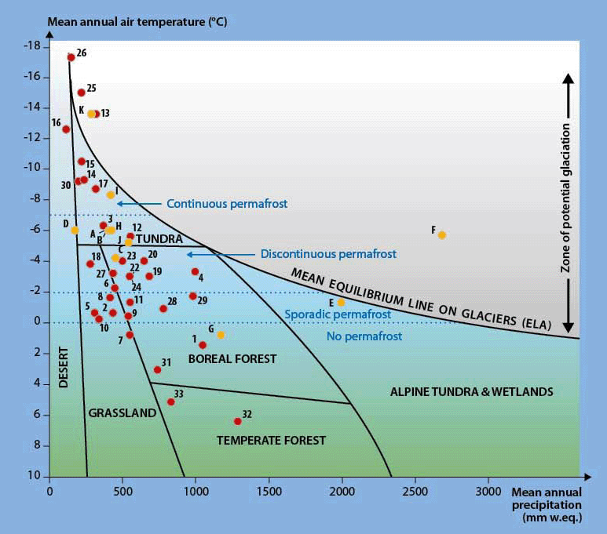
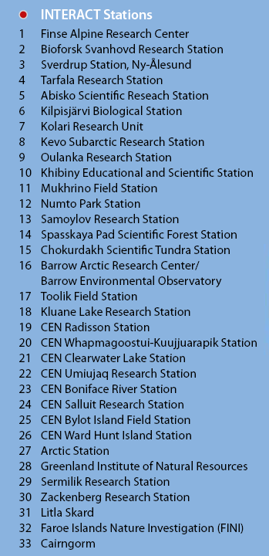
INTERACT stations sample the wide
environmental envelope of The North

Slide 6




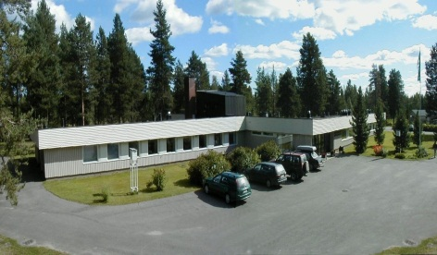
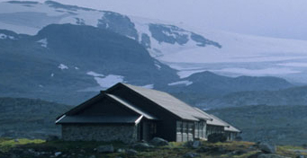
The INTERACT:ers
Main coordinator: Dist. Prof. Terry Callaghan
Coordinator of WP7 on Data Management: Assoc. Prof. Tomas Thierfelder
INTERACT stations host thousands of researchers world-wide, using map services and producing spatial data on environmental change in the Arctic
They participate in all major Arctic terrestrial initiatives e.g.
IASC, ISAC, SAON, CBMP, AMAP, IPA/CALM, ITEX and relevant EU
ESFRI projects like LifeWatch, ICOS and SIOS

Slide 7
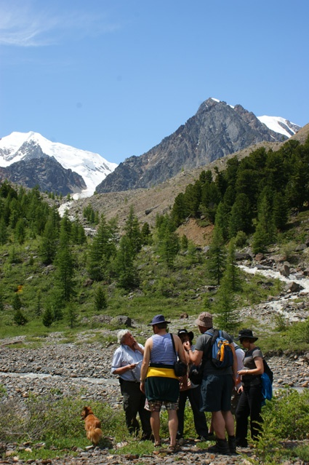
INTERACT Services for the Arctic and northern alpine regions where observing capacity is low:
INTERACT partner monitoring activities have been on-going for up to 100 years
Ground validation of remote sensing
Model testing on the ground
Hosting standardised experiments (e.g. ITEX, LTER, ANAEE, EXPEER)
Hosting observation and sampling networks (e.g. CALM, LifeWatch, ICOS, GLORIA)
Sampling and inventorying (EBON, ABC)
Building capacity for education e.g. species identification (University of the Arctic)
Altai Mts 2010, International summer school

Slide 8
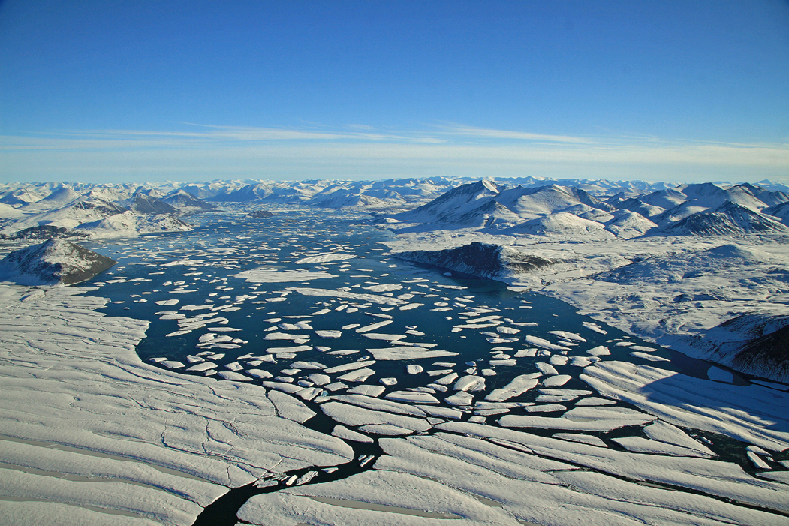
INTERACT Services for the Arctic and northern alpine regions where observing capacity is low:
Real time monitoring (GEO, CBMP, SAON, WWF)
Retrospective monitoring (BTF, IASC, CBMP) – monitoring does not start from today!
Instrument design, testing and distribution (SIOS)
Attribution of remotely sensed data through local knowledge and access to stakeholders
Improved data compatibility and accessibility (IASC + ??)
Rapid response sampling Arctic-wide (e.g. carbon, contaminants)

Slide 9
INTERACT WP7 – Data Management
WP7 in a nutshell
With INTERACT stations generating large data-volumes for many purposes, it is essential to share efficient standards for data management across stations.
The overall aim of WP7 is to increase the transparency through the collective archives of the INTERACT infrastructure
  in order to minimize risks of information gaps and unexploited synergies, and to prevent outreach from being hampered by the lack of centralized information
  and in order to provide managerial decision-support across stations
The specific objectives for WP7 are, therefore, to design and implement a prototype geographic metadata catalogue at the Abisko research station,
  to expand the Abisko GIS system specification throughout the INTERACT infrastructure (implementation lies beyond the INTERACT project)
  and to establish a repository (ScanDB) of standardized tools for streamlining the process of managing, publishing and curating the data products produced and handled in the INTERACT infrastructure.

Slide 10
INTERACT WP7 – Data Management
Wishes for the future
Beyond the INTERACT:
  Actual implementation across Polar stations
    Within INTERACT, WP7 will implement the prototype Abisko GIS at the Abisko station only.
      Expansion across other INTERACT stations will be carried out by expanding the Abisko GIS metadata profile to encompass a handful of other principal Polar stations.
    The resulting product will be a blueprint system specification for others to use if they wish to build a system of their own.
    Beyond the INTERACT, we would like to actually implement a web-based geographic decision-support system across a network of principal stations.
  What good would actual network implementation do?
    Being biometricians rather than computer programmers, we develop and implement experiments that allow us to formally infer the effect of things.
    In a biometric context, the big question is whether the implementation of a web-based geographic metadata catalogue changes anything.
    The big question is whether these systems allow us to better understand the effects of climate-change in the Arctic,
      and for biometricians, a system implemented across Polar stations would be an ideal instrument for inferring such effects.

Slide 11
INTERACT WP7 – Data Management
Future predictions
Benefits of a fully implemented decision-support system
  A virtual instrument for monitoring environmental change in the Arctic
    Standards in-common supports a monitoring culture in-common
      encompassing the metadata catalogue as a decision-support system
    With real-time input, anybody can see what everybody is planning
      and base strategic decisions regarding own activities on the current network profile of activities
    A dynamic regulated network of (quite autonomous) station nodes
      where nodes are equipped with a network of communicating sensors
      is what we’ll have in the future
  Organised research and monitoring output across the Arctic
    Todays research and monitoring output is immensely difficult to grasp
    With a metadata catalogue reflecting the historic and on-going effort across stations, the effort of querying the collective output will be tremendously reduced
      which radically increases the cost-effectiveness of the collaborative research and monitoring effort
      and increases the effectiveness with which crucial information may be used for political decision-making

Slide 12
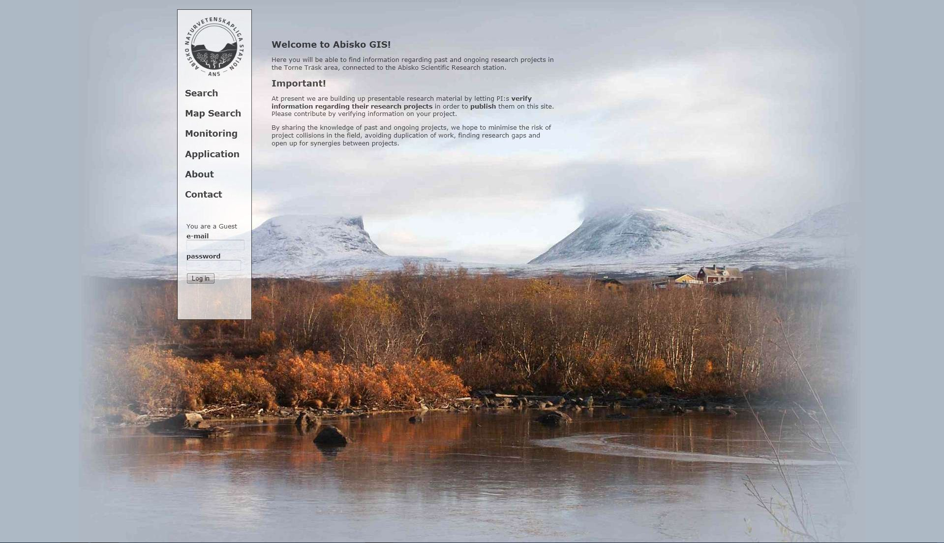
INTERACT demands for standardised map-services
Abisko Scientific GIS front-page

Slide 13
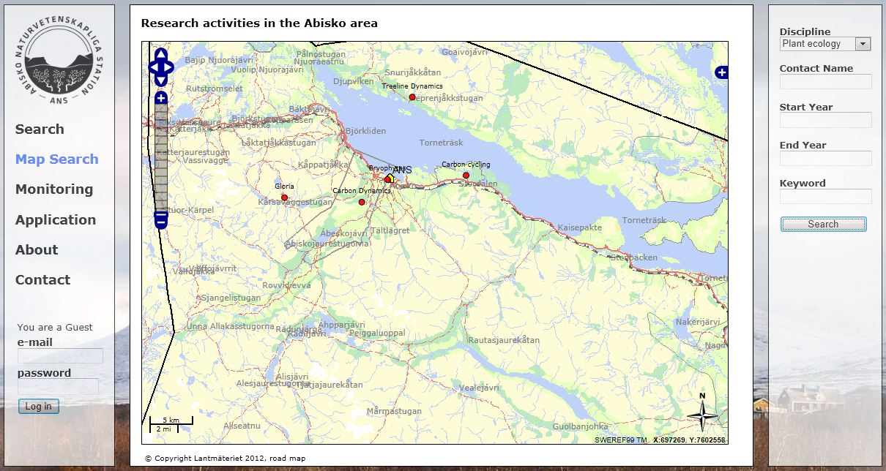
INTERACT demands for standardised map-services
Abisko Scientific GIS map-based query interface

Slide 14
INTERACT demands for standardised map-services
Abisko Scientific GIS map-based query interface
When expanded throughout the INTERACT
  our system would require another set of backdrop maps for every station
  and possibly thematic coverage to change with the query theme
    e.g. biome, ground cover, vegetation, soils, hydrography, topography, permafrost, infrastructure, etc.

Slide 15
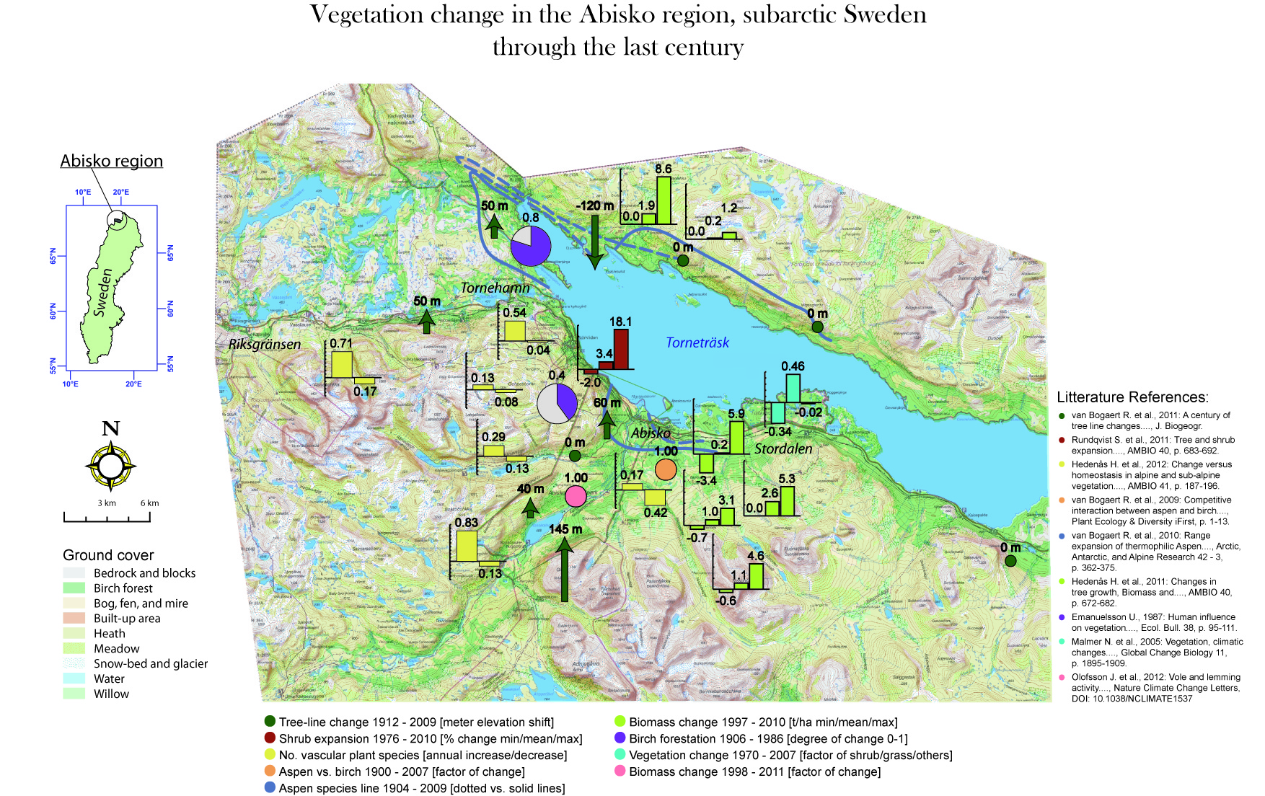
INTERACT production of geographic information
Environmental change in the Abisko region
Map by: Thierfelder T., Callaghan T.,
and Jonasson C., 2012

Slide 16
INTERACT production of geographic information
Environmental change in the Abisko region
Typical map products to be expected from within the INTERACT
  Local data – there are HUGE territories not covered by anything but satellite and airborne sensors
  Strongly varying time span from one station to another
  Under the above circumstances, most terrestrial themes are addressed
Map by: Thierfelder T., Callaghan T.,
and Jonasson C., 2012

Slide 17
Prospects of collaboration across
INTERACT and Arctic SDI
  Arctic SDI map services available in the expanded version
  of Abisko Scientific GIS
    Standards in-common
    Perhaps master project, perhaps external funding
      Any suggestions are welcome!
  Thematic output from INTERACT stations
    Routines for harvesting data, standards in-common
    External funding, long term research and development
      Perhaps in the continuation of INTERACT (2015 – 2019)
  Continuation of INTERACT
    New major infrastructure project is already being designed
    Arctic map authorities would certainly be welcome to join INTERACT
    in a new application
      All Arctic nations together
      in EU:s new Horizon 2020 programme
      with a research and development agenda
      perhaps like outlined above

Slide 18
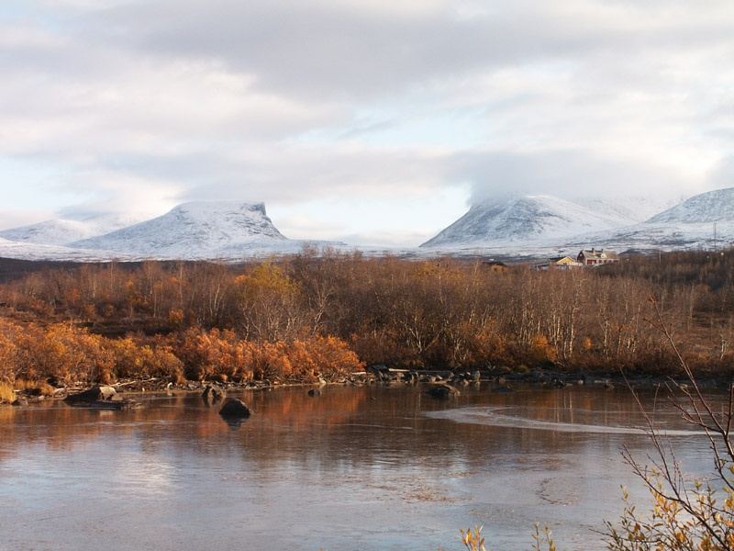
Thanks’ for your attention!
Photo: Sofia Bryntse
Abisko Scientific GIS in collaboration with Abisko Scientific Research Station
Contact: Tomas.Thierfelder@slu.se
Abisko Scientific GIS web-service: www.abiskogis.se (from early spring 2013)
Notes:
18

