Slide 1
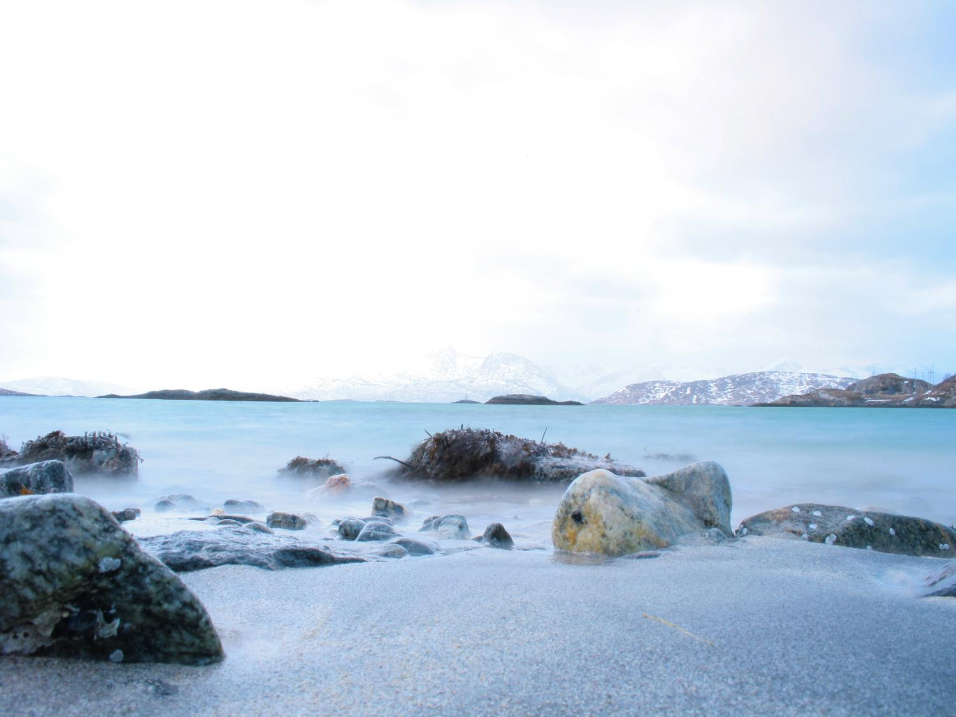
  The Arctic SDI
  Status report from the TWG –
  2012-10-31
Fredrik Persäter
Chairman of TWG

Slide 2
Arctic SDI
The Technical Working Group
Review of previous SC Meeting
  Reference data/Background map
  Metadata specification
  Next steps - Activities and responsibilities
  Preconditions for success
Status Report
  Status - decided Next steps
  Status - On going work
Involvement of user groups
  IPY Montreal 2012
  Arctic SDI – INTERACT/AbiskoGIS
Demonstrations
  Demo on VMAP data 1:1M
  Demo on WMS 1:1M from Russia
  Demo on WMS 1:250M from Norway
Discussion
www.arctic-sdi.org
2
Notes:
2

Slide 3
The Technical Working Group (TWG)
Chair - Fredrik Persäter; National Land Survey of Sweden
Jean-Francois Bourgon; Centre for Topographic Information, Canada
Sylvain Vallières; Centre for Topographic Information, Canada
Trond Johannessen; Norwegian Mapping and Cadastre Authority
Frank Arntsen; Norwegian Mapping and Cadastre Authority
Douglas Nebert; US Geological Survey, USA
Esa Tianen; National Land Survey of Finland
Ari Öysti; National Land Survey of Finland
Eydis Lindal Finnbogadottir; National Land Survey of Iceland
Ásta Kristín Óladóttir; National Land Survey of Iceland
Alexander Rebry; Gosgiscentr, Russia
Andrew Flatman; National Survey and Cadastre, Denmark (Faroe Islands)
Karl Brix Singlersen; Asiaq, Greenland.
3
3

Slide 4

Review of previous SC Meeting
Reference data/Background map
  Start with simple map at a small scale and few layers
  Strategy:
    WMS in 1:1M
    WMS 1:250K
  The result is not awaited to be homogenous
  Each country is responsible for setting up and hosting a WMS service according to the recommendations from the technical WG
  The WMS services will together form the Arctic SDI background map
www.arctic-sdi.org
4
Notes:
4

Slide 5

Review of previous SC Meeting
b) Metadata specification
  First draft of metadata specification for the Arctic SDI
  TWG proposes to use GEMET as thesaurus which is also used within Inspire
www.arctic-sdi.org
5
Notes:
5

Slide 6
Review of previous SC Meeting
c) Next steps - Activities and responsibilities
NR | ACTIVITY | RESPONSIBILITY (name) | FINALISED (y/m)
WG-1 | WIKI/Tool to share info Gather what's available within the group | Peter (CA) Fredrik (SE) | Feb 3
WG-2 | Set up WMS services according to agreements | Doug N (US) Denis (CA) Frank (NO) Fredrik (SE) Andrew (GL,DK) Esa (FI) Brandur (IS) ? (RU) | end of March for all but Finland. Finland May 1
www.arctic-sdi.org
6
Notes:
6

Slide 7
Review of previous SC Meeting
c) Next steps - Activities and responsibilities
WG-3 | Bathymetric data, contact GEBCO and IBCAO | Owe&Martin | Feb 3
WG-4 | Validation Compare the existing validation rules (GeoNetwork) with our decided md fields | Andrew (DK) | Feb 10
WG-5 | Define layer names for decided layers | Peter (CA) | Feb 1
WG-6 | Cartography (draft spec) according to agreed layers (SLD) | Frank (NO) | Feb 10
WG-7 | Check if it's ok to use the decided layers openly in the SDI | Denis (CA) Rob (US) Frank (NO) Fredrik (SE) Esa (FI) Andrew (DK,GL) ? (RU) ? (IS) | No restrictions. Ok to use! No restrictions. Ok to use! Feb 3 Feb 10 No restrictions. Ok to use! (May 1) Feb 3 Owe&Martin Check! Feb 3 Owe&Martin Check! Feb 3
www.arctic-sdi.org
7
Notes:
7

Slide 8
Review of previous SC Meeting
c) Next steps - Activities and responsibilities
WG-8 | Create use cases (CAFF,AMAP,EPPR) Owe&Martin arrange a meeting with EPPR to create a Use case about search & rescue | Owe&Martin | At the latest April
WG-9 | Landsat Image Mosaic – Arctic Each country check possibilities to contribute with work power for our part of the Arctic Funding? Carl will talk to Jim Devine Send out more info. | Carl (US) All contact point in each country. | March 15 March 10 Aug 30
www.arctic-sdi.org
8
Notes:
8

Slide 9

Review of previous SC Meeting
d) Preconditions for success
  Support from the NMA’s executive
  Time for selected resources to work
  WG members must prioritize the work
  WG members have to attend meetings
  WG members must have the support of experts in their own organization. Advisory and practical work
www.arctic-sdi.org
9
Notes:
9

Slide 10
Status Report
a) Status - decided Next steps
NR | ACTIVITY | FINALISED (y/m)
WG-1 | WIKI/Tool to share info Gather what's available within the group | Ok
WG-2 | Set up WMS services according to agreements | 1:1M WMS with VMAP-data up and running for entire arctic.
www.arctic-sdi.org
10
Notes:
10

Slide 11
Status Report
a) Status - decided Next steps
WG-3 | Bathymetric data, contact GEBCO and IBCAO | Batymetric data from in 1:1M WMS
WG-4 | Validation Compare the existing validation rules (GeoNetwork) with our decided md fields | A comparison is done by Andrew and the rules seems to work
WG-5 | Define layer names for decided layers | Done for 1:1M scale
WG-6 | Cartography (draft spec) according to agreed layers (SLD) | Done for the first iteration
WG-7 | Check if it's ok to use the decided layers openly in the SDI | Still a little bit unclear from Denmark/Greenland (Denmark will release their data as free data by Jan 2013, but it is not cleared out for me if it includes Greenland and the Faroe Island)
www.arctic-sdi.org
11
Notes:
11

Slide 12
Status Report
a) Status - decided Next steps
WG-8 | Create use cases (CAFF,AMAP,EPPR) Owe&Martin arrange a meeting with EPPR to create a Use case about search & rescue | We have started up a cooperation with INTERACT and AbiskoGIS. We need to work more with the users. Specially search & rescue has been pointed out as a High Priority area by both Russia and Canada.
WG-9 | Landsat Image Mosaic – Arctic Each country check possibilities to contribute with work power for our part of the Arctic Funding? Carl will talk to Jim Devine Send out more info. | We use Blue Marble in 1:1M WMS Unclear if we can get a Mosaic with better resolution. Has Douglas any comments on this?
www.arctic-sdi.org
12
Notes:
12

Slide 13

Status Report
b) Status - On going work
Geoportal and Applications
Transport Layer (Internet)
GeoRM
GeoRights Management
Services
Service
Services
Services
Services
Services
Services
Services
Services
Services
Service
Service layers
Service layers based on open standards
Thematic Data
National reference data
Russia
Finland
Sweden
Norway
Iceland
Denmark
Greenland
Canada
USA
Other Data Providers
National Mapping Organisations
20120209

Slide 14
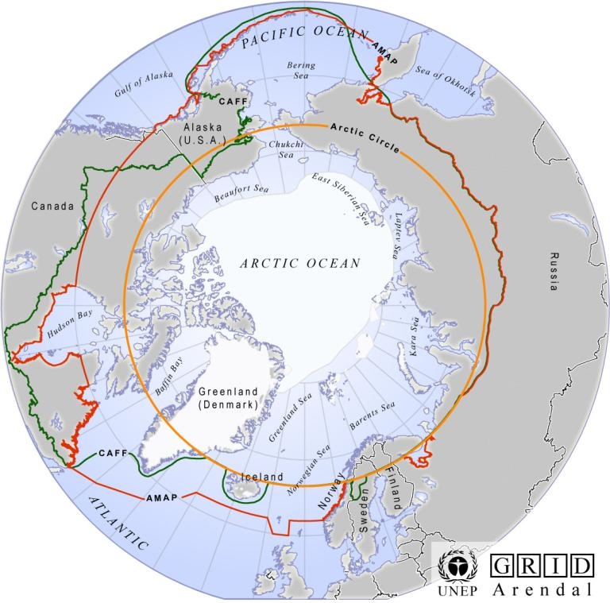
Status Report
b) Status - On going work
Web Map Services - Reference data
  Scale: 1:250 000
  Area: The Arctic
  Largest common denominator according to definitions by CAFF and AMAP
  Projection: North Pole Azimuthal Lambert Equal Area EPSG 3571-3576
www.arctic-sdi.org
14
Notes:
14

Slide 15
Status Report
b) Status - On going work
Data model/Cartography 1:250 000
GIT Barents SLD
Russian Proposal
ERM – data model
www.arctic-sdi.org
15
Notes:
15

Slide 16
Status Report
b) Status - On going work
Data model/Cartography 1:250 000
ExM
INSPIRE
Subset
ASDI data model
ERM
EBM
EGM
www.arctic-sdi.org
16
Notes:
16

Slide 17
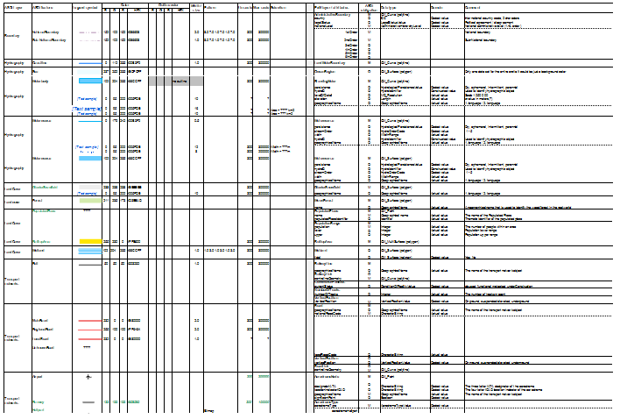
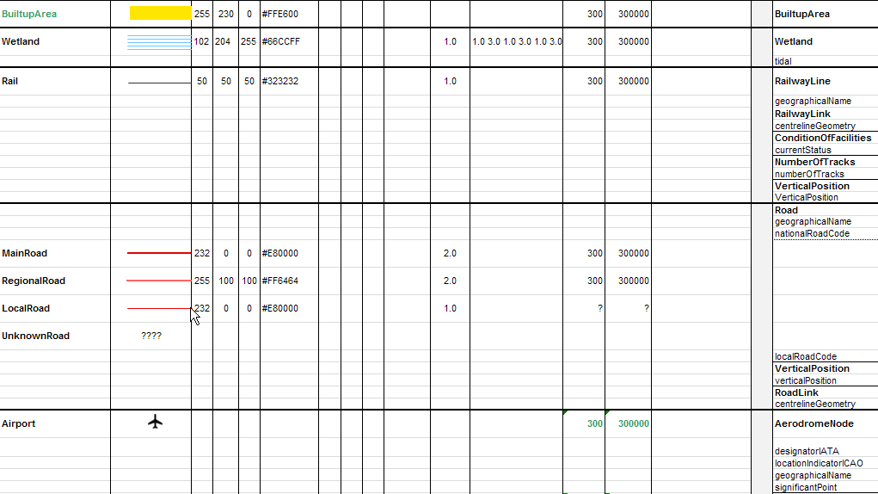
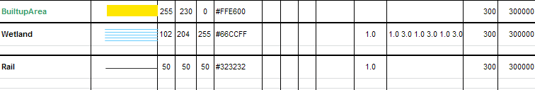
Status Report
b) Status - On going work
Data model/Cartography 1:250 000
www.arctic-sdi.org
17
Notes:
17

Slide 18


Involvement of user groups
a) Meetings IPY Montreal 2012
AMAP – Simon Wilson
  The decreasing permafrost impacts on the Inuits
INTERACT – Prof. Terry Callaghan
  Abisko GIS
www.arctic-sdi.org
18
Notes:
18

Slide 19
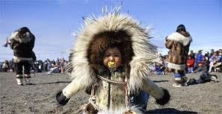
Involvement of user groups
a) Meetings IPY Montreal 2012
AMAP - The decreasing permafrost impacts on the Inuits
Good use case – Highlights the Inuits
Would be great with a use case connected to one of the AC WG
Challenges:
AMAP has no central data store
Data and maps are gathered when creating their reports
Possible to work different in the future?
www.arctic-sdi.org
19
Notes:
19

Slide 20
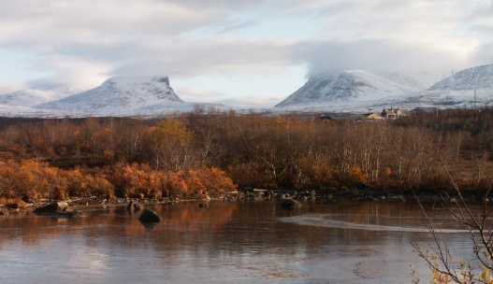
Involvement of user groups
b) Arctic SDI – INTERACT/AbiskoGIS
Presentation of Abisko GIS by Tomas Thierfelder and Mohsen Bashang (Abisko, May 31)
Common project established
  Master project – Swedish University of Agricultural Sciences in Uppsala
  Arctic SDI – Mentor, Supervisor
www.arctic-sdi.org
20
Notes:
SLU - Swedish University of Agricultural Sciences in Uppsala
20

Slide 21
Involvement of user groups
b) Arctic SDI – INTERACT/AbiskoGIS
Abisko GIS data is important for the entire Arctic region
Arctic SDI would like to expand the use of information stored in Abisko GIS
  A Discovery Service interface will be added to Abisko GIS
  Potential conflicts between metadata in the to projects will be inventoried and eliminated
  Keywords in metadata will be reviewed
www.arctic-sdi.org
21
Notes:
21

Slide 22
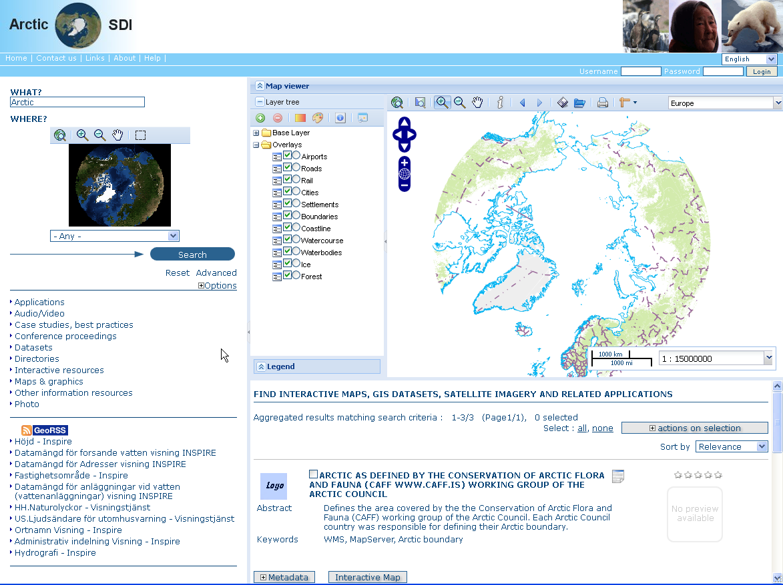
Demonstrations
Demo on VMAP data 1:1M
Demo on WMS 1:1M from Russia
Demo on WMS 1:250M from Norway
www.arctic-sdi.org
22
Notes:
22

Slide 23
Discussion
Time schedule
Arctic SDI – what’s left?
Resources
Organisation for hosting Arctic SDI
Involvement of user groups
More… ?
www.arctic-sdi.org
23
Notes:
23

Slide 24

Discussion
a) Time schedule
  End of project - February 2013!!?
  We are still discussing how to work!
www.arctic-sdi.org
24
Notes:
24

Slide 25
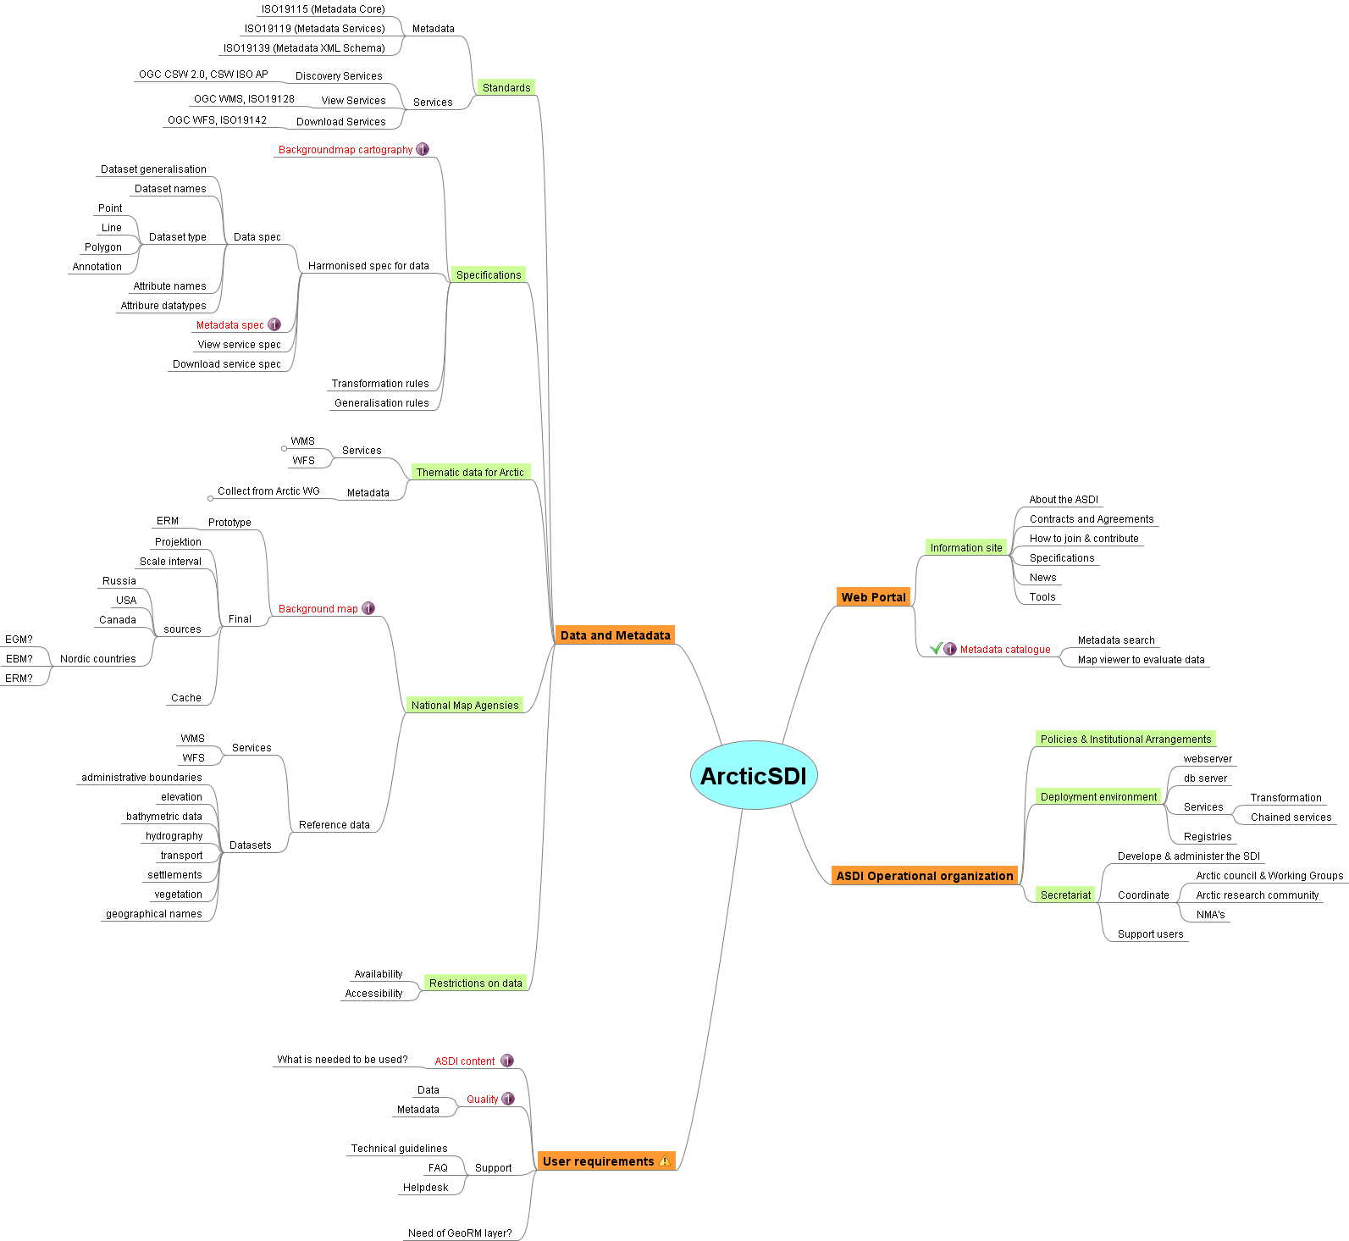
Discussion
b) Arctic SDI – what’s left?
www.arctic-sdi.org
25
Notes:
25

Slide 26
Discussion
c) Resources
Support from the NMA’s executive
  We still need resources!
  We need time for the resources to work!
  We need to meet!
www.arctic-sdi.org
26
Notes:
26

Slide 27
Discussion
d) Organisation for hosting Arctic SDI
Who will be responsible for the hosting?
  We need a physical server
  We need central services
    Cascading service (collect all WMS’ies into one)
    Store the central map cache
  We need the organisation!
www.arctic-sdi.org
27
Notes:
27

Slide 28
Discussion
e) Involvement of user groups
  General comments!
www.arctic-sdi.org
28
Notes:
28

