Slide 1
Spatial Data Infrastructure Status of the Arctic SDI
Magnús Guðmundsson

Slide 2
Spatial data infrastucture
A spatial data infrastructure (SDI) is a data infrastructure implementing a framework of Spatial data, Metadata, Users and Tools that are interactively connected in order to use spatial data in an efficient and flexible way.

Slide 3
Spatial Data Infrastructure
SDI must also be user driven as their primary purpose is to support decision making for many different purposes.
SDI involves institutional matters related to organisational responsabilities, overal national information policies and availability of financial and human resources.

Slide 4
Spatial Data Infrastructure
Human resources
Financial resources
Metadata
Tools
Standards
Policies
Users
Spatial Reference Data
Maintain
Acquire
Process
Distribute
Preserve

Slide 5
Arctic SDI Status feb 2013
Human resources
Organisational responsibility and connectivity, 9 countries
Financial resources
Grants, NMA of each country, Users ?
Metadata
In Arctic Geoportal and National discovery services
Tools
Arctic Geoportal
Vision, Scope,
Objectives
Standards,
Artic SDI and national
Policies
Pricessing / licensing,
National information policies
Users
ARCTI Councill WG and others
Spatial reference Data
From 9 countries
Maintain
Each country and data provider
Acquire
Process
Distribute
Preserve

Slide 6
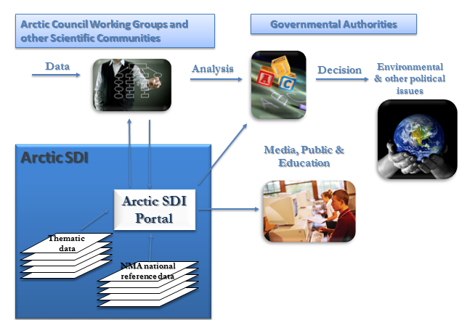
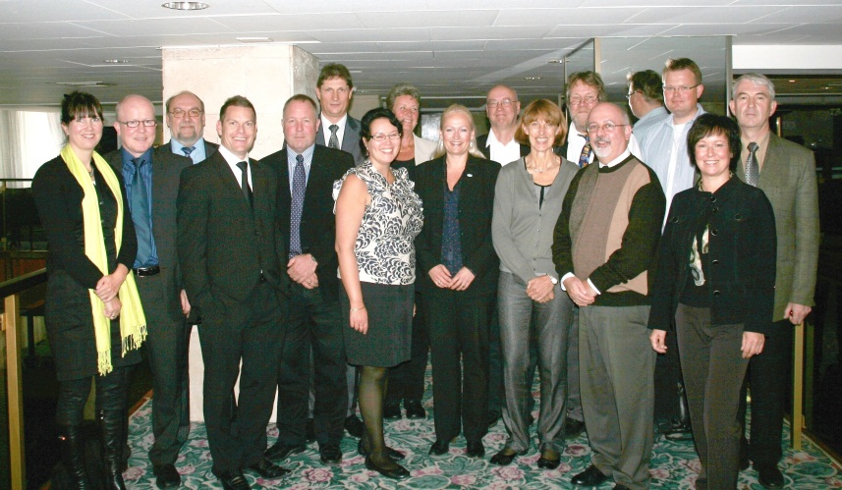
Road Ahead
To be very clear were we are going:
We need to continue to think big, start small and adapt often:
We need to invest time in team work;
We need to understand your users’ real needs;
We should under promise and over deliver;
We need to communicate clearly, simply and often;
We should use the right tool for the job, don’t re-invent the wheel;
We should not be a slave to technology or design;
We should Celebrate Success !

Slide 7
SDI Status in Iceland
Implementing INSPIRE in Iceland
Icelandig SDI law based on INSPIRE
National Land Survey and ministrie for environment have leadership
Coordination Committee
Committee of key Directors
Working Goups in specila themes
Nordic INSPIRE Working Group
EuroGeographics INSPIRE working Group
INSPIRE Conference once a Year

Slide 8
SDI organisation in Iceland
U S E R S
Access to data free from Jan 2013
Ministry for Resources and Environment
EU / EEA
INSPIRE
Coordination Committee
National Land Survey of Iceland
Iceland
Reference Datasets
Group og Directors
Governmental Data producers Working Groups
34 data themes (INSPIRE)
Raw data

Slide 9
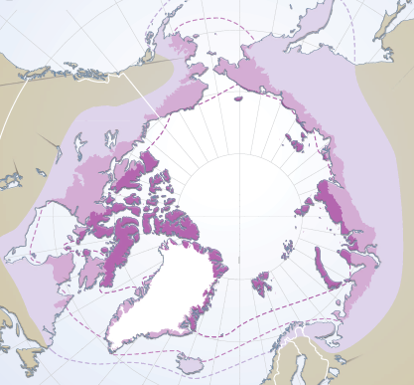
Status of Arctic SDI in Icelend
Arctic SDI is fully supported on political level but not specially funded in Iceland
Three pesons are workin on Arctic SDI at Landmælingar Íslands
Magnús Guðmundsson
Eydís Líndla Finnbogadóttir
Ásta Kristín Óladóttir
Expectations are high in Iceland and both SAO and ministers of foreign affairs and minister for respurces and environment are informed.

