Slide 1
Norwegian SDI
The Arctic SDI project, Portland, February 2013
Frank Arntsen, Senior Engineer, Norwegian Mapping Authority

Slide 2

Content
- “Norge digitalt” – 10 years of cooperation
- INSPIRE

Slide 3














«Norway digital»
The public have free access
to a variety of viewservices
Partnership and
joint venture funding
Distributed infrastructure
Unifying reference data and thematic data
Covers local, regional and national authorities
Norge digitalt parter
Delivery
services
Kommuner/Fylker
Parliamentary white paper – Norge digitalt (2003)
– Operative from 01.01.2005
The major concept in the White Paper is the establishment
of the national geospatial infrastructure

Slide 4

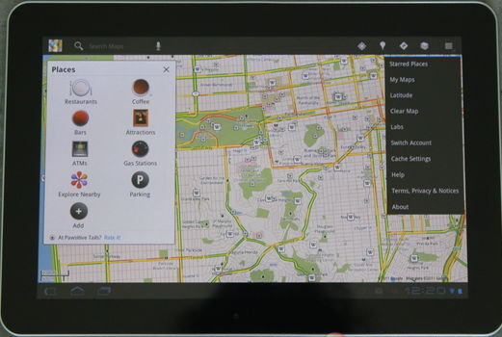
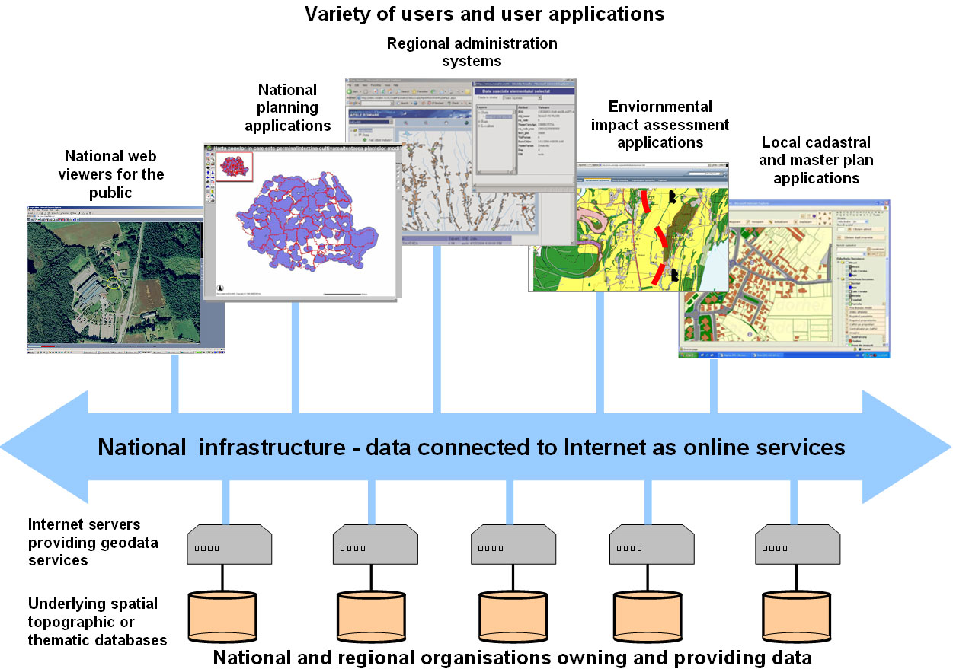
a system of distributed responsibilities
- offering harmonised services

Slide 5

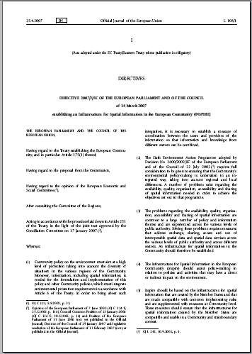
INSPIRE
New national Geodata legislation
Implemented in Norwegian law
3. sept. 2010
Additional regulation 8. august 2012

Slide 6

DT NS
DT NS
DT NS
INSPIRE Arhitecture
Applications and Geoportals
Service Bus
GeoRM Layers
Registers
Discovery Service
GeoRM
Service
View
Service
Download
Service
Transf.
Service
InvokeSD
Service
DT MD
DT MD
DT DS
DT DS
Register Data
Service
Metadata
Data Set
Metadata
GeoRM
Data
Spatial Data Set
TWG
TWG
TWG
TWG
TWG
TWG
Thematic DS
Framework for
harmonized DS

Slide 7
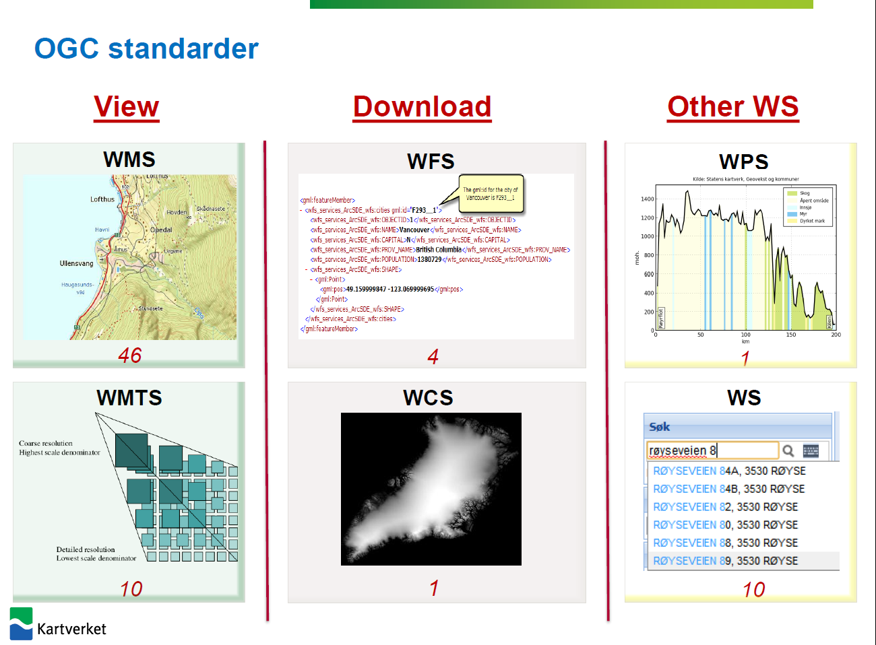
Norwegian Mapping Authority
- Geodataservices

Slide 8
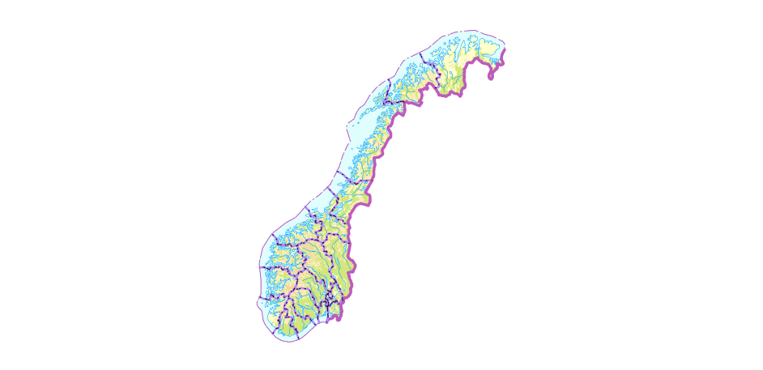
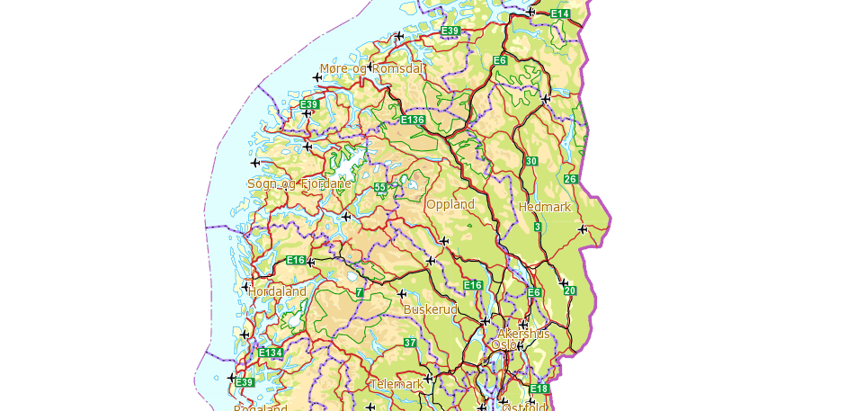
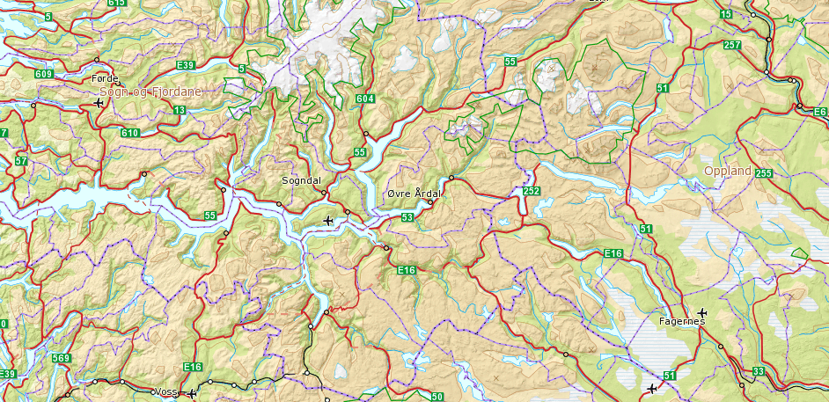
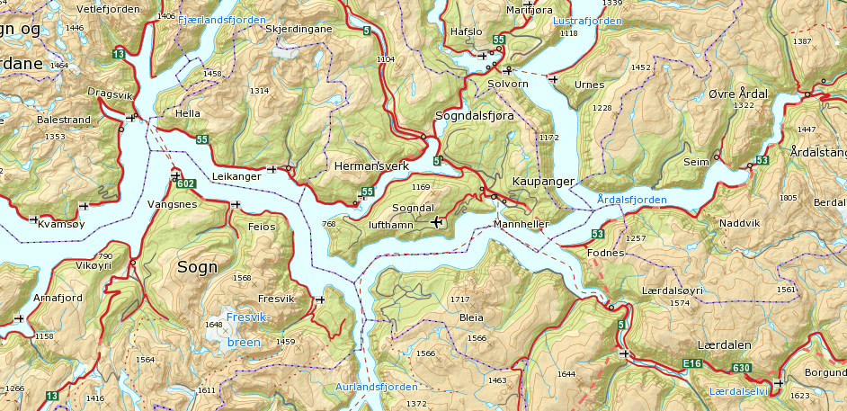
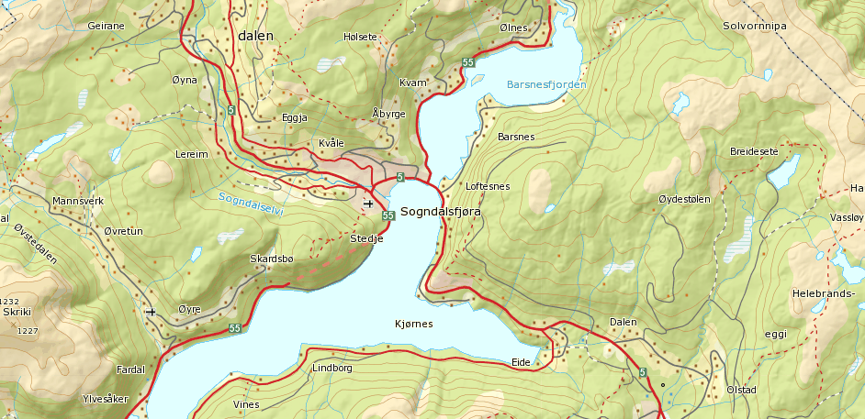
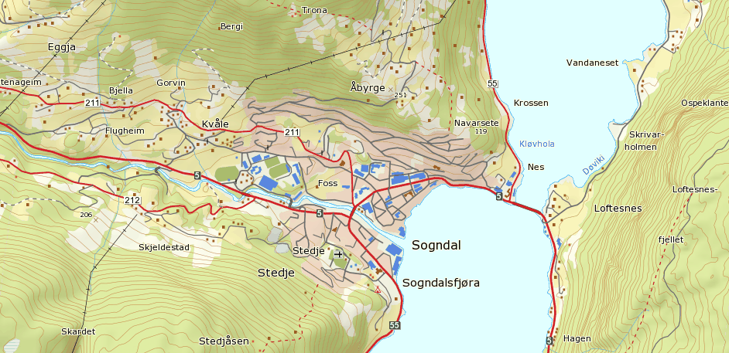
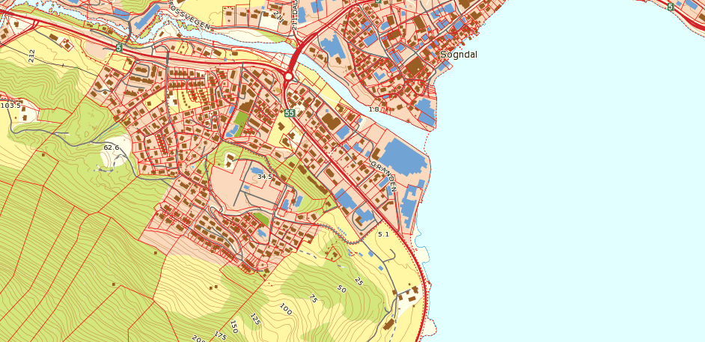
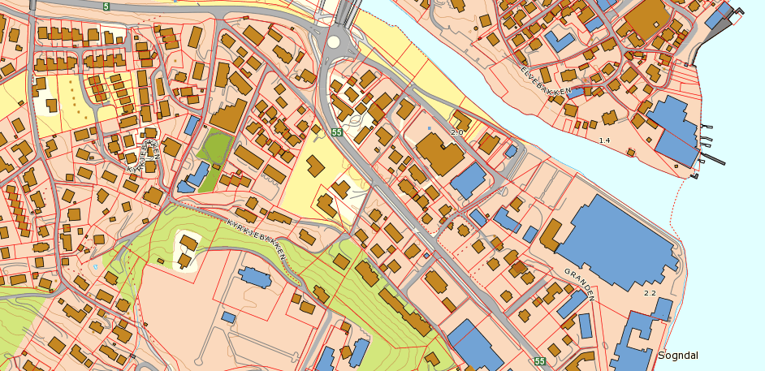
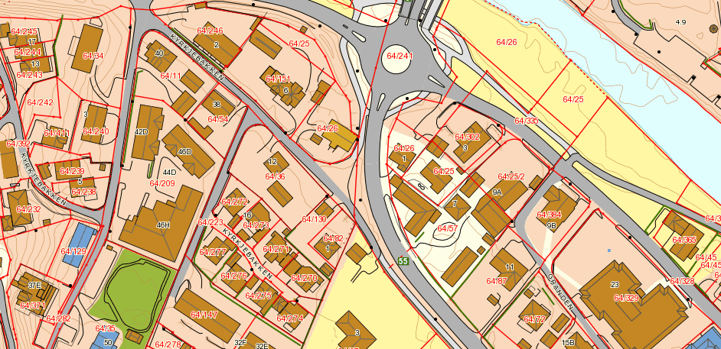
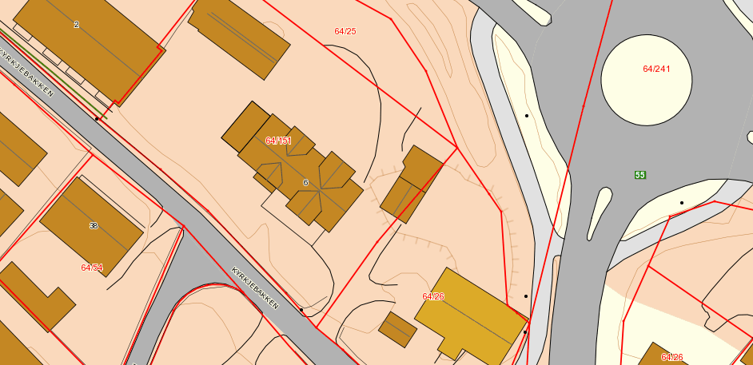
Topographic web map service from NMA
Data store: PostGIS
Vector data
Data volume: 260 GB
Response time: ca1.5 sek
Notes:
Et stort problem med dagens desktop og web klienter ar at de stort sett viser hele landet i utm sone 33. Koordinater som da vises på skjerm blir gale i forhold til hva en GPS ville vist i terrenget. Denne WMS tjenesten tegner ut riktig rutenett i lokal sone.

Slide 9
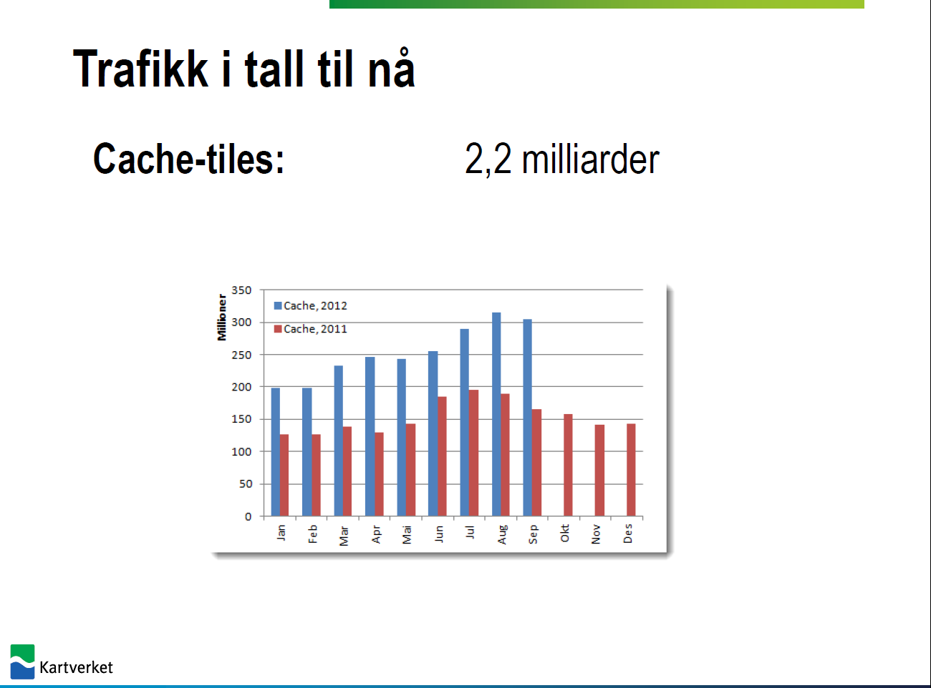

Slide 10
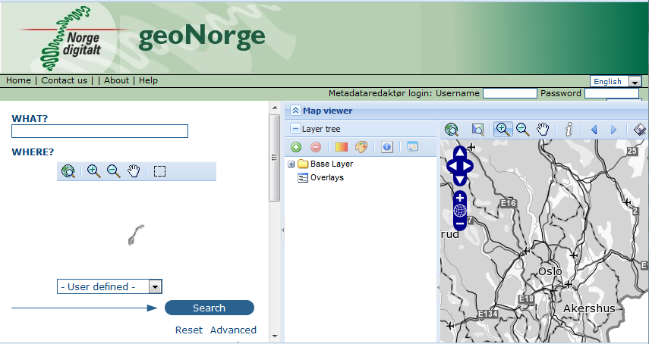
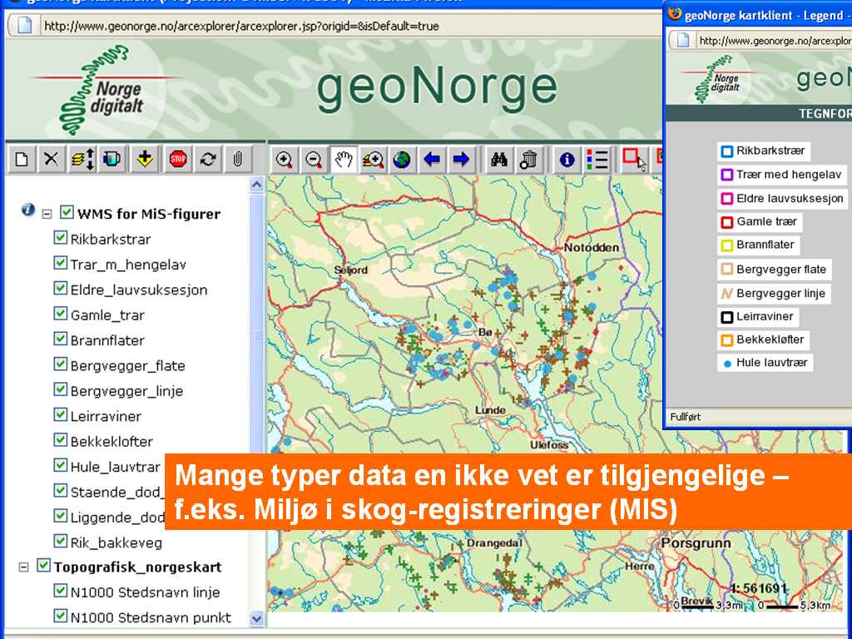
National geoportal
Overview of all available data and services
Development of a new version started up this year.

Slide 11
More information:
www.norgedigitalt.no
www.kartverket.no
www.geonorge.no
http://www.norgeskart.no
http://www.norgeibilder.no

Slide 12
Arctic SDI
General:
Information and status on the project given to my Director General, who would also be in direct contact with Magnus Gudmundsson
Direct contact with both the ministry of Foreign Affairs and the ministry of Environment.
Information to the SAO since 2008
Close cooperation with the Norwegian Polar Institute, and other departments with interest in the North
Close cooperation with the technical staff (Trond, Frank, Tom)
During 2012:
SAO meeting Stockholm
Board and SC meetings
International conferences (IPY, GSDI, etc)
Input to the Arctic SDI from Norway 2012 – 100 000 $ from the ministry of Environment/Foreign affairs.
Input from the Norwegian Mapping Authority 2012 – 150 000 $
National report

