Slide 1
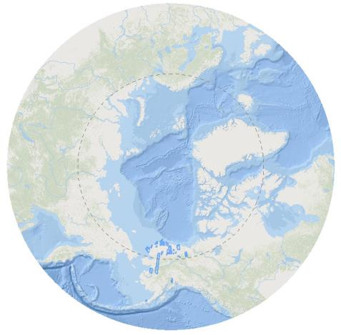
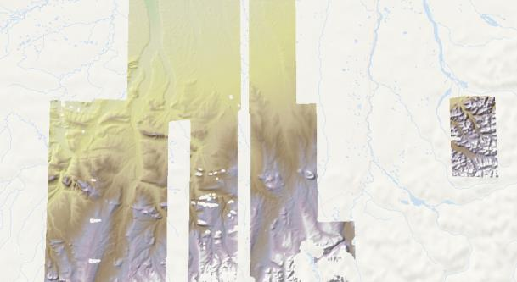
Esri will be Hosting the Arctic Elevation
As Web Services
ArcGIS REST, OGC WMS, WCS and KML
Use Arctic Elevation without needing to download
Open services, not requiring any login or subscription
Services can be used for both visualization and analysis
Elevation data >60Deg North from multiple sources
Updated with new data as soon as it becomes available

Slide 2
Datasets will consist of data sets provided by:
PGC – Created from Digital Globe WorldView stereo imagery
USGS – Primarily IfSAR + GMTED
Other state organizations - TBD
This will be part of Esri’s Community Map program:
Enables organizations to contribute datasets for including in products such as World Imagery and World Elevation

Slide 3
PGC Data Specifics
Data will remain as collected: Individual strips, clipped to suitable footprints with Metadata
Service updated with new data as is made available
Transformations may be added for vertical and horizontal refinements.
These will be refined over time (based on information provided by PGC)
This ensures no unnecessary resampling of the data occurs
When dataset are complete, merged tiles may also be created

Slide 4

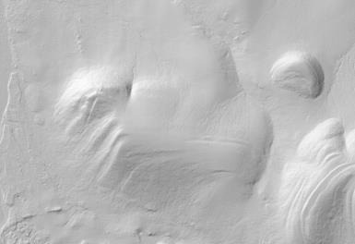
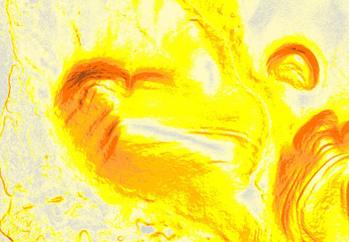
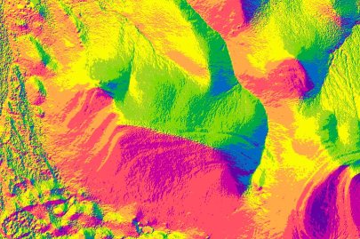
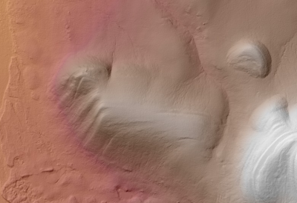
Data Access
OGC WCS – Data values
OGC WMS & KML – HillShades
OGC WFS – Feature service of footprints with Metadata
ArcGIS Image Services – Data Values, Wide range of renderers, User defined transforms and functions, Metadata
Download – Metadata will include links to source for downloading
Users will also be able to directly use data on S3 with Amazon
Esri reserve the right to provide additional services that could be accessible only to ArcGIS Online subscribers.

Slide 5
Technical Implementation Details
Will be stored on Amazon S3 using MRF format
Compressed with a LERC tolerance (Either 10cm or 1cm)
Data will remain in its original projection and alignment
Esri will not change any of the data values
Will apply clipping and geometric transforms – As defined by PGC
Applications can request data in any projection
Default Projection Alaska Polar Stereographic (WKID 5936)

Slide 6

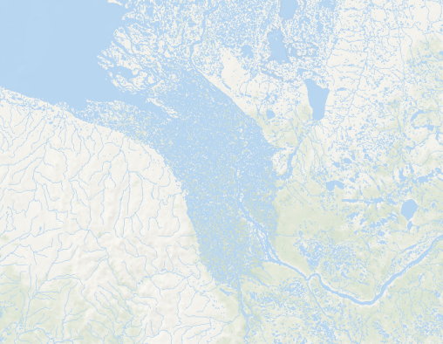
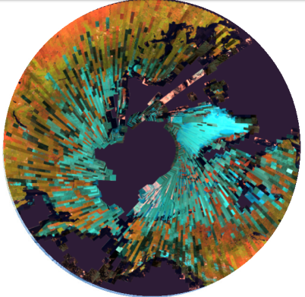
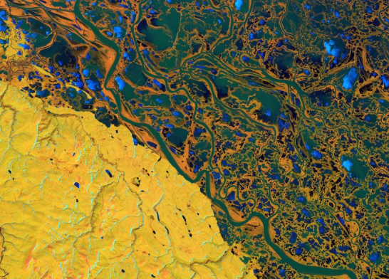
Other Arctic Dataset to be Hosted by Esri
Arctic Basemap
Landsat
  Landsat 8
  GLS

Slide 7
White House Blog - https://www.whitehouse.gov/blog/2015/09/02/using-new-elevation-data-explore-arctic

Slide 8
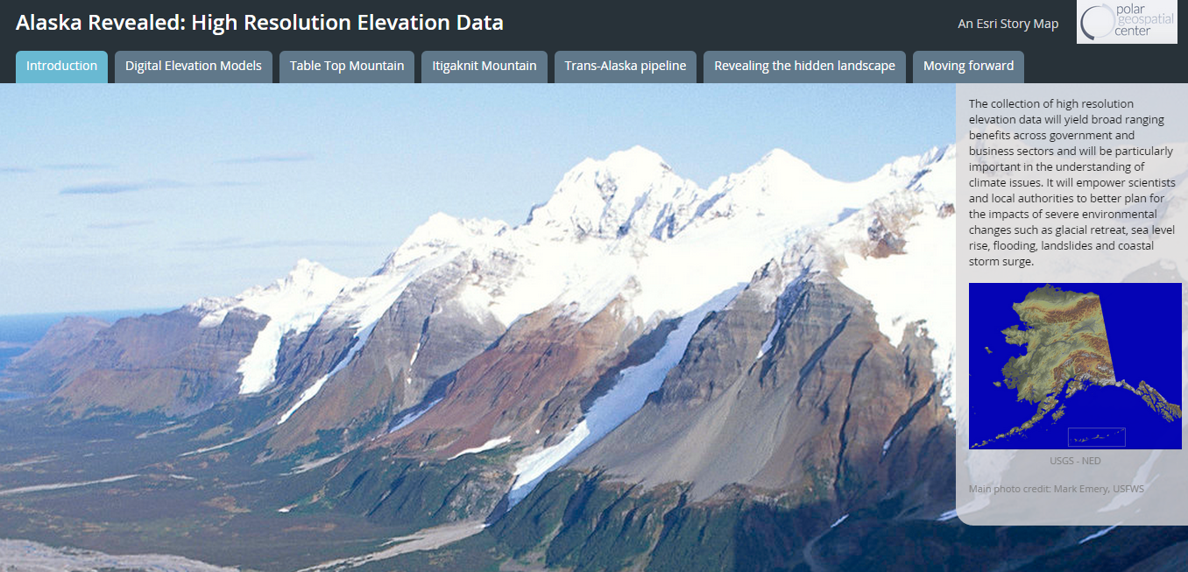
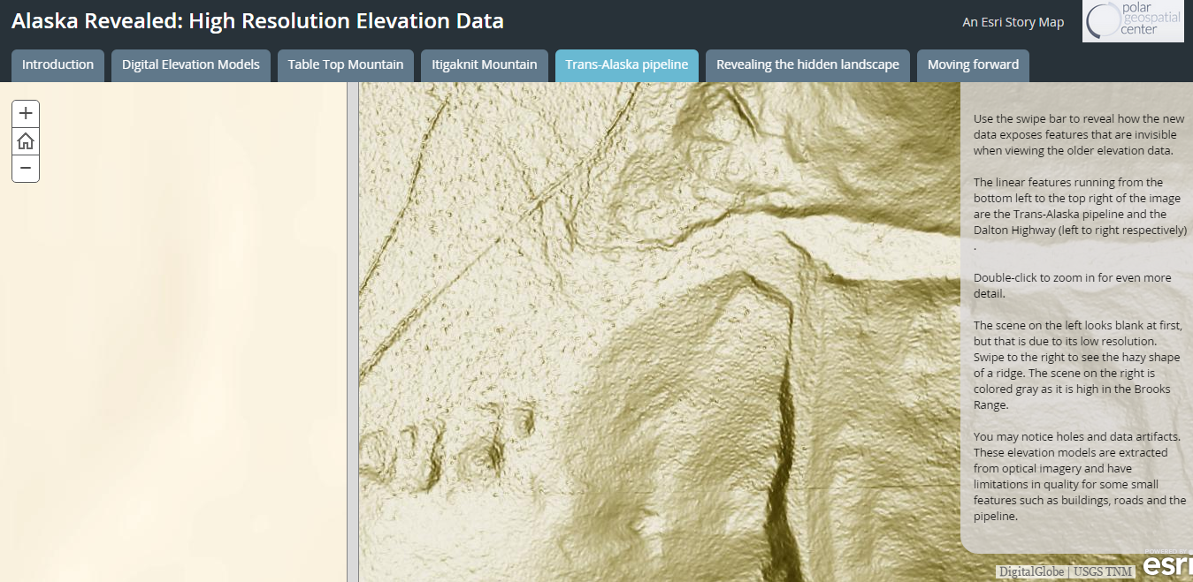
Storymaps showcase the new High Res Elevation Data in an interactive way
The Alaska Revealed: High Resolution Elevation Data story map walks you through preliminary high resolution elevation models for the region. You can explore interactive views of Table Top Mountain, Itigaknit Mountain, and more. This story map also lets you swipe to compare current data from the National Elevation Dataset with new data collected for the NGA to better understand the importance of updated digital elevation
http://story.maps.arcgis.com/apps/MapSeries/?appid=4608165489764f10b75f946e1b7cdc8c

Slide 9
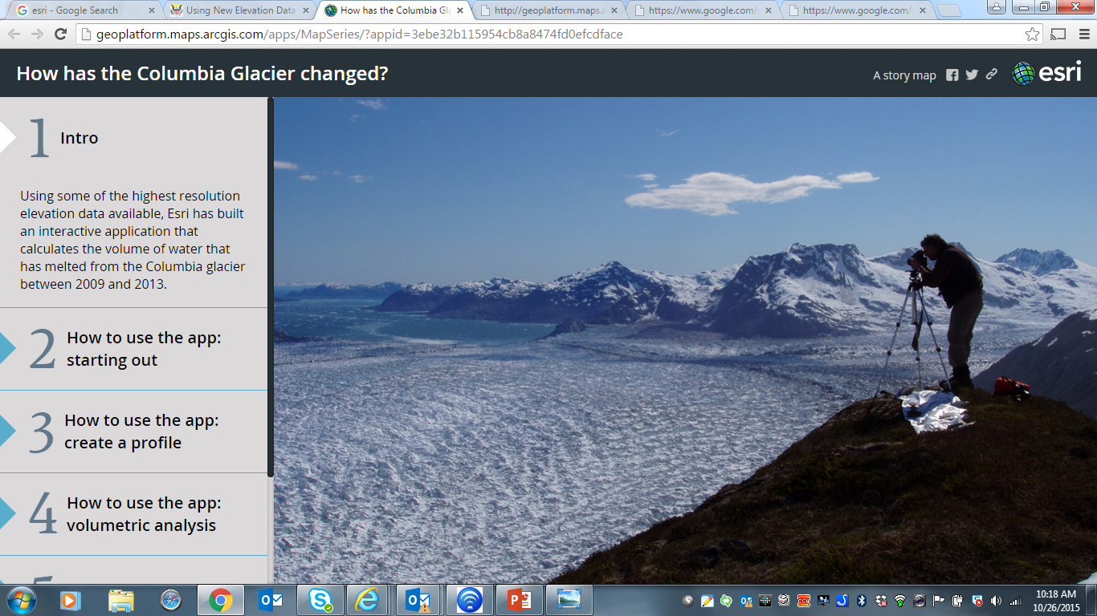
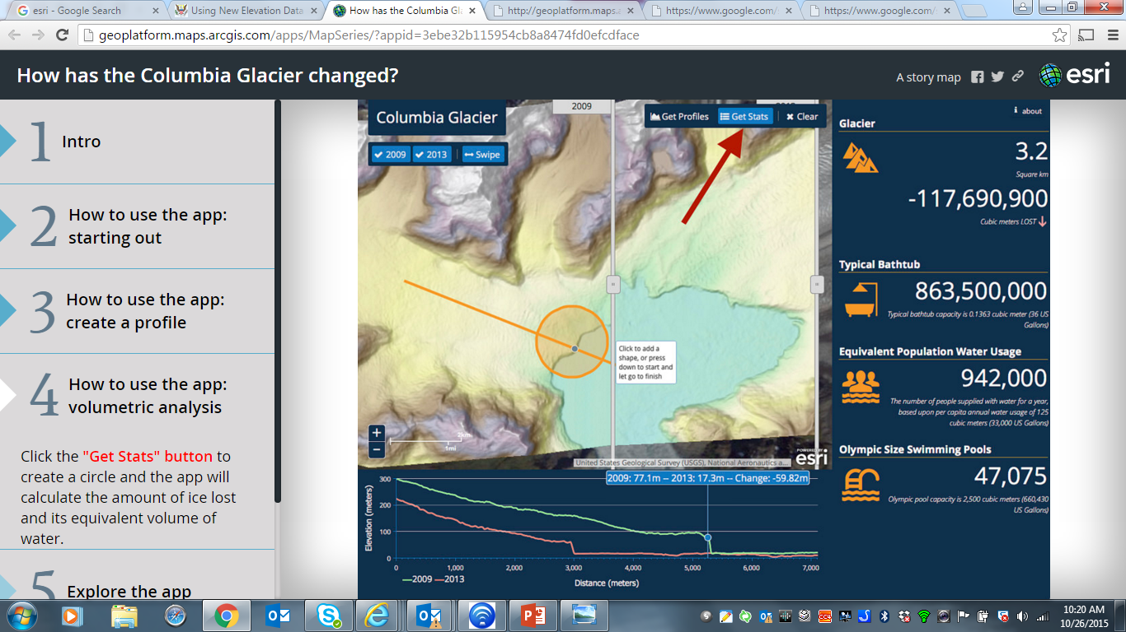
Columbia Glacier explore the change – story map
Explore changes to the Columbia glacier from 2009 to 2013 with the How has the Columbia Glacier Changed? app. This interactive Story Map shows you how to use the application to calculate the volume of water that has melted or generate a profile by interacting with the map. It also includes a video tutorial.
http://story.maps.arcgis.com/apps/MapSeries/?appid=3ebe32b115954cb8a8474fd0efcdfac
e

Slide 10
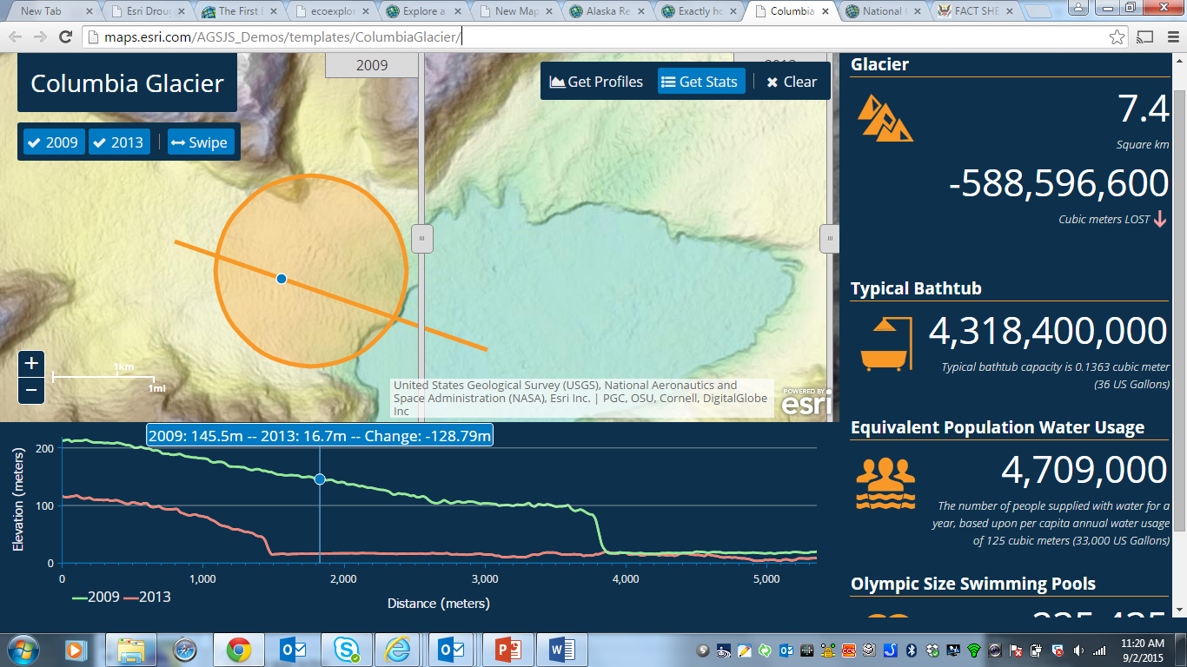
Web Apps and tools make the data engaging and understandable
This interactive map lets you generate profile and calculate the volume of water that has melted from the glacier by drawing points, lines, or polygons on the map
http://climatechange-51531526.us-east-.elb.amazonaws.com/ColumbiaGlacier/index.html

Slide 11
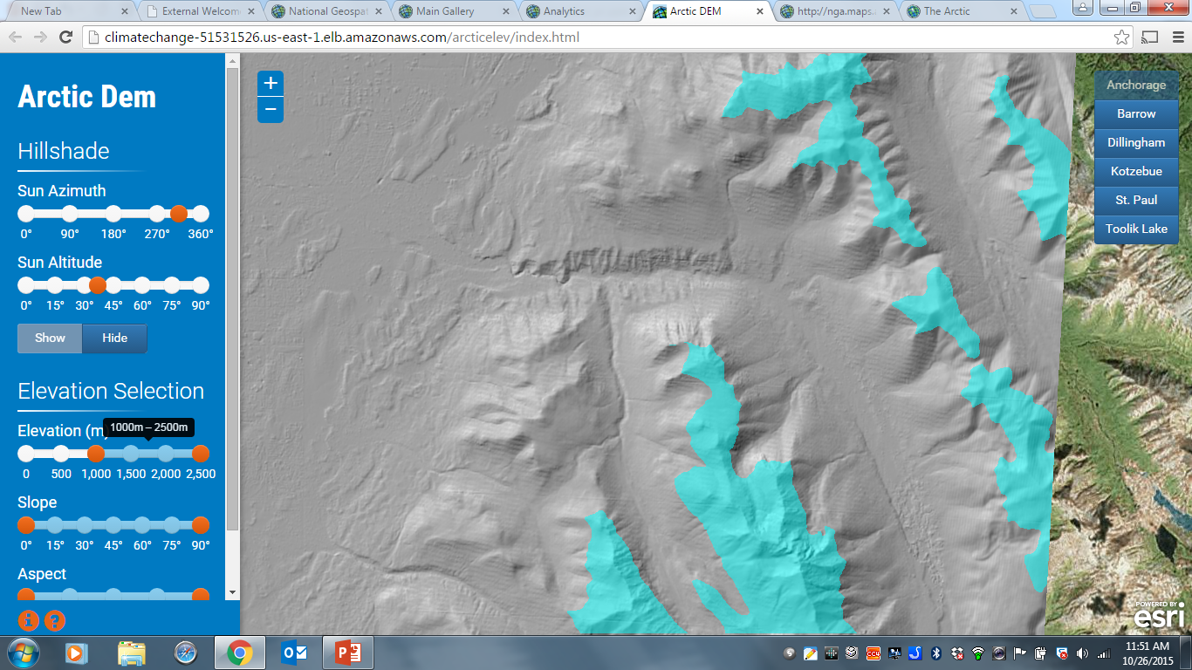
Arctic DEM interactive Explorer app - set your own azimuth and altitude for Hillshade render - highlight selected elevation, slope and aspect
http://climatechange-51531526.us-east-1.elb.amazonaws.com/arcticelev/index.html

Slide 12
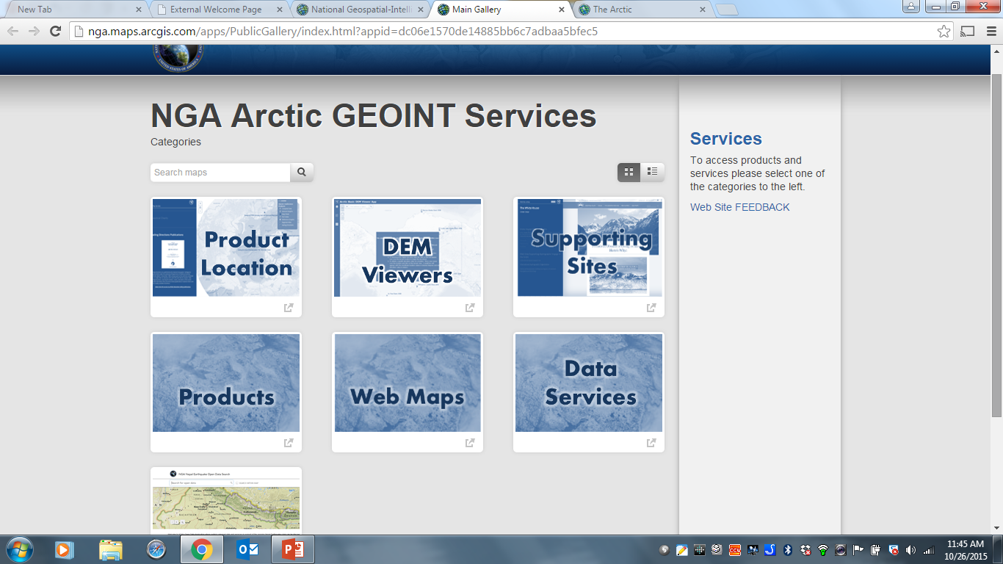
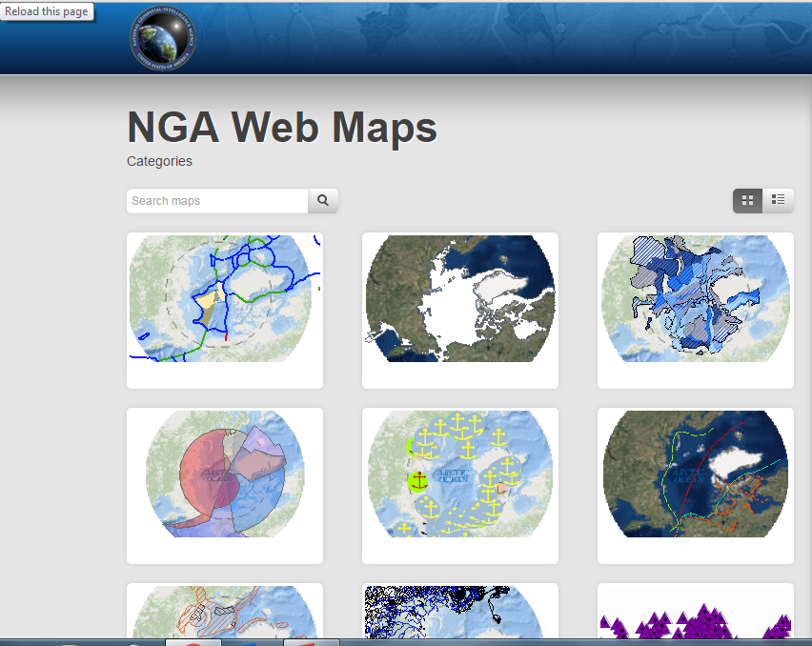
National Geospatial Intelligence Agency (NGA)
http://nga.maps.arcgis.com/apps/PublicGallery/index.html?appid=dc06e1570de14885bb6c7adbaa5bfec5

