Slide 1






ArcticDEM
Paul Morin and Mike Cloutier
Polar Geospatial Center
October 26, 2015

Slide 2
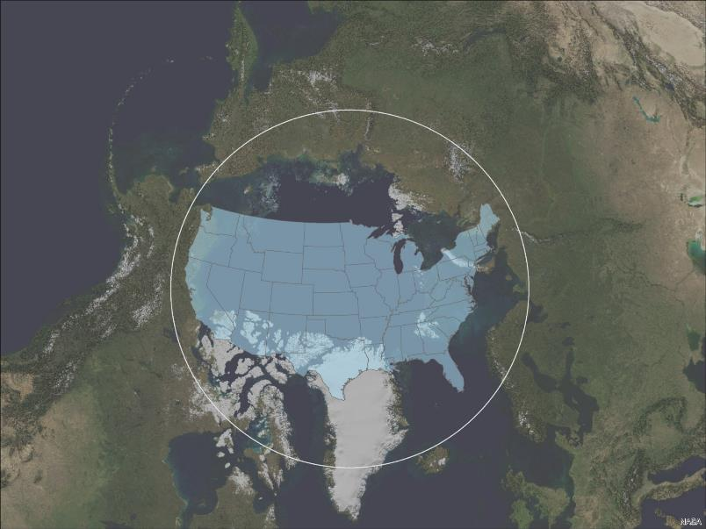
Polar Geospatial Center

Slide 3
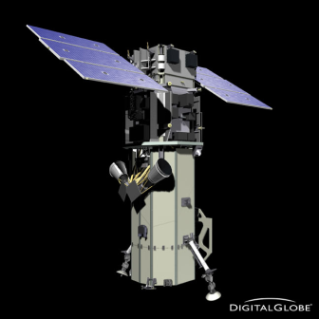
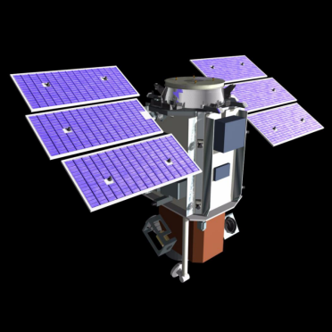
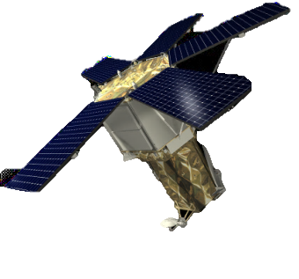
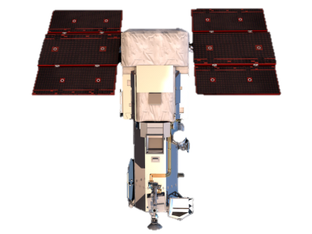
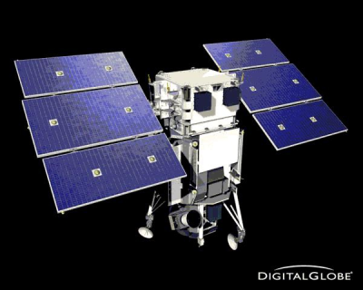
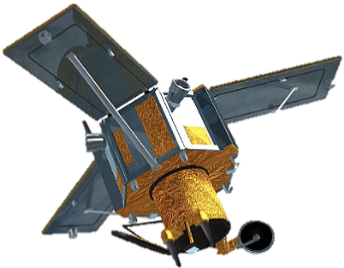
The DigitalGlobe Satellite Constellation
GeoEye
QuickBird
WorldView-2
IKONOS
WorldView-3
WorldView-1

Slide 4

NSF Funded Polar Researchers See the Arctic Differently
On-demand sub-meter archive imagery and new collection
Orthorectification and mosaicking as required
Terrain is on-request for almost all of both poles

Slide 5
Terrain Generation Looks Different to PGC
NGA and DigitalGlobe have a huge, high-latitude stereo collection capacity
NSF has high performance computing
100Gbit networking is common in the US
HPC ready DEM extraction software is open source
Storage is cheap

Slide 6
About NGA Commercial Imagery
Licensed from DigitalGlobe, Inc. for USG purposes.
Resolution of 32-42cm panchromatic and 1.2-1.6m multispectral.
Raw and orthorectified imagery is copyrighted. Derived data (DEMs, NDVI, coastlines) can be freely distributed.
Free to US civilian agencies and federally funded investigators if their sponsoring agency provides an access point.

Slide 7
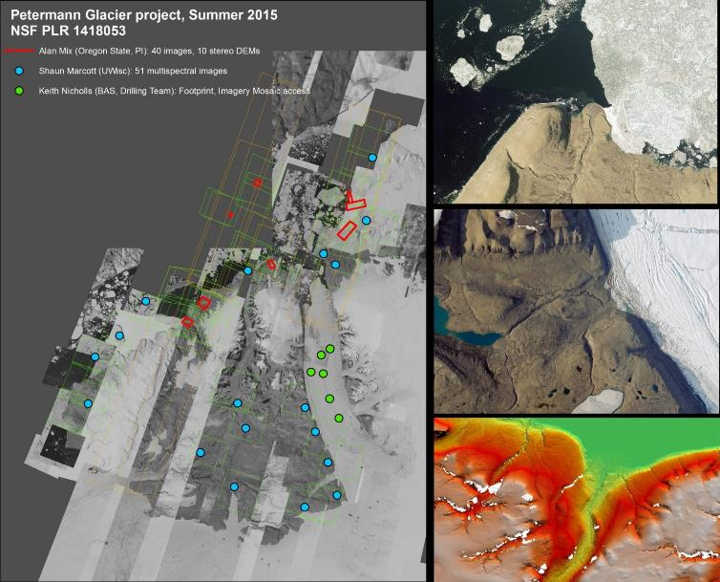
EXAMPLE SUPPORT REQUESTS
user services

Slide 8
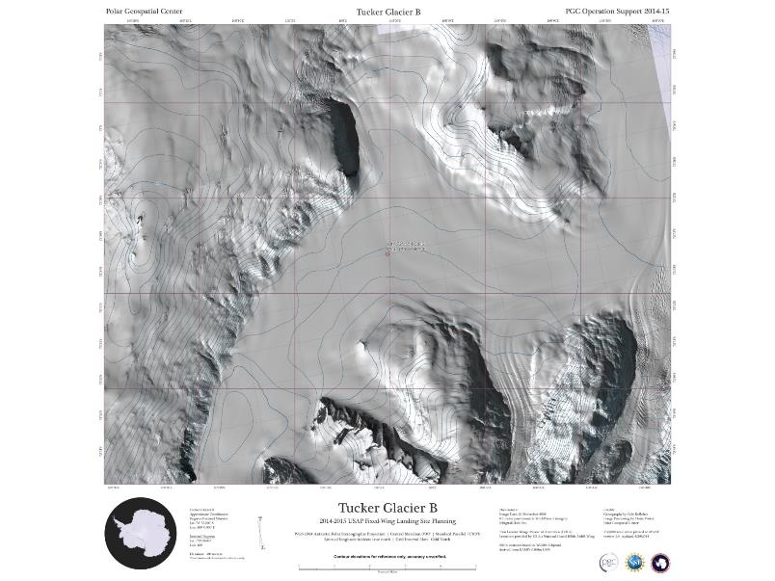
EXAMPLE SUPPORT REQUESTS
user services
Fixed Wing Landing Site Support, Tucker Glacier, Antarctica

Slide 9
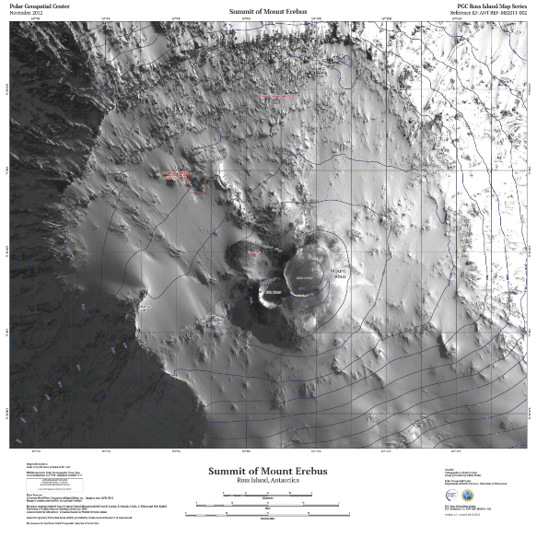
EXAMPLE SUPPORT REQUESTS
user services
Summit of Mount Erebus Reference & Planning Map

Slide 10
ArcticDEM Goal
Produce a 2m posting digital surface model of the Arctic during the US Chairmanship of the Arctic Council using DigitalGlobe stereo imagery licensed by the National Geospatial-Intelligence Agency

Slide 11
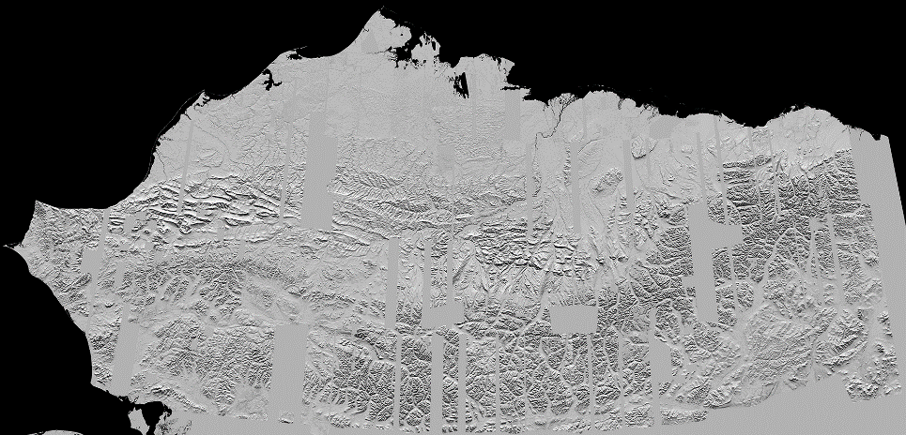
Alaska: Two Meter Resolution Test

Slide 12
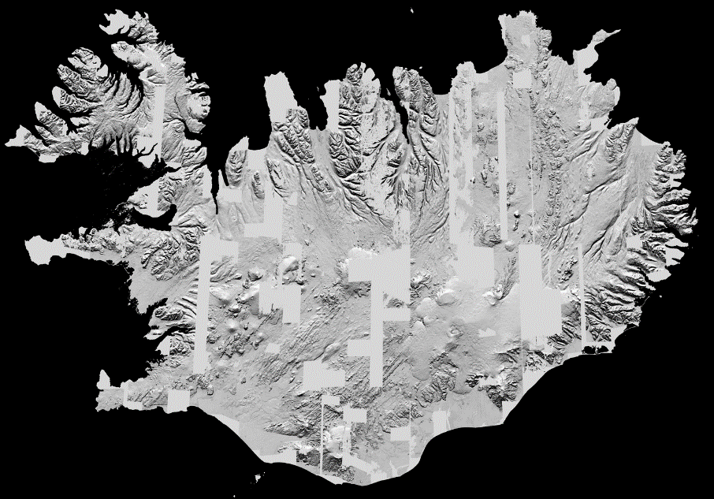
Iceland 2m Test

Slide 13
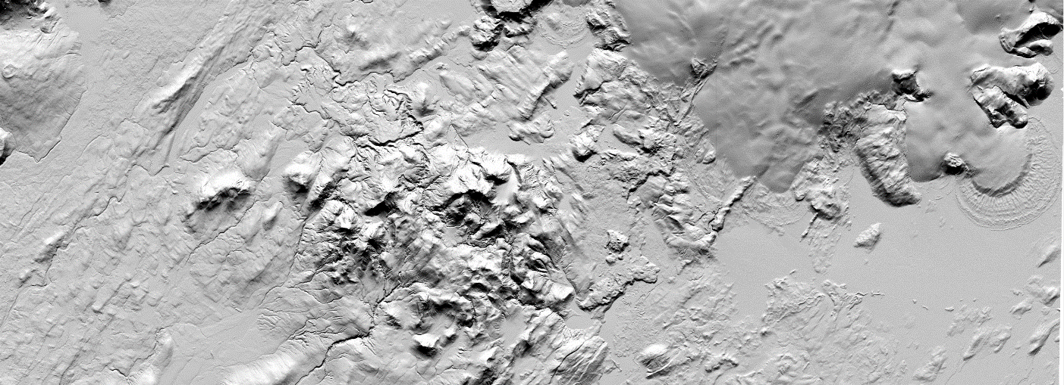
Iceland 2m Test

Slide 14
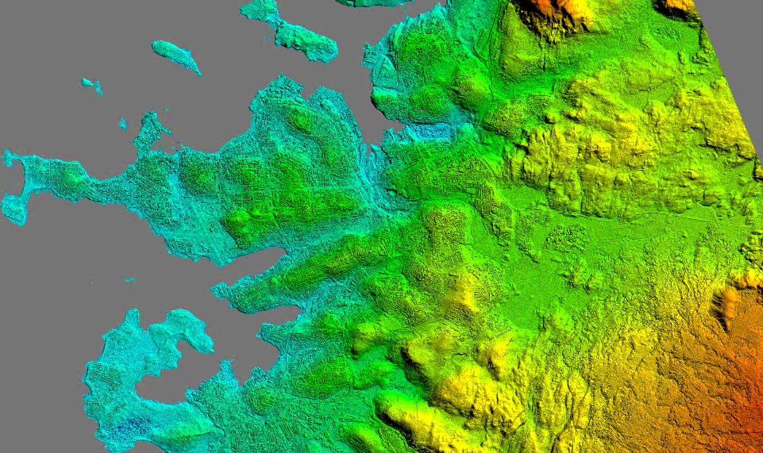
Reykjavik, Iceland – 2m Digital Surface Model
Coastline provided by the National Land Survey of Iceland, delivered by Tómas Jóhannesson of the Icelandic Met Office
Elevation derived using Surface Extraction with TIN-based Search-space Minimization (SETSM) – M.J. Noh and Ian Howat (Ohio State University)

Slide 15
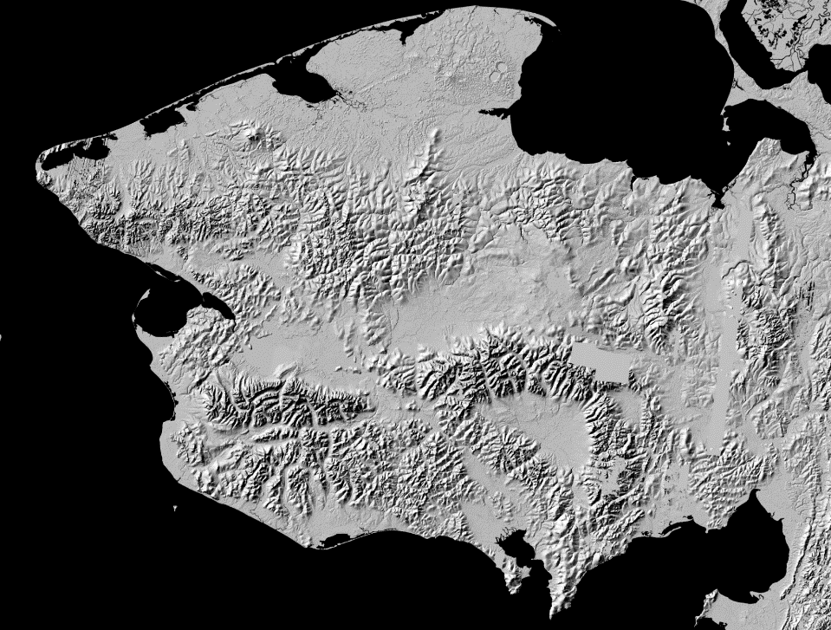

Slide 16
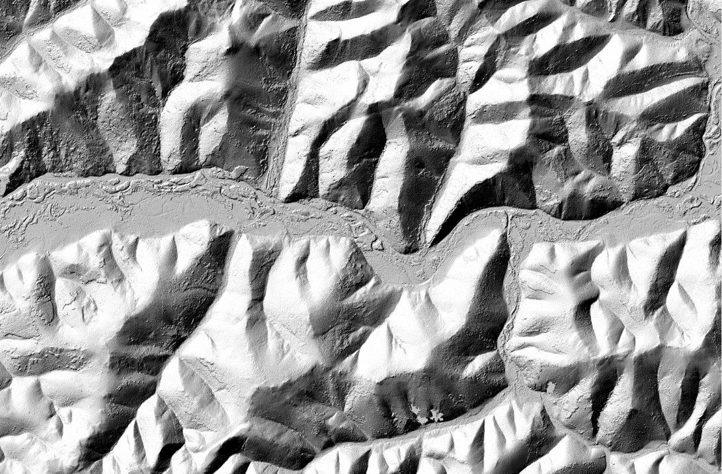

Slide 17
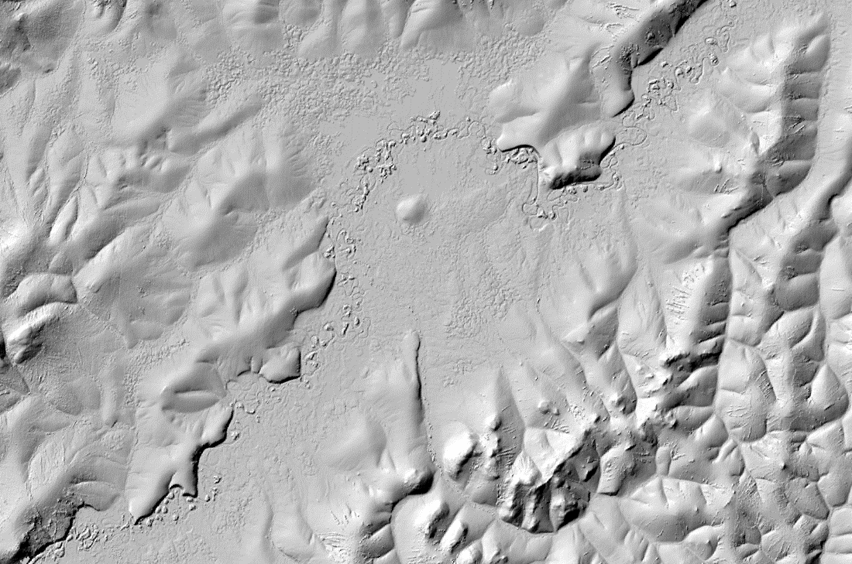

Slide 18
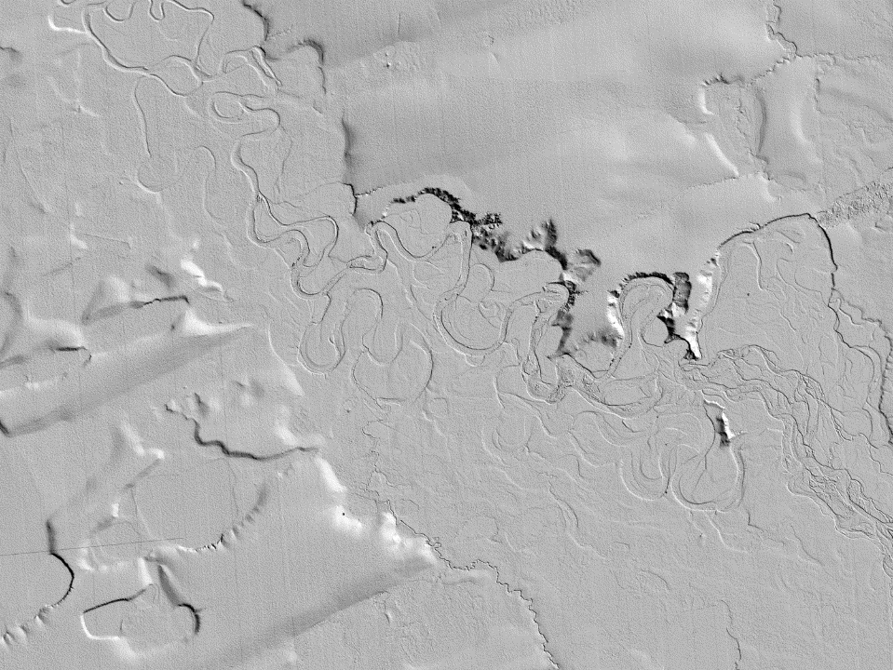

STEREO-DERIVED ELEVATION MODELS
Hillshade rendering: Thermokarst collapse, Kuparuk watershed, Alaska

Slide 19
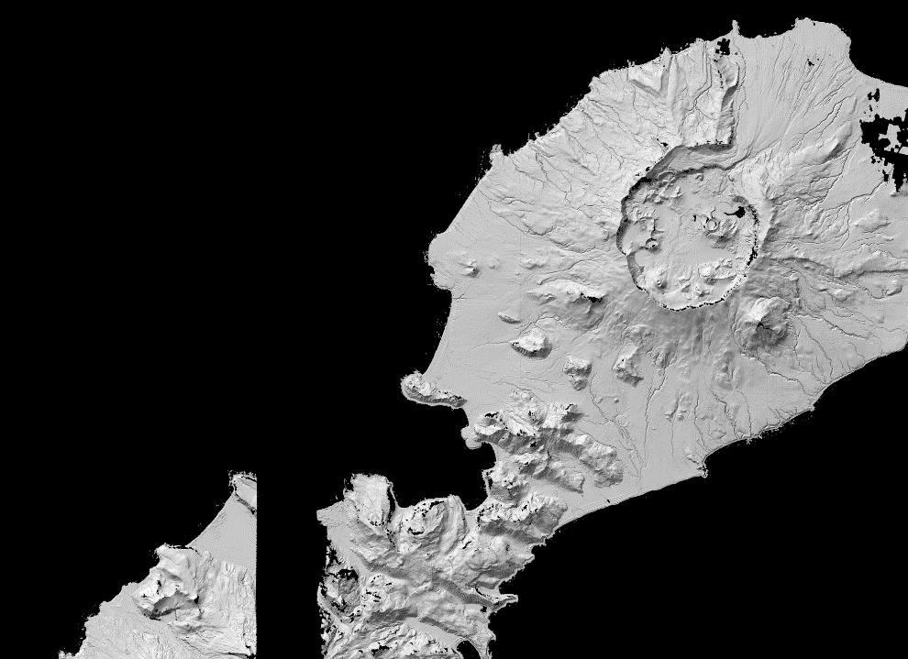
STEREO-DERIVED ELEVATION MODELS
Hillshade rendering: Okmok Caldera, Umnak Island, Alaska

Slide 20
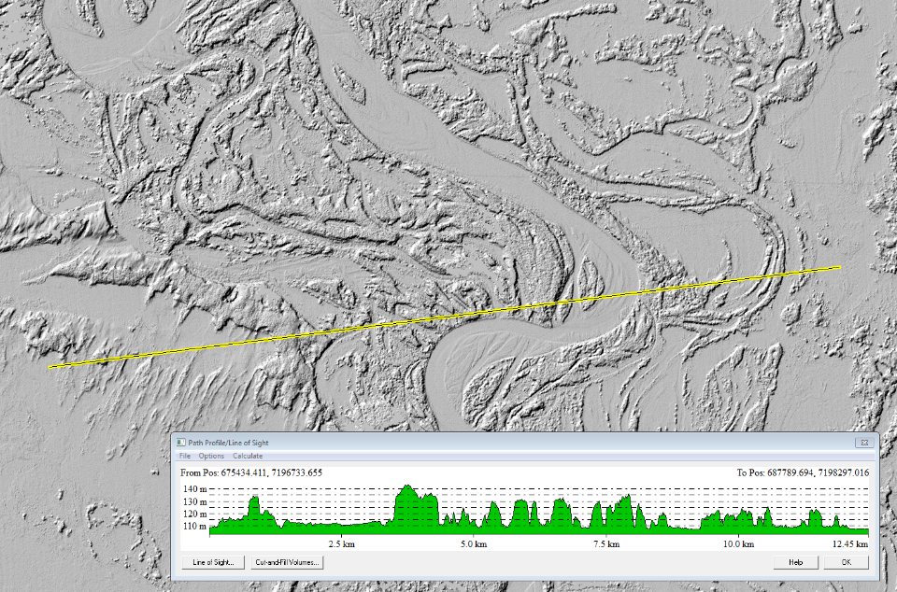

Slide 21
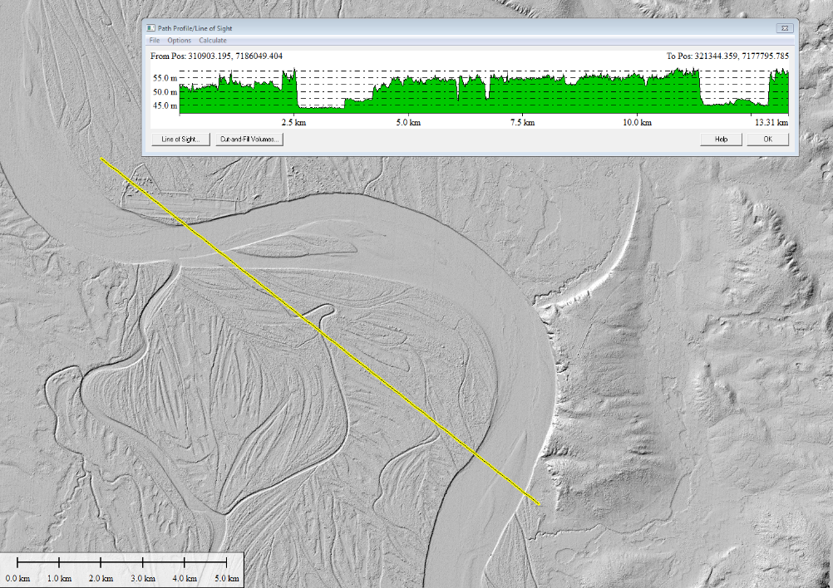

Slide 22
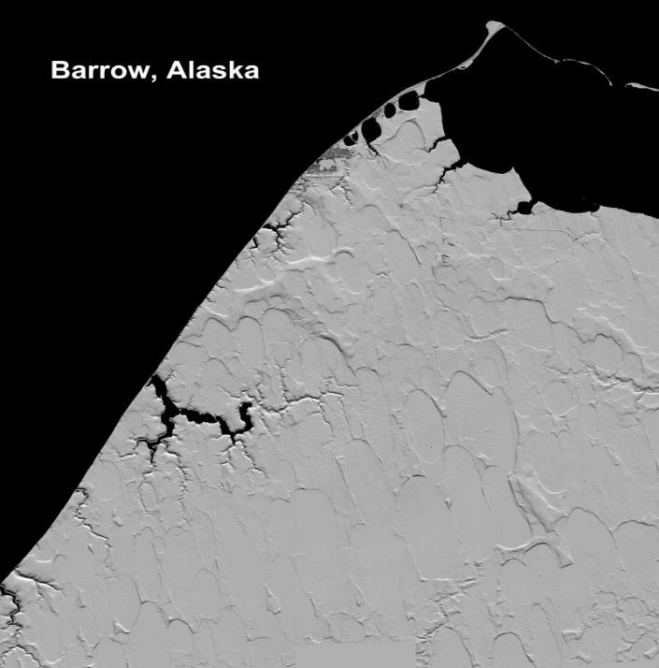
Hillshade rendering: Barrow, Alaska - Porter

Slide 23
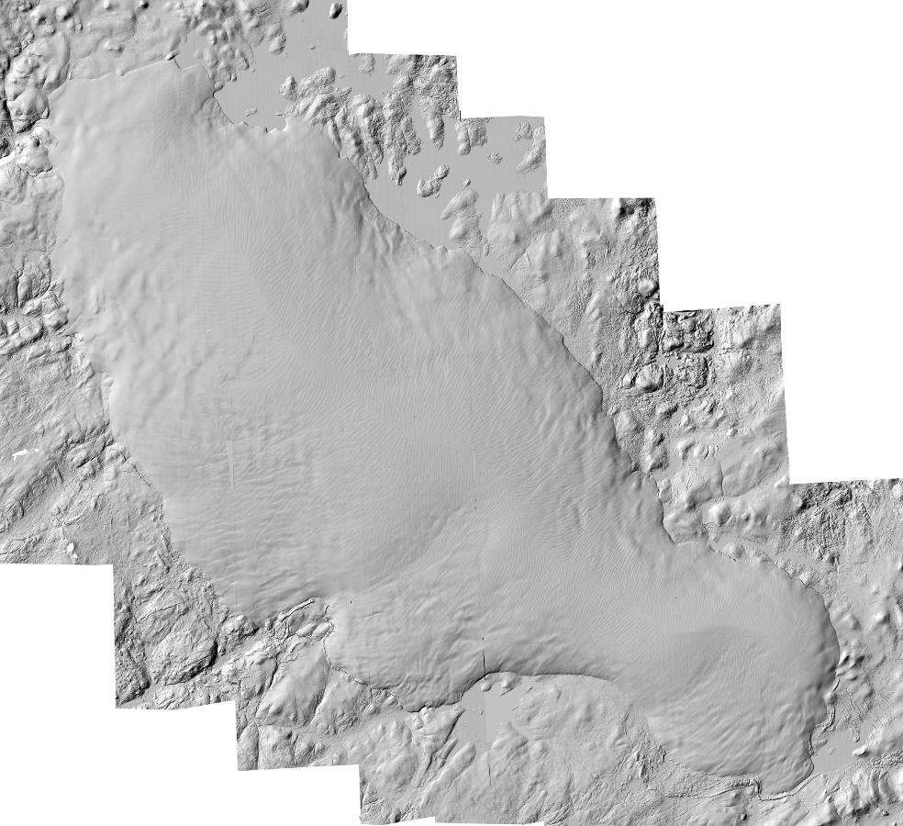

STEREO-DERIVED ELEVATION MODELS
Hillshade rendering: The Barnes Ice Cap, Nunvavut, Canada, Noh and Howat

Slide 24
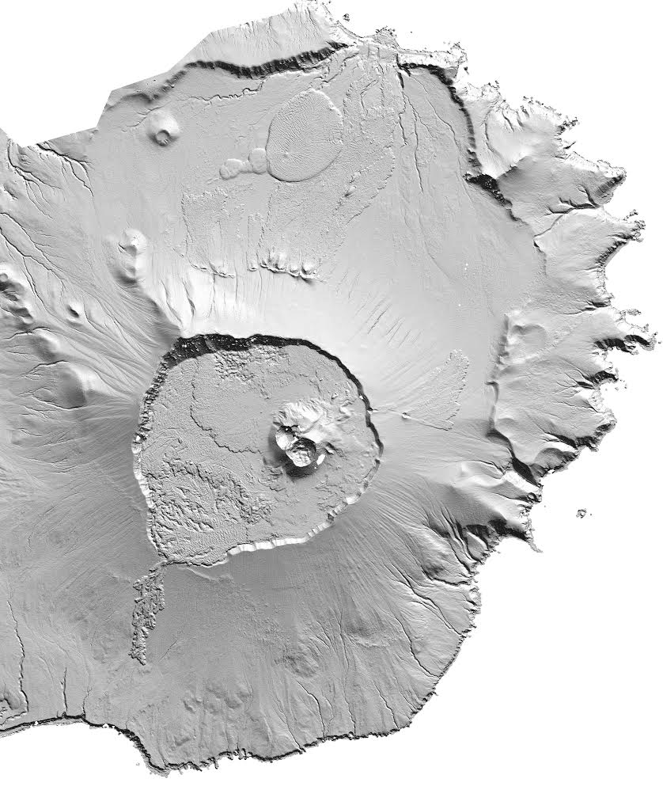
STEREO-DERIVED ELEVATION MODELS
Hillshade rendering: Unaska Island, Alaska - Morin

Slide 25
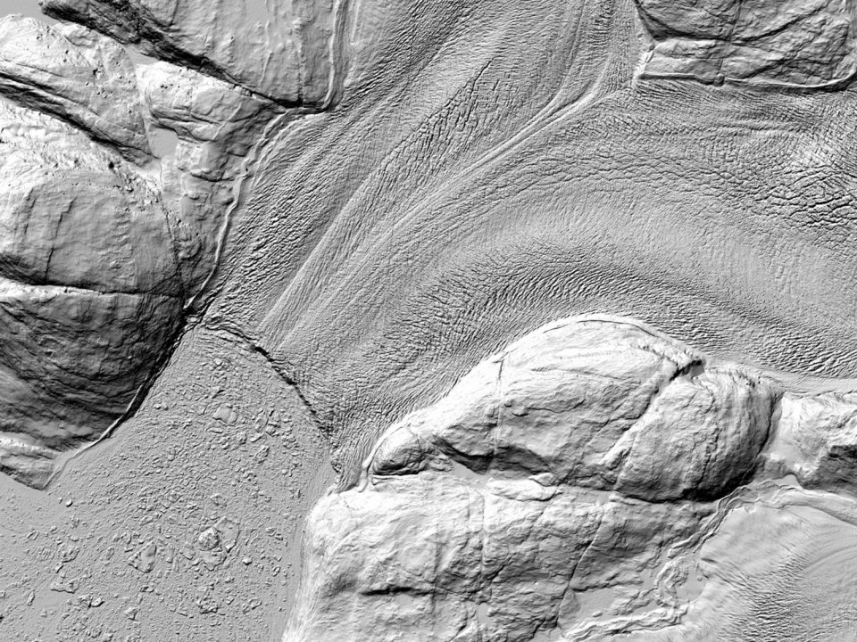
STEREO-DERIVED ELEVATION MODELS
Hillshade rendering: Outlet glacier, west Greenland Noh and Howat

Slide 26
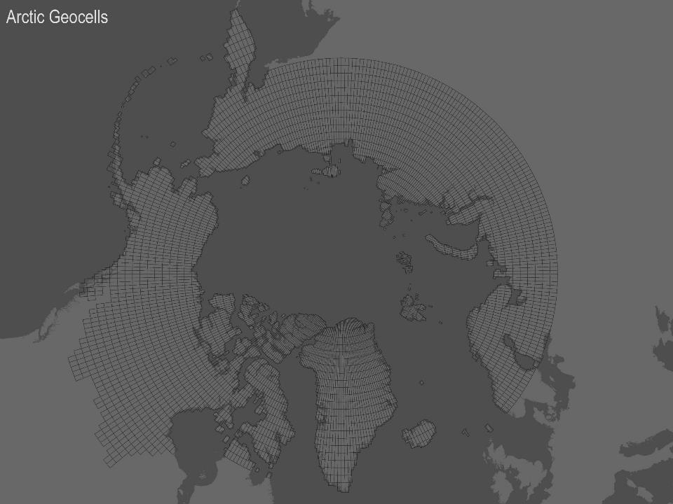
The ArcticDEM Domain

Slide 27
Expected Accuracy
Without ground control
  Dependent on the sensor’s Rational Polynomial Coefficients (RPC) accuracy
  WorldView 1 & 2 DTMs have a horizontal positional accuracy of 4m CE90
Using NASA Operation IceBridge LiDAR
  Point accuracy of 0.20-0.35 m (1 standard deviation – accuracy of lidar or DEM after registration)
Ground-survey (e.g. GPS benchmark) control points not yet employed, but tests show similar accuracy to lidar
Myoung-Jong Noh & Ian M. Howat (2015): Automated stereo-photogrammetric
DEM generation at high latitudes: Surface Extraction with TIN-based Search-space Minimization (SETSM) validation and demonstration over glaciated regions, GIScience & Remote Sensing, DOI:10.1080/15481603.2015.1008621

Slide 28
Basic Statistics
300,000-17x17km scene pairs in the current archive
An 8m posting DEM for one scene pair requires 4 SUs of HPC time
A 2m posting DEM for one scene pair requires an additional 8 SUs of HPC time

Slide 29
What we need
Your input
Accurate Coastline
Ground Control
  LiDAR
  InSAR Surveys
  Kinematic GNSS Ground Surveys
  Cadastral Points, Leveling and GNSS Locations
  ICESat and Cryosat Altimetry

Slide 30
What you need to do
Ensure you have bandwidth
Disk space
Look at lots and lots of data
Formulate a strategy to improve data
Figure out if and how you can contribute

Slide 31
Don’t do significant work before talking to PGC
New data is processed all the time
Possible bugs
New post-processing improvements
New data is being collected and received at PGC

Slide 32
ArcticDEM Final Products
2m Posting Mosaic of the Arctic
2m Time-stamped Strips

Slide 33
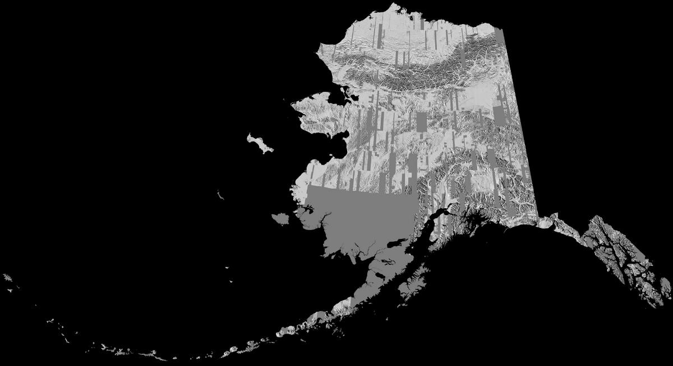

Slide 34
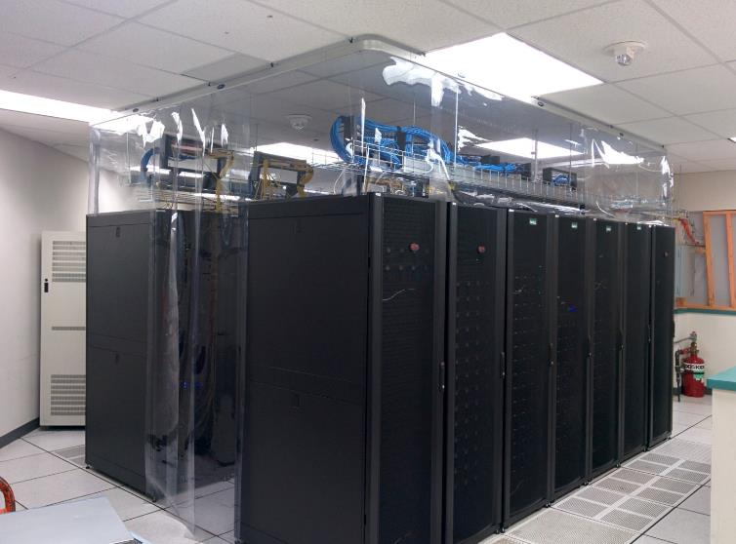
SUPERCOMPUTING
hardware & infrastructure
Servers at OIT data center wrapped for cooling

Slide 35
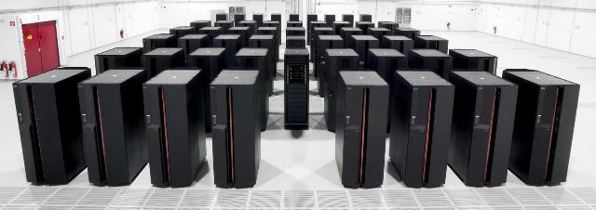
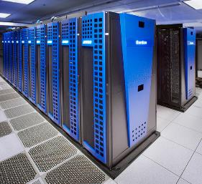
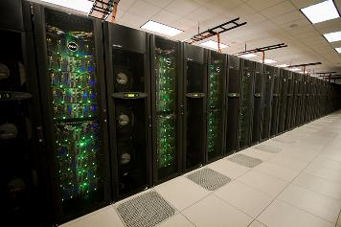

NSF High Performance Computing
About 40,000,000 Core hours Allocated

Slide 36
g
Gemini Fabric (HSN)
Cray XE6/XK7 - 276 Cabinets
DSL
48 Nodes
XE6 Compute Nodes
5,688 Blades – 22,640 Nodes – 362,240 Cores –
724,480 Integer Cores 4 GB per FP core
XK7 GPU Nodes
1056 Blades – 4,224 Nodes
33,792 Cores – 4,224 GPUs
MOM
64 Nodes
BOOT
Nodes
SDB
Nodes
RSIP
Nodes
Network GW
Nodes
Unassigned
Nodes
LNET Routers
582 Nodes
SMW
esLogin
4 Nodes
Boot RAID
InfiniBand fabric
Boot Cabinet
Import/Export
28 Nodes
10/40/100 Gb
Ethernet Switch
HPSS Data Mover
50 Nodes
Sonexion
25+PB online storage
144+144+1440 OSTs
Cyber Protection IDPS
Management Node
NCSAnet
Near-Line Storage
300+PB
esServers Cabinets
NPCF
Notes:
Blue Waters supersystem, Need to emphasize the unprecedented scale. Largest Cray, IE, HPSS, Lustre, Network. Hold performance discussion to later slides. Note all storage sizes are usable storage.

Slide 37
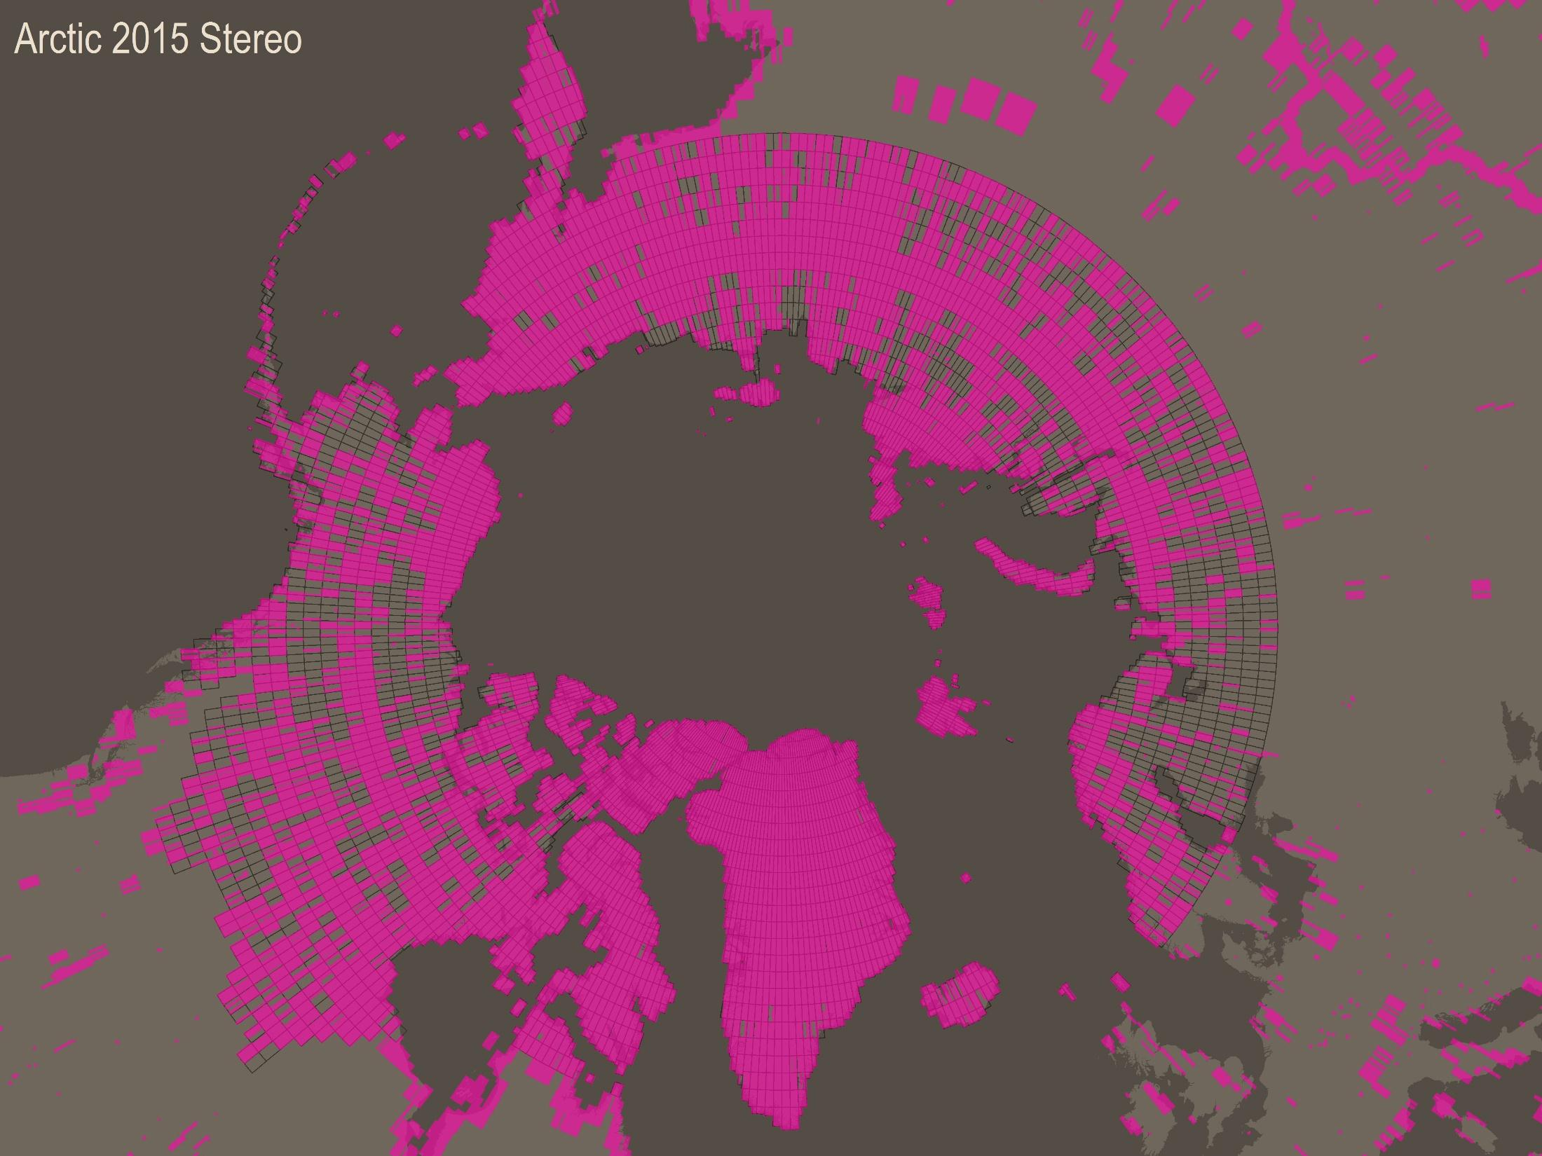

Slide 38
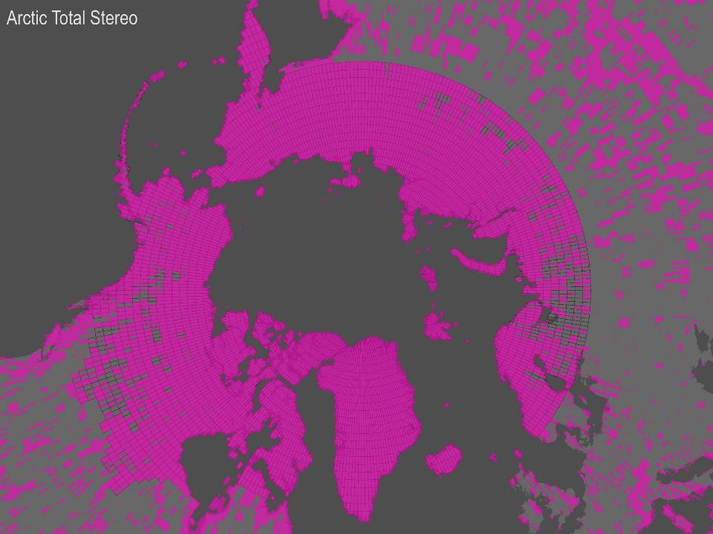

Slide 39
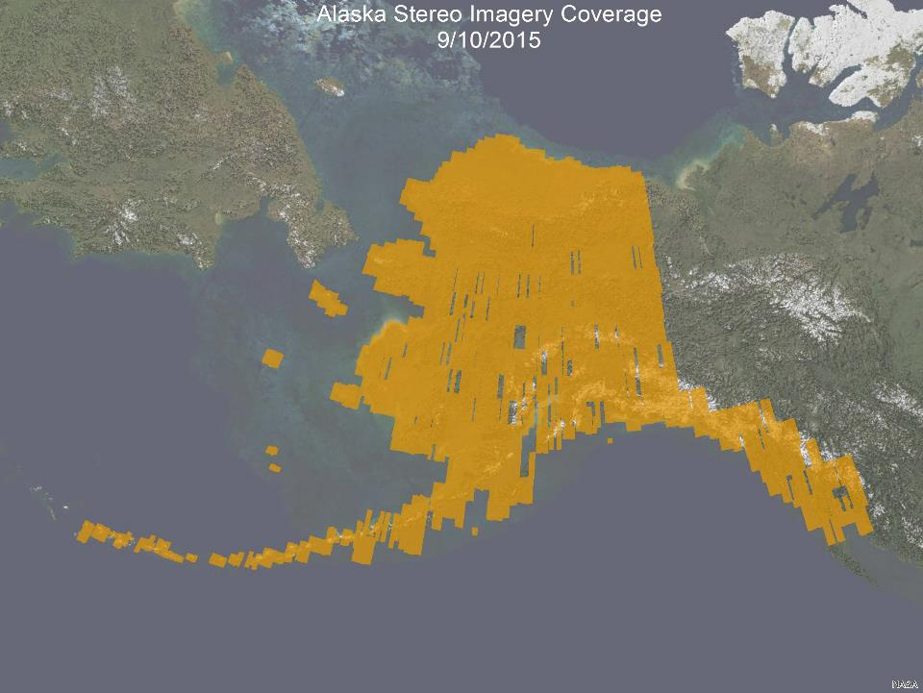

Slide 40
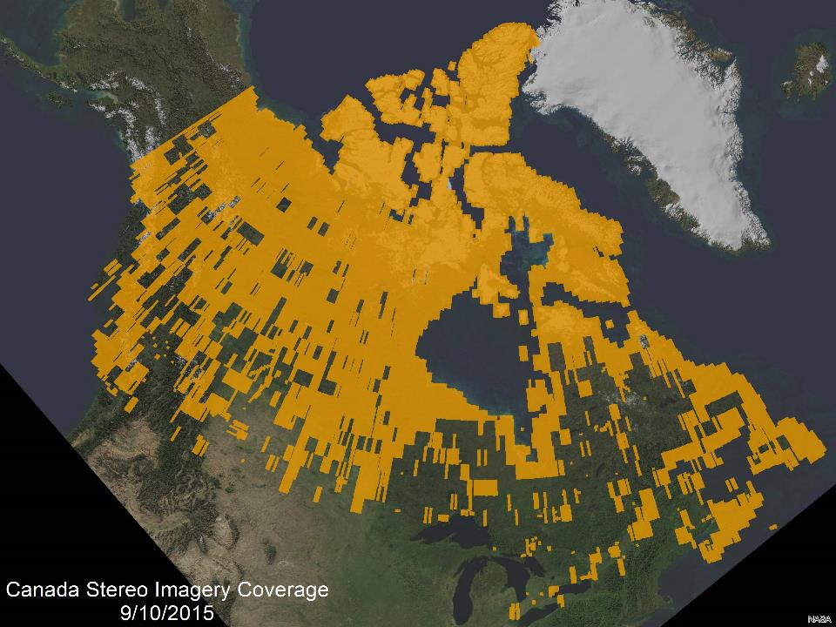

Slide 41
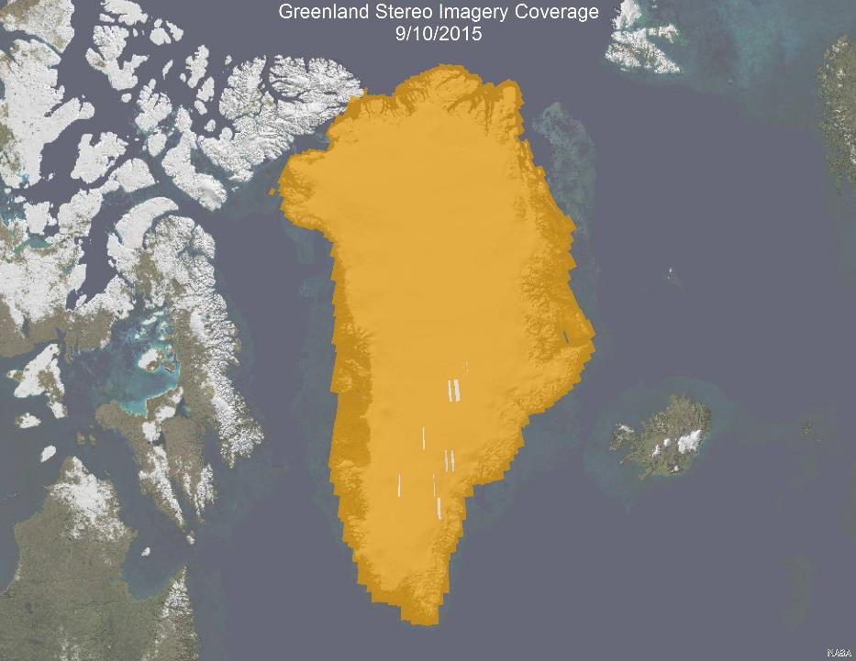

Slide 42
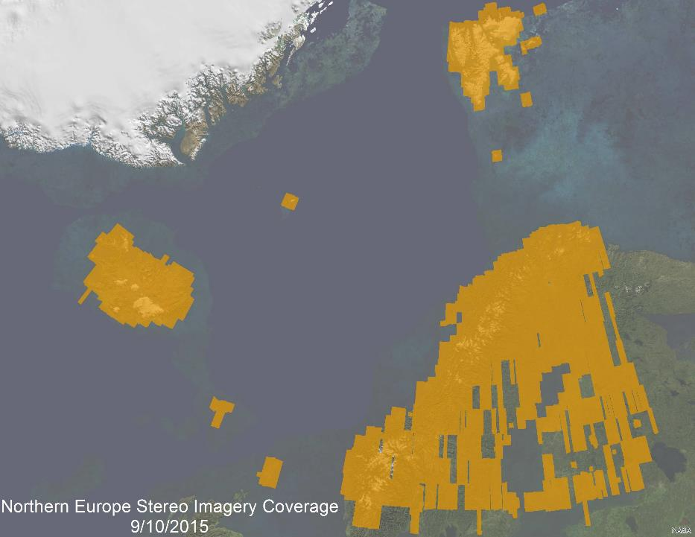

Slide 43
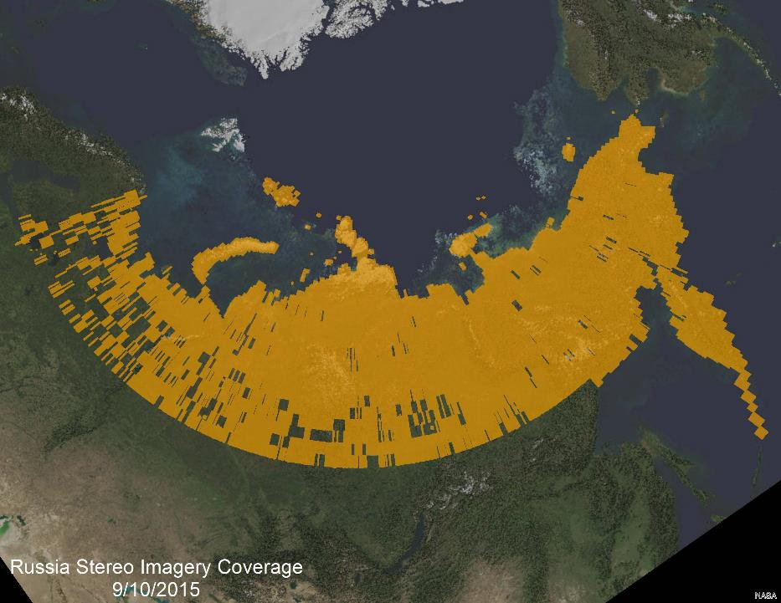

Slide 44
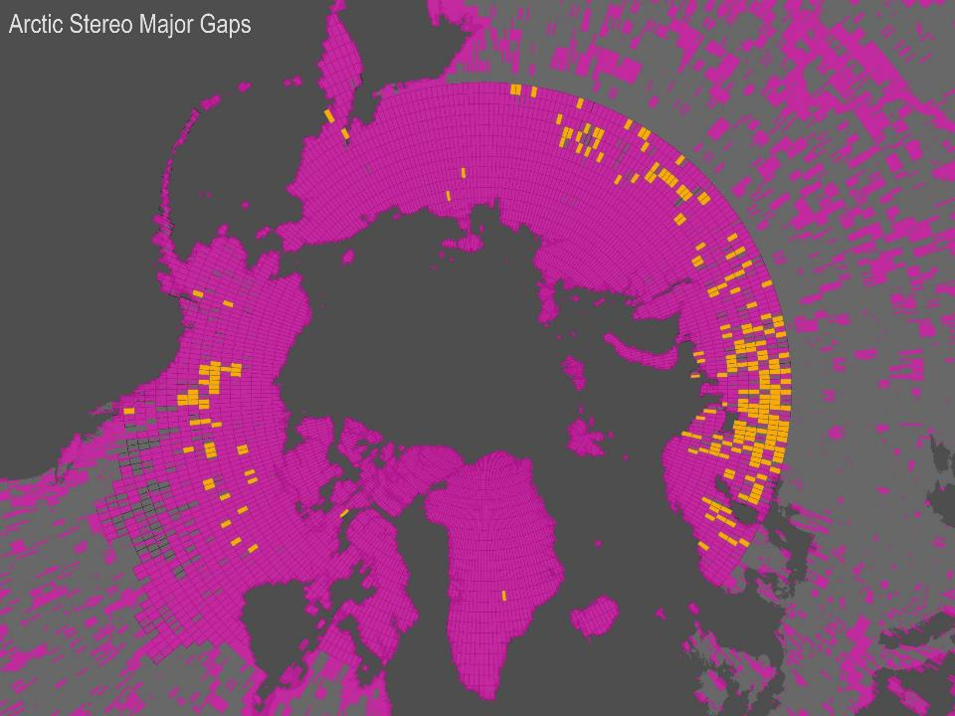

Slide 45
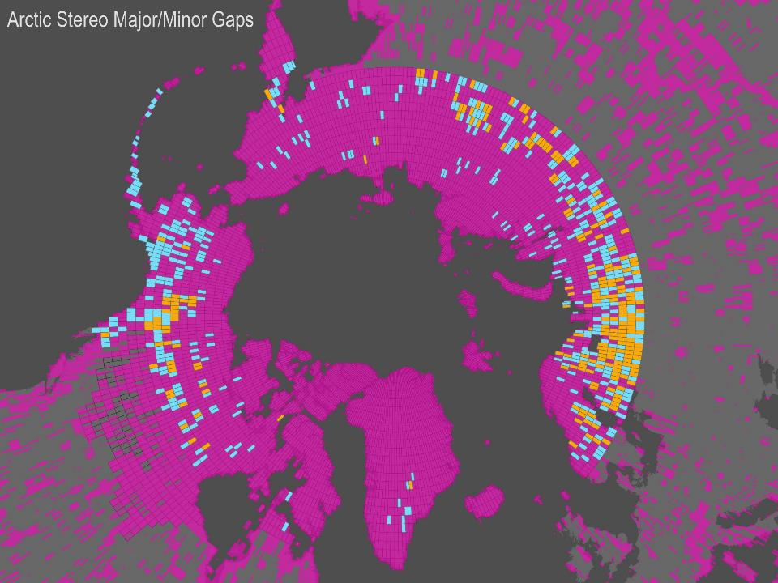

Slide 46
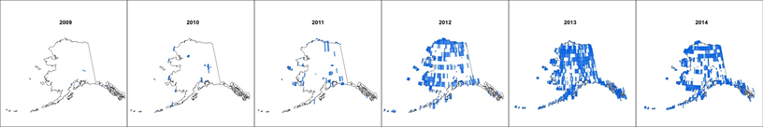
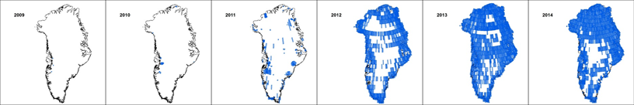
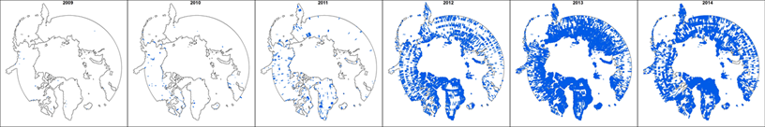
Stereo Coverage by Year

Slide 47
US ArcticDEM Partners
National Geospatial-Intelligence Agency
  Manages the DigitalGlobe contract
  Providing data and tasking to NSF/PGC
  Improvement of the Alaska DEMs
  Advise on automated improvement of all DEMs
National Science Foundation
  Providing HPC (Blue Waters/XSEDE and funding to PGC
  PGC will be generating DEMs and managing the project
USGS
  Overall coordination
ESRI and Google
  Data distribution
  Viewers

Slide 48
PGC’s Contribution
Processing the stereo imagery into DEMs
Tasking to continue to fill holes and continue the time series
Other automated post processing
  Ground control using LiDAR
  Mosaicking
PGC will not manually improve data products

Slide 49
Next Steps
8m Circum-Arctic test.
Begin development of circum-arctic ground control database
NGA is raising the priority of collection over stereo imagery holes.
All DigitalGlobe arctic stereo is being moved to PGC.
Work with the arctic nations on their contributions including ground control, coastline, DEM improvement, etc.
Work out delivery with ESRI and Google.

Slide 50
What will happen today
Deeper discussion about the data, limitations, expectations, contributions and products.
Delivery of requested DEMs of AOIs to the partners

Slide 51
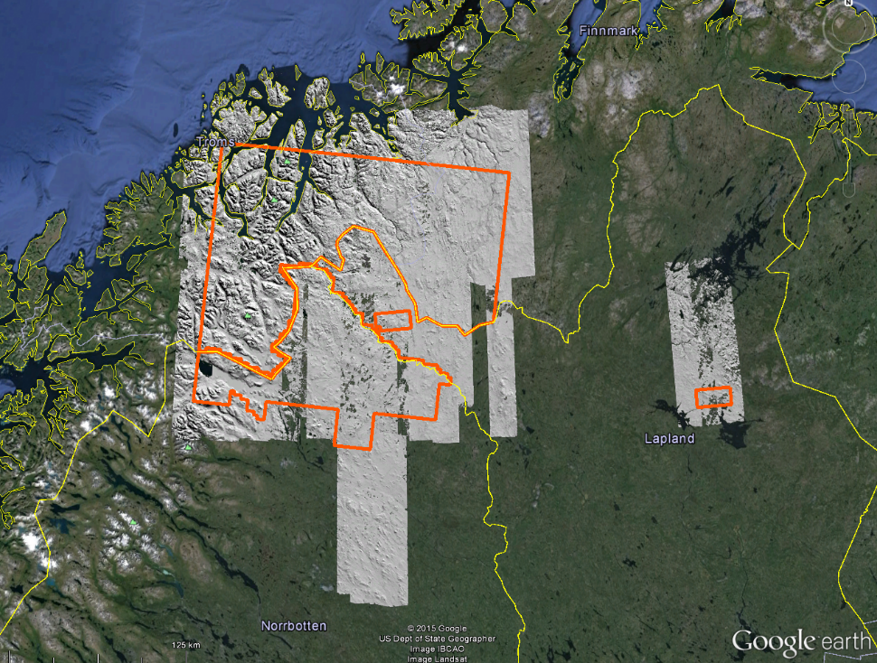

Slide 52
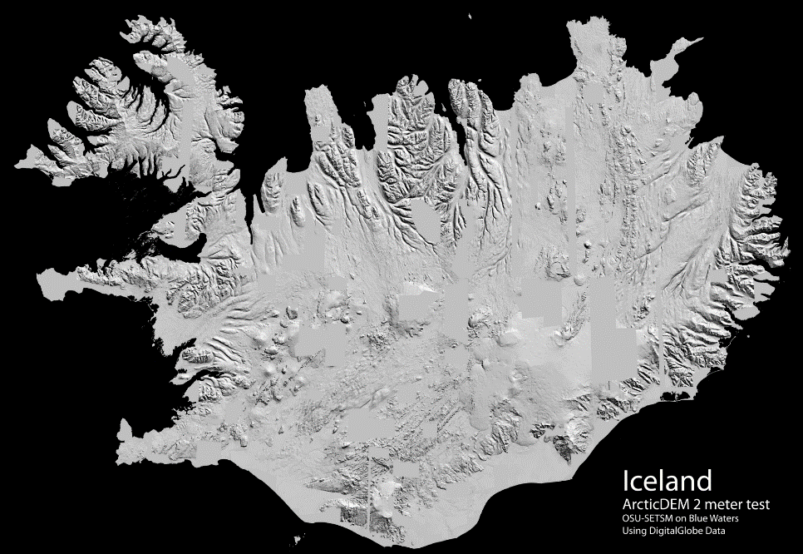

Slide 53
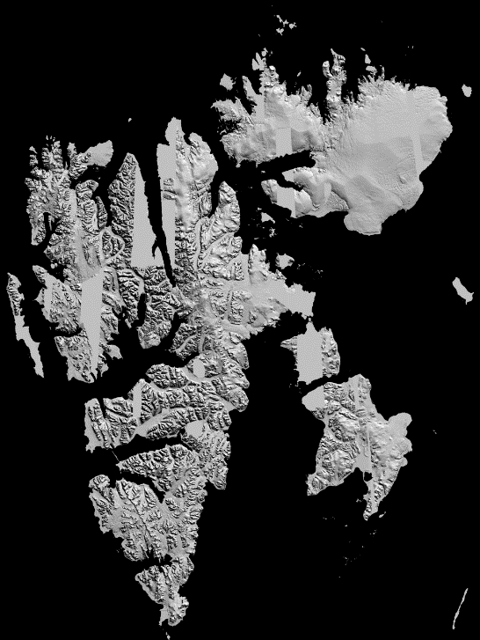
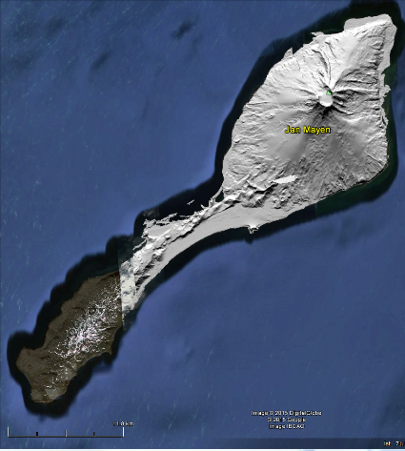

Slide 54
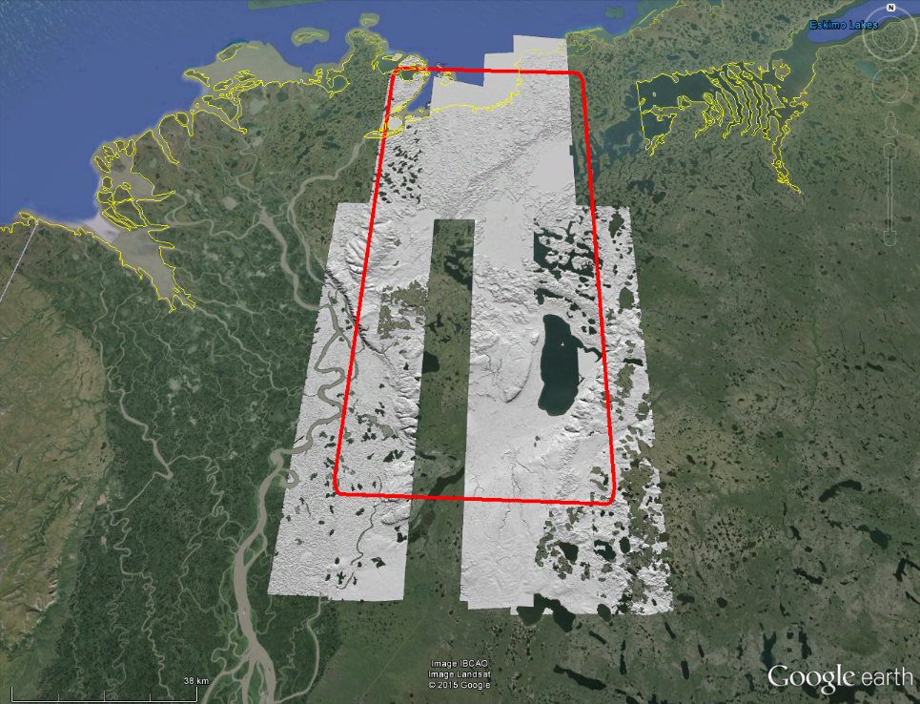

Slide 55
Paul Morin
PGC PI/Director
lpaul@umn.edu
Mike Cloutier
ArcticDEM Contact for International Partners
clou0012@umn.edu
Polar Geospatial Center
www.pgc.umn.edu
@polargeospatial
/polargeospatial

Slide 56
ArcticDEM Technical Details
Paul Morin and Mike Cloutier
Polar Geospatial Center
October 26, 2015

Slide 57
The DigitalGlobe Satellite Constellation
GeoEye
QuickBird
WorldView-2
IKONOS
WorldView-3
WorldView-1

Slide 58
Problems with the DEMs
~4m bias in all directions because of the RPCs
Holes in the DEMs
Water
Ice
Snow
This is a Digital Terrain Model - No bare ground
Derived from optical data

Slide 59
Strategy
Process 2 coverages of 8m DEMs first
Identify what failed and why
Can the failures be fixed?
Process the rest
Develop automated methods for hole filling, applying ground control and mosaicking
Reapply as needed
Volume is key

Slide 60
The ArcticDEM Domain

Slide 61
SUPERCOMPUTING
hardware & infrastructure
Servers at OIT data center wrapped for cooling

Slide 62
NSF High Performance Computing
About 40,000,000 Core hours Allocated

Slide 63
g
Gemini Fabric (HSN)
Cray XE6/XK7 - 276 Cabinets
DSL
48 Nodes
XE6 Compute Nodes
5,688 Blades – 22,640 Nodes – 362,240 Cores –
724,480 Integer Cores 4 GB per FP core
XK7 GPU Nodes
1056 Blades – 4,224 Nodes
33,792 Cores – 4,224 GPUs
MOM
64 Nodes
BOOT
Nodes
SDB
Nodes
RSIP
Nodes
Network GW
Nodes
Unassigned
Nodes
LNET Routers
582 Nodes
SMW
esLogin
4 Nodes
Boot RAID
InfiniBand fabric
Boot Cabinet
Import/Export
28 Nodes
10/40/100 Gb
Ethernet Switch
HPSS Data Mover
50 Nodes
Sonexion
25+PB online storage
144+144+1440 OSTs
Cyber Protection IDPS
Management Node
NCSAnet
Near-Line Storage
300+PB
esServers Cabinets
NPCF
Notes:
Blue Waters supersystem, Need to emphasize the unprecedented scale. Largest Cray, IE, HPSS, Lustre, Network. Hold performance discussion to later slides. Note all storage sizes are usable storage.

Slide 64
Stereo Coverage by Year

Slide 65
PGC’s Contribution
Processing the stereo imagery into DEMs
Tasking to continue to fill holes and continue the time series
Other automated post processing
  Ground control using LiDAR
  Mosaicking
PGC will not manually improve data products

Slide 66
Next Steps
2m DSM of Alaska – Currently ~84% of the state has existing stereo
8m Circum-Arctic test
Begin development of circum-arctic ground control database
NGA is raising the priority of collection over stereo imagery holes.
Work with the arctic nations on their contributions including ground control, coastline, DEM improvement, etc.

Slide 67
Ironies
North is better
Coastal is better
Remote is better
It is all about volume
Cloud cover assessment is often wrong
It is about having the data online
Networking, storage and compute is key

Slide 68
What is SETSM?
Surface Extraction through Triangulated Irregular Network-based Search-space Minimization
Authored by Dr. Myoung-Jong Noh, Ohio State University
The main objective of SETSM is fully automatic and high quality stereoscopic DEM extraction from pushbroom (e.g. WorldView, GeoEye, etc.) satellite images.
No tuning parameters: fully adaptive match operations
No tie point selection: only sensor model needed.
No seed DEM: match refinement by sensor model bias correction.
No manual editing: effective blunder elimination and post-processing using only match-point density.

Slide 69
How does SETSM work?
Three innovations make SETSM possible:
Object-Space matching using Vertical Line Locus (VLL)
Traditional “Area-space” matching: Given a point in one image, where is the corresponding or conjugate point in the second image?
Object-Space Matching: Given a planimetric location in object space (on the ground), what is the elevation that gives the best match between a pair of sub-image patches, obtained by projecting the candidate points into the images?
VLL Object-space matching allows for adaptive search space sizing based on geometry and relative sensor model accuracy. Also, the posted resolution of the DEM is the “true” resolution, unlike area-space matching.
Coarse-to-fine processing structure
Iterative refinement and adaptive adjustment of match constraints and blunder detection.
Sensor model Refinement
Bias in the sensor model are reduced through iterative refinement, enabling processing without a priori information (e.g. seed DEM or tie points).

Slide 70
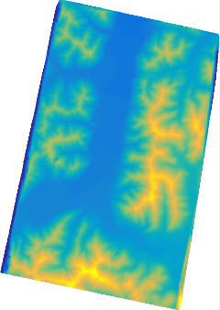
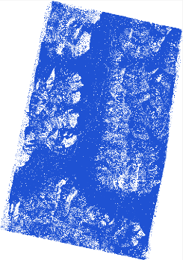

What does SETSM produce?
Gridded and gap-filled DEM
“Matchtag” Image with 1’s for pixels with matched points and 0’s for interpolated pixels.
16 bit orthorectified image at DEM resolution (not openly distributable currently)
Raw DEM
Matchtag Mask
Ortho Image

Slide 71
What’s the data quality?
Raw DEM’s have systematic positional errors of up to several meters
  due to sensor model errors (Rational Polynomial Coefficients or RPCs)
  corrected with ground control (lidar, GPS points, etc)
The relative (point-to-point) error in the DEM is order decimeters
  this is the expected error after ground control is applied
Image edge effects, clouds, severe shadows and water bodies result in bad data
  these are effectively filtered using the matchtag field

Slide 72






How is data quality improved?
Arctic tundra example
edge effects
Raw DEM (hillshade)
lakes
Ortho Image
matchtag field
Red = point density < 30%
point density field

Slide 73
What Can You Offer?
Ground Control
Improvement of the DEMs
  Hole identification
  Hole filling
  Blunder editing
Staff for short-term detail at PGC in Minnesota

Slide 74
Processing Strategy
We cannot manually examine 300,000 pairs
Use the processing of 8m DEMs to check the quality of the pair
When a 8m DEM succeeds process to 2m when more HPC time is available
PGC has enough time to produce 8m DEMS for ~150,000 – 17x17km pairs

Slide 75
ArcticDEM Characteristics
File Format: 32 bit GeoTIFF
Projection: NSIDC Sea Ice Polar Stereographic North
  Note: forthcoming effort to mosaic DEM strips will be tiled and projected to UTM
Vertical Datum/Reference: WGS84 ellipsoidal (native SETSM output)
Elevation Units: meters
No Data Value: -9999
Initial data generated and archived according to the DigitalGlobe satellite stereopair “strip” used to create the terrain
  Typically around 17km x 120km, but a lot of variability
File Size
  2m Resolution: Approximately 1 MB per sqkm (~1 GB per 1000 sqkm)
  8m Resolution: Approximately 0.06 per sqkm (~65 MB per 1000 sqkm)
File naming
  Pipeline_Sensor_YYYYMMDD_Pair-ID1_Pair-ID2_Part#_Resolution_Component
  SETSM_WV01_20150215_102001003A308300_102001003BC43700_1_8m_dem

Slide 76
Pocket Drive Contents (yours to keep)
ArcticDEM data
  DEM strips over AOIs requested through Tracy
    Canada, Finland, Sweden, Norway, Faroe Islands (2m & 8m resolution)
  Additional Data: Alaska Regions, Svalbard (8m resolution)
  Matchtag files
    Bitmask of pixels derived from stereo match (1) or interpolated (0)
Auxiliary Files Folder
  Shapefile of ArcticDEM regions being produced
  Shapefile index of DEM files
    Refer to “Pairname” field above to identify DEM/Matchtag files
SETSM_ASP_Components_Doc.pdf
  Explanation of output files generated from SETSM and ASP stereo pipelines
    Note: not all files will be included on the hard drive at this time

Slide 77
General Notes and Comments
We ask that you not release the DEMs yet
Due to licensing, source stereo imagery used for production will not be available for distribution
  Metadata associated with the source imagery will be available
    Collection date, collection angles, image resolution, cloud cover, browse images

Slide 78
Useful Partner Contributions
Control Sources to Enhance Accuracy
  LiDAR (airborne or terrestrial)
  InSAR Surveys
  GNSS ground surveys
  Cadastral Points
High Resolution Coastline Features
Large scale polygonal & linear hydrographic features (1:25,000 scale or better)
Feedback
  Recommendations
  Identification of problem areas (artifacts, voids, pits/spikes)
Post-processing & editing

Slide 79
Next Steps
Metadata Generation and Indexing
  Auto-generated XML files describing data
  Polygonal coverage footprints
FTP delivery
  Folders set up by region
  PGC can notify Partner’s when new data becomes available
Discovery & Understanding of Auxiliary Partner Data Sources to Improve Terrain
Ongoing Gap/Cloud-Fill Image Tasking
Versioning
Re-ingest and re-distribution strategy of improved data

Slide 80
Paul Morin
PGC PI/Director
lpaul@umn.edu
Mike Cloutier
ArcticDEM Contact for International Partners
clou0012@umn.edu
Polar Geospatial Center
www.pgc.umn.edu
@polargeospatial
/polargeospatial

