Slide 1
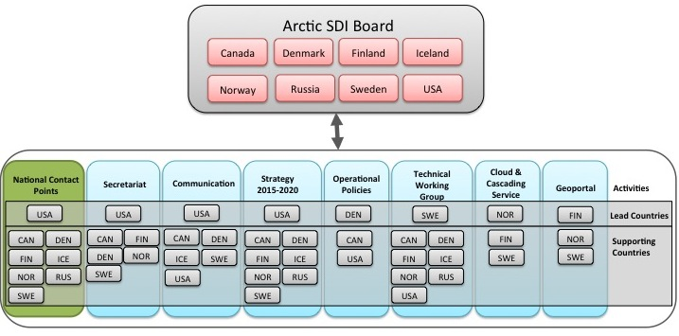
Arctic SDI Organization December 2015

