Slide 1
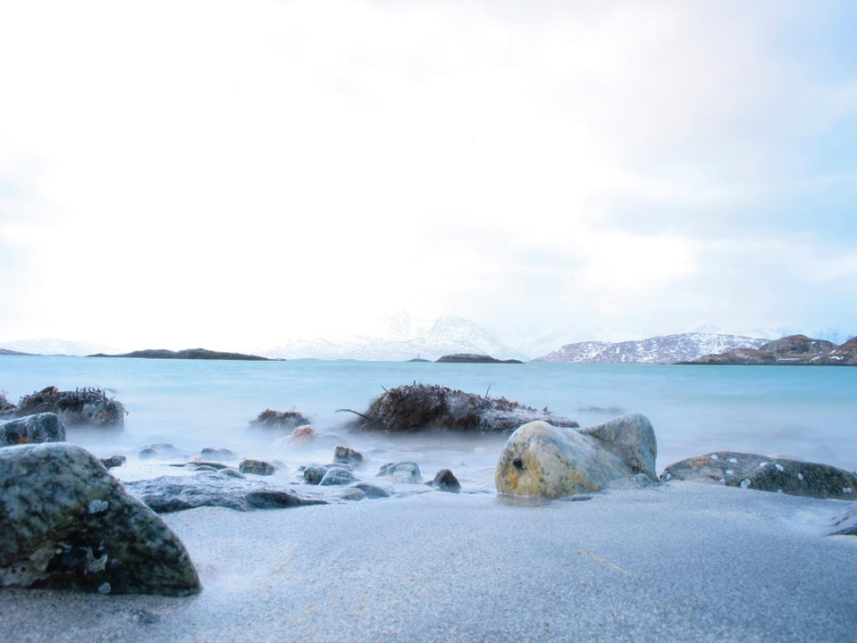


  Arctic Spatial Data Infrastructure
  - A circumpolar mapping initiative -
  EPPR II and UAS Workshop
  Seattle
  www.arctic-sdi.org
Martin Skedsmo
Becci Anderson

Slide 2
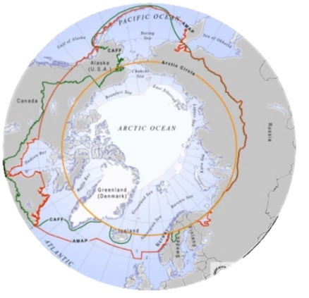
The Arctic
1/6 of the earth´s landmass
More than 30 million km²
8 countries
24 hours- all time zones
2

Slide 3
What is a Spatial Data Infrastructure?
is a coordinated series of agreements on technology standards, institutional arrangements, and policies that enable the discovery and use of geospatial information
by users and for purposes other than
those it was created for
Kuhn, W. (2005) presentation "Introduction to Spatial Data Infrastructures".
3

Slide 4
Spatial Data Infrastructure Basics
Data and metadata are managed by the data originator and/or owner
Tools and services connect via computer networks to the various sources through a common end point
To achieve the objectives
coordination is necessary
standards are essential
Steiniger, S., and Hunter, A.J.S. (2012) preprint "Free and open source GIS software for building a spatial data infrastructure".
4

Slide 5
Arctic SDI
A cooperation between the mapping agencies of
Canada
Denmark including Greenland and Faroe Island
Finland
Iceland
Russia
Sweden
USA
5

Slide 6
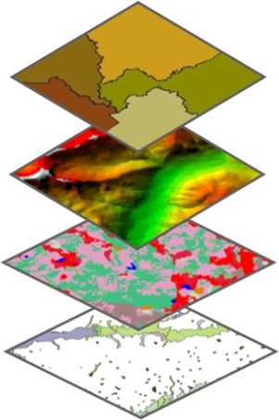
Main Content of the Artic SDI
The Arctic SDI is an infrastructure that provides a web portal with easy access to:
A geoportal for geospatial data viewing and discovery
A searchable metadata catalogue
Authoritative reference data as a Web Map Service (WMS)
Thematic data (birds, icecover, ship routes, land cover change, flora etc.)

Slide 7
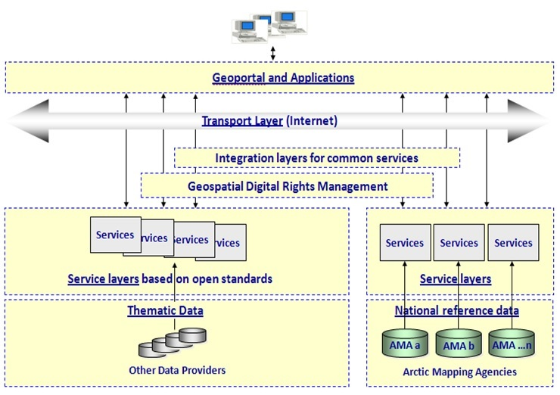
Architecture of the Arctic SDI

Slide 8
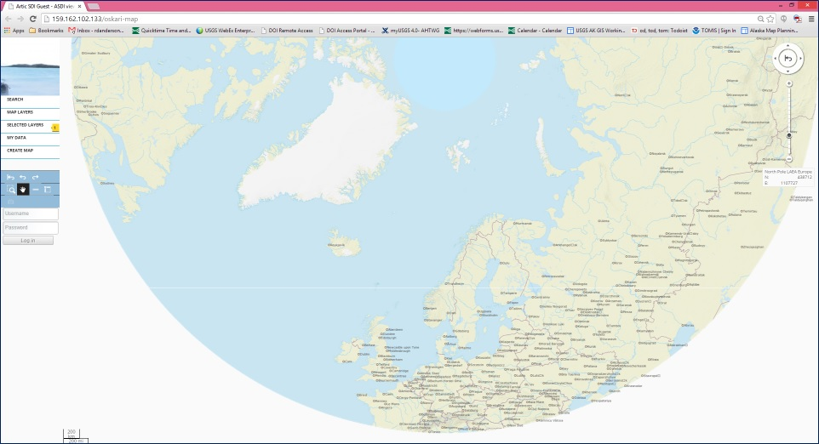
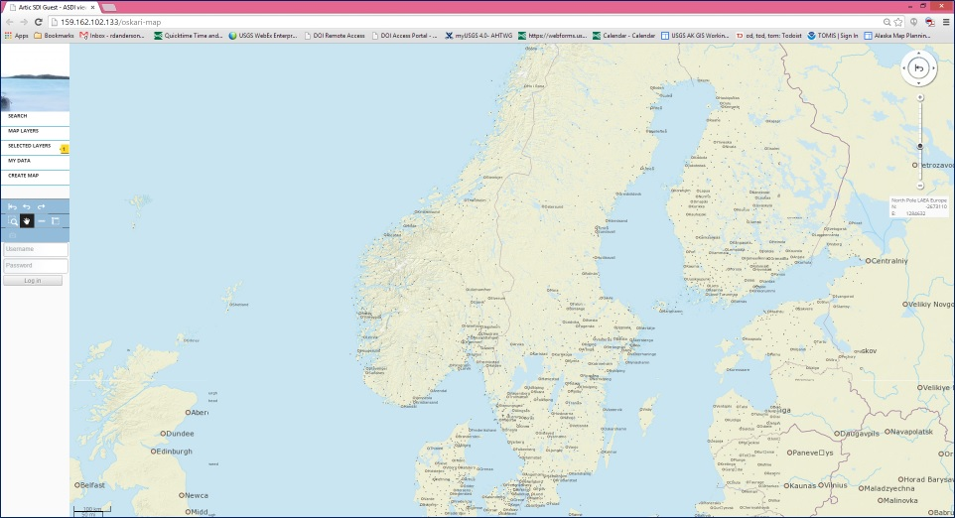
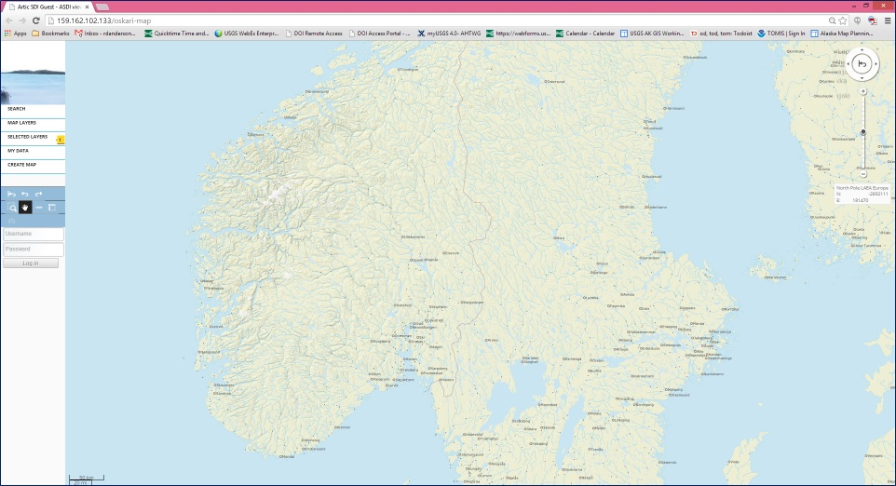
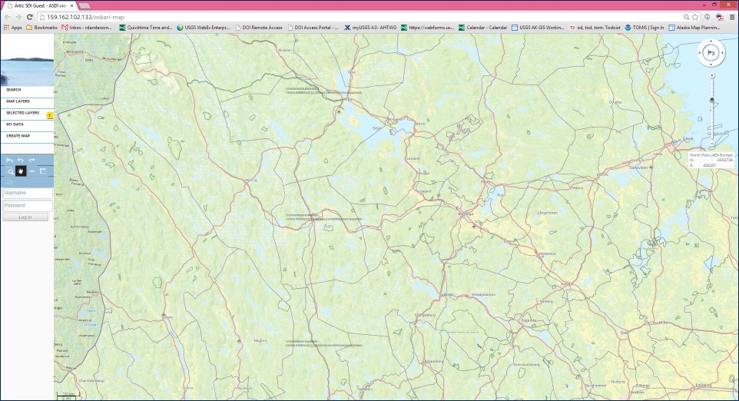
1:250k Basemap from National Mapping Agencies

Slide 9
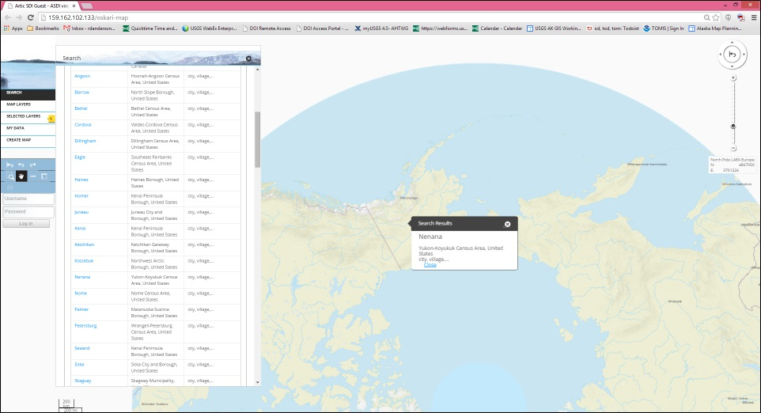
Location Search

Slide 10
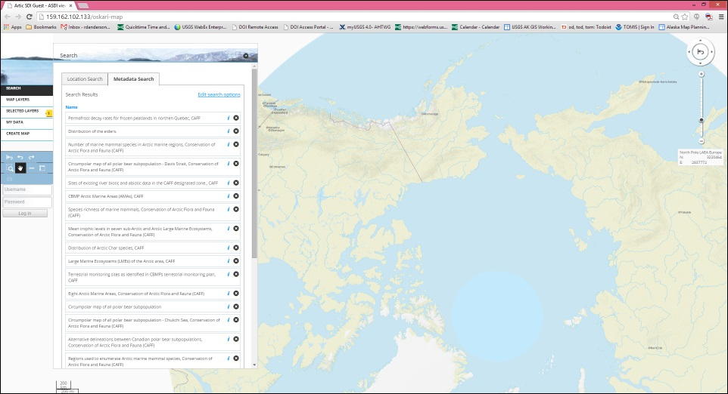
Metadata Search

Slide 11
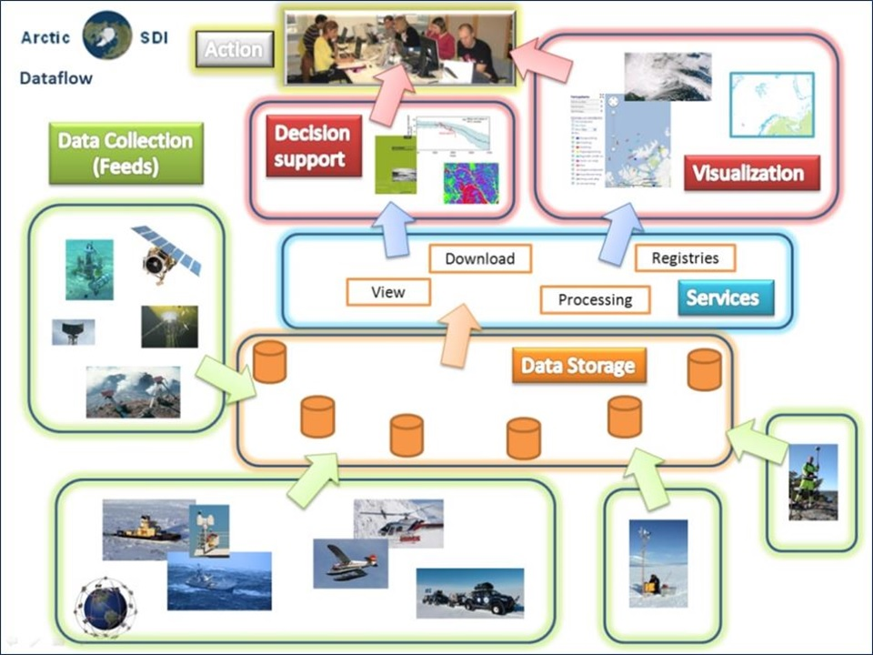
“Full” Arctic SDI

Slide 12
A Short History
Arctic SDI discussions have been ongoing for a number of years
1990s GITBarents, Finland, Norway, Russia and Sweden
2007 Yellowknife Declaration - GeoNorth Conference
2009 Formal Arctic Council support – SAO meeting
  2011- the Arctic SDI project launched by the 8 National Mapping Agencies with CAFF acting as a link to the SAOs
Notes:
12

Slide 13
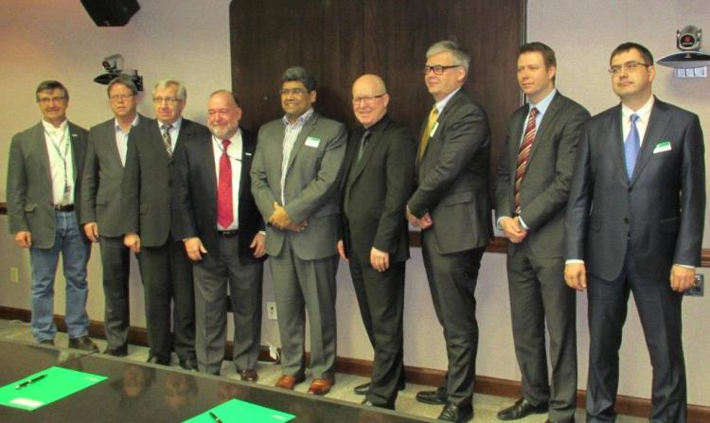
The foundation for the Arctic SDI is the legally non-binding “Memorandum of Understanding” (MOU) signed by participating NMAs in 2014

Slide 14
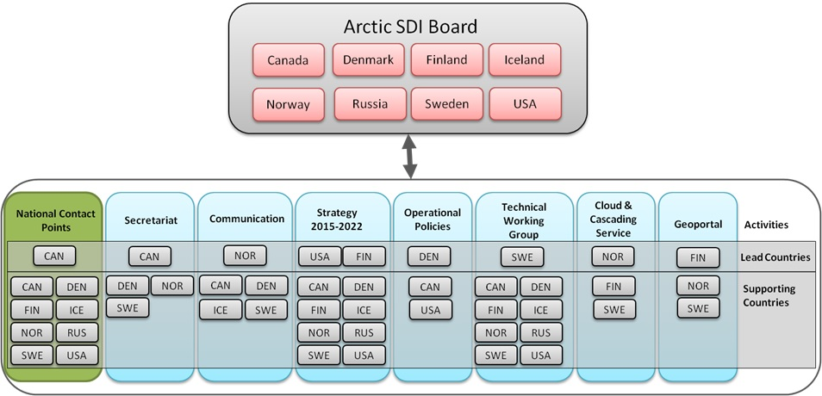
Arctic SDI Organizational Structure

Slide 15
Aim and Vision of Arctic SDI
Aim: To provide politicians, governments, policy makers, scientists, private enterprises and citizens in the Arctic access to geographically related Arctic data, digital maps and tools to facilitate monitoring and decision making
Vision: An Arctic SDI – based on sustainable co-operation between mandated national mapping organizations – which will provide for access to spatially related reliable information over the Arctic to facilitate monitoring and decision making

Slide 16
Users, Stakeholders and
Data Providers
Arctic Council
Working Groups: CAFF, EPPR, PAME, AMAP
Academic institutions in the Arctic
Government and governmental authorities
Media, citizens, NGOs,…
www.arctic-sdi.org
16
Notes:
16

Slide 17
Benefits
How can the Arctic SDI serve the AC WGs?
Can be used for visualizing the work of the Arctic Council and their WG
Supporting stakeholders in meeting their goals and objectives by using reliable, interoperable, authoritative geospatial reference data from the National Mapping Agencies of the Arctic
Provides a reference data basemap for viewing thematic datasets
Providing stakeholders with a tool for more robust management and manipulation of data thus supporting monitoring and decision making
Can be used to provide access to WG data through both the geoportal and metadata catalog
17

Slide 18
Project Framework and Phases
SDI Engagement Phase 2015/2020
Leverage Global/National SDI Communities
Stakeholder Engagement and Requirements
From Strategy to Roadmap to Projects
SDI Interoperability
Resource Allocation and Business Models
Voluntary Resource Commitment to Tasks
Performance Metrics
Standards Coordination
Operational Phase 2014/2015
Geoportal
Metadata Catalogue
Web Map Service-
National Mapping Data
Thematic Data Provider
Partnerships- CAFF
Establishing Phase 2011/2014
Memorandum of
Understanding, 2014
Simplified Governance
Reference Model
Working Groups
Established
Structuring Phase 2010/2011
Arctic Council Links
Project Management
Technical Group
Steering Committee
18

Slide 19
2014 – Status
  Geoportal
  Metadata Catalogue
  Web Map Reference Data Service 1:250.000
  CAFF thematic data
  Strategic Plan 2015 – 2020
  Senior Arctic Official - invitation to start dialogue with all Arctic Council Working Groups
Notes:
19

Slide 20
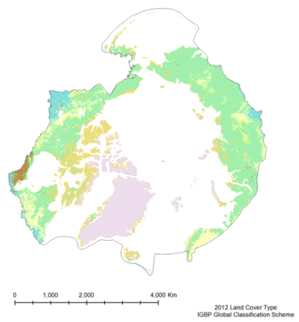
WG Example:
CAFF - Earth Observation Products
CAFF commissioned Michigan Tech to develop circumpolar earth observation products from MODerate resolution Imaging Spectroradiometer (MODIS) sensor
Approximately 6,000 files across 12 products
Time-series from 2002
36 spectral bands
250, 500, 1000m resolutions
55 tiles at 250m to cover CAFF defined pan-Arctic extent
Lambert Azimuthal Equal Area Polar Projection

Slide 21
Product | Resolution | Time Series
Normalized Difference Vegetation Index and Enhanced Vegetation Index | 0.05 deg (~5600 m) | 16-day; May-September, 2000-2013
Land Cover Dynamics (Vegetation Phenology) | 500m | 2001 - 2010
Land Cover Type | 0.05 deg (~5600 m) | 2001 - 2012
Land Surface Temperature | 0.05 deg (~5600 m) | Monthly; Feb. 2000 - present
Albedo | 0.05 deg (~5600 m) | 16-day; Feb. 2000 - present
Snow Covered Area | 0.05 deg (~5600 m) | Monthly; March 2000 - present
Land Water Mask | 0.05 deg (~5600 m) | Monthly; March 2000 - present
Sea Surface Temperature, Nighttime | 4 km | Monthly; June 2002 - present
Marine Chlorophyll a | 4 km | Monthly; June 2002 - present
Coloured Dissolved Organic Matter | 4 km | Monthly during March to Oct. period; Jun 2002 - present
Marine Primary Productivity | 9 km | Monthly; July 2002 - present

Slide 22
Arctic SDI Role in CAFF Project
Arctic Spatial Data Infrastructure (Arctic SDI) enables geospatial data discovery and sharing through Geoportal and Metadata Catalogue
Data are housed and Web Mapping Services (WMS) are served from CAFF
WMS were added to Arctic SDI Geoportal and dataset metadata were harvested into the Arctic SDI Metadata Catalogue
Distributed Artic SDI effort supporting all project components including assistance from Canada, Iceland, Sweden, Finland and Norway

Slide 23
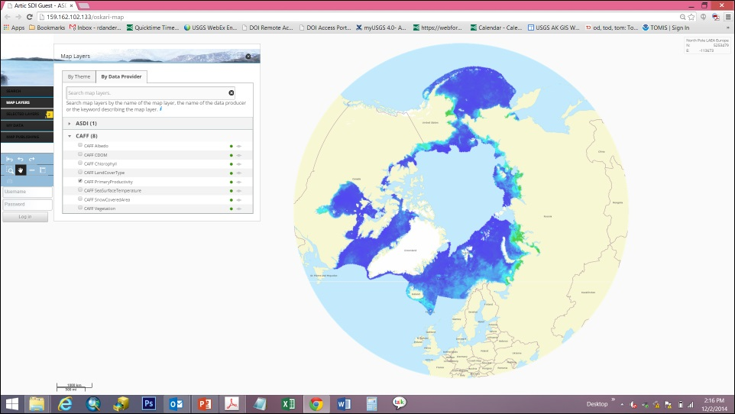
CAFF – EOP Available on Arctic SDI Geoportal

Slide 24
Future Examples
Access to relevant and updated thematic geospatial information covering the entire circumpolar region
Visualizing the work of the Arctic Council and its WGs
Possibilities for governmental authorities and decision makers to always have access to receive relevant and updated information
Daily use of the project's web map services in schools and universities in the Arctic and elsewhere.
Possibilities for media to receive relevant and updated information
Possibilities to foster cooperation with industry on Arctic issues
24

Slide 25
How Can You Contribute ?
Provide digital access to your thematic data
Manage your data according to international standards for data
Demand standards to be applied by partners producing or distributing your data
Update the metadata information for your data in the metadata catalogue
Visit the Arctic SDI website to learn more
25

Slide 26
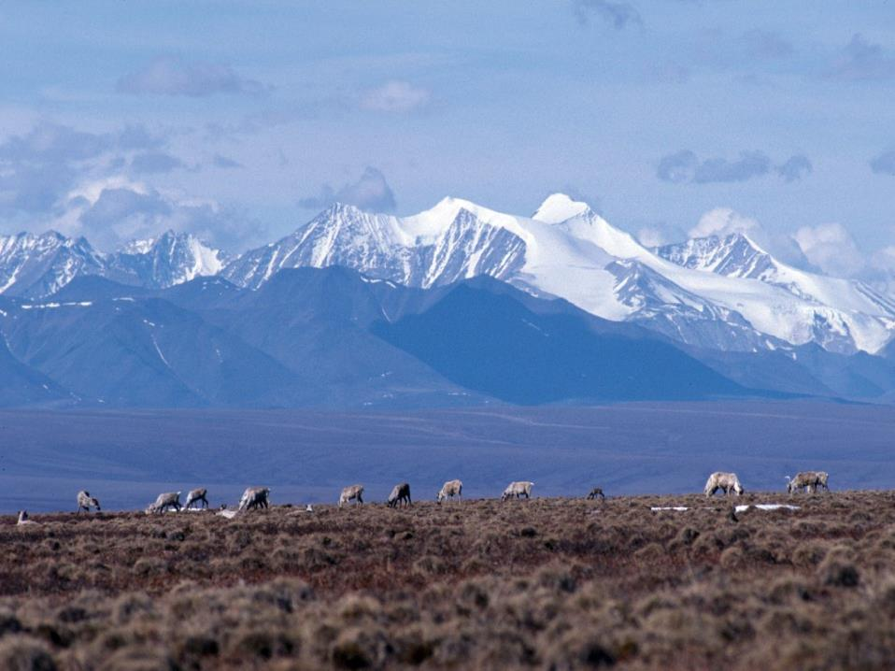

  Thank You!!
  www.arctic-sdi.org
Martin Skedsmo
Martin.Skedsmo@kartverket.no
Becci Anderson
rdanderson@usgs.gov

