Slide 1
Arctic SDI basic presentations
The standardized Arctic SDI slide show consists of 2 basic presentations of which one is technical.
Supplementary slides can be found in a separate file.
Arctic SDI standard presentation_V1.0_150311
Arctic SDI technical presentation_V1.0_20150219
Arctic SDI supplementary slides _V1.0_150311
The series are to be seen upon as gross series.
They can be used as they are but it is recommended to edit/modify/complete due to the audience
Slides from the supplementary could be used as complement
serves as a basic PowerPoint, and that, depending on the audience and the presenter, it is a PowerPoint that most likely will be altered as time goes by. It would be a great idea if we could have all these PowerPoints on the webpage
Name
Organisation or logo

Slide 2
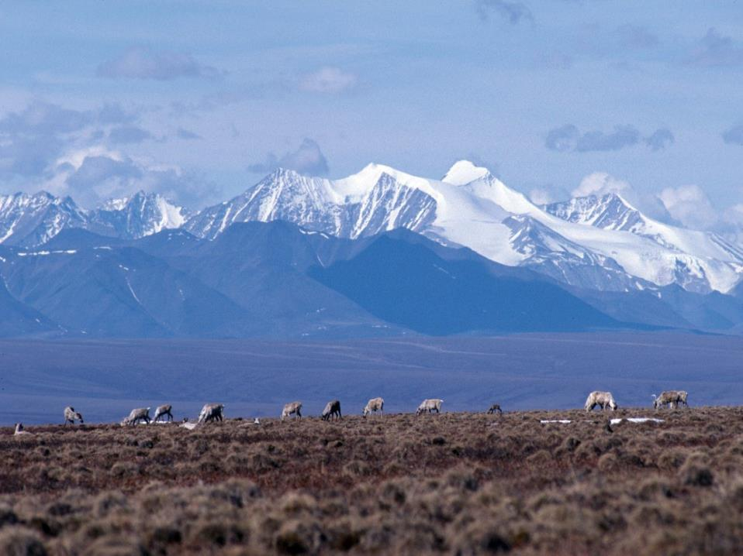
Arctic Spatial Data Infrastructure
- A circumpolar mapping initiative -
Name of conference or meeting
Place
Name
Organization or logo
www.arctic-sdi.org
Name
Organisation or logo

Slide 3
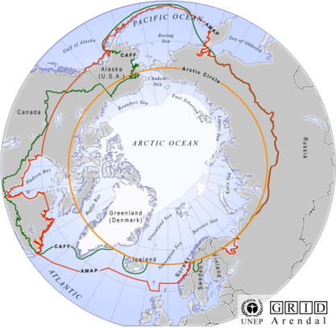
The Arctic
1/6 of the earth´s landmass
30 mill km² /11.5 mill mi²
8 countries/4 mill people
24 hours- all time zones
Name
Organisation or logo

Slide 4
What is a Spatial Data Infrastructure?
SDI is a coordinated series of agreements on technology standards, institutional arrangements, and policies that enable the discovery and use of geospatial information by users and for purposes other than
those it was created for
Kuhn, W. (2005) presentation "Introduction to Spatial Data Infrastructures".
Name
Organisation or logo

Slide 5
Spatial Data Infrastructure Basics
Tools and services connect via computer networks to the various sources through a common end point
Standards are essential
agreements and coordination is necessary
Distribution of data and metadata are managed by the data originator and/or owner
Name
Organisation or logo

Slide 6
Arctic SDI
A cooperation between the National Mapping Agencies of
Canada
Denmark including Greenland and Faroe Island
Finland
Iceland
Norway
Russia
Sweden
USA
Name
Organisation or logo

Slide 7
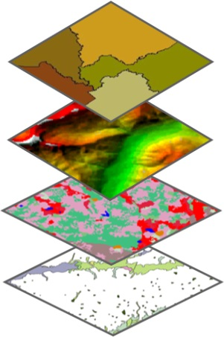
Main Content of the Artic SDI
The Arctic SDI is an infrastructure that provides a web portal with easy access to:
A geoportal for geospatial data viewing and discovery
A searchable metadata catalogue
Authoritative reference data as a Web Map Service (WMS)
Thematic data (birds, icecover, ship routes, land cover change, flora etc.)
Name
Organisation or logo

Slide 8
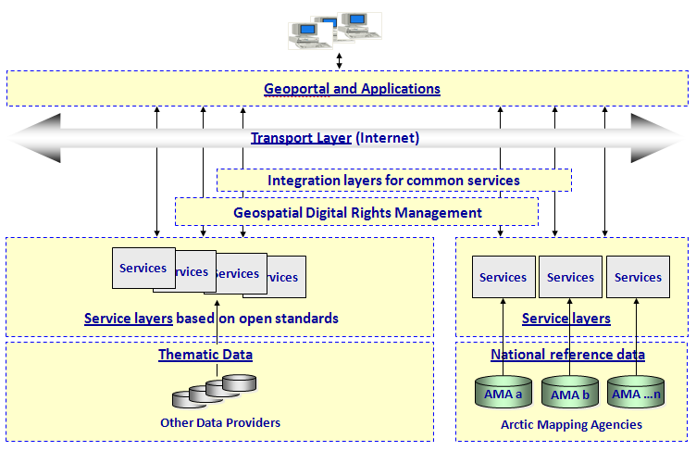
Architecture of the Arctic SDI
Name
Organisation or logo

Slide 9
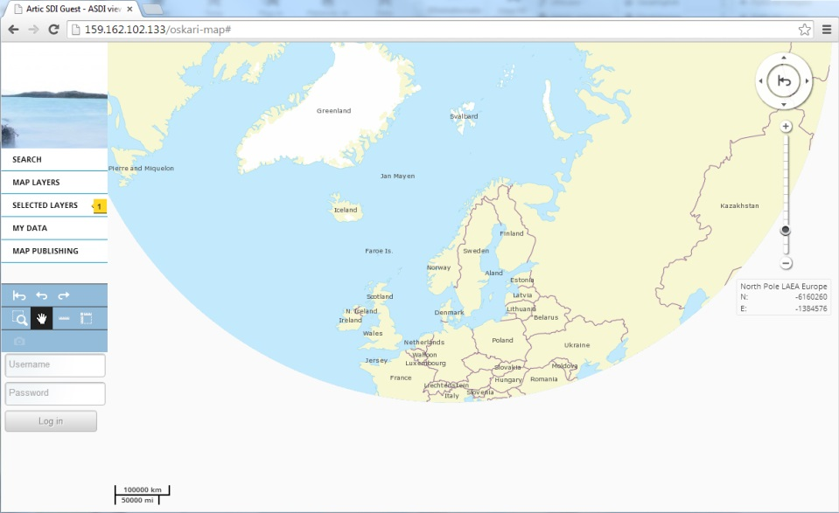
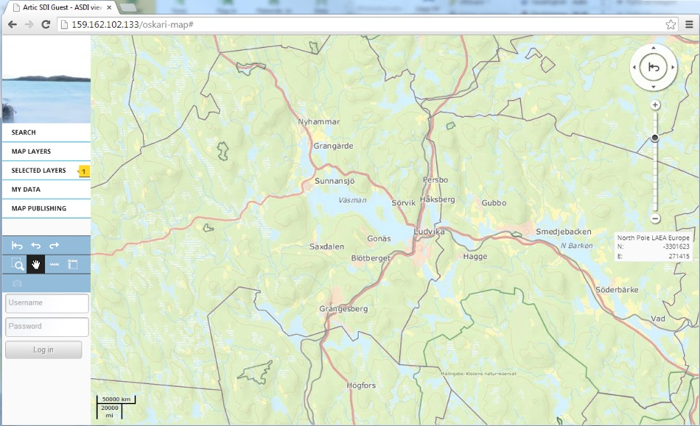
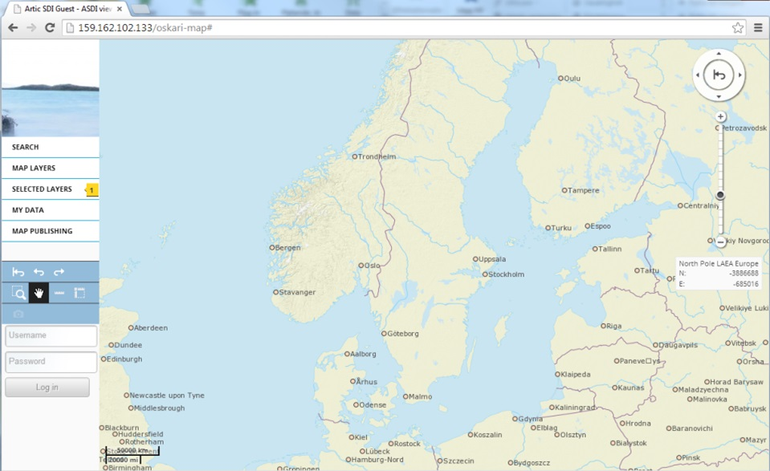
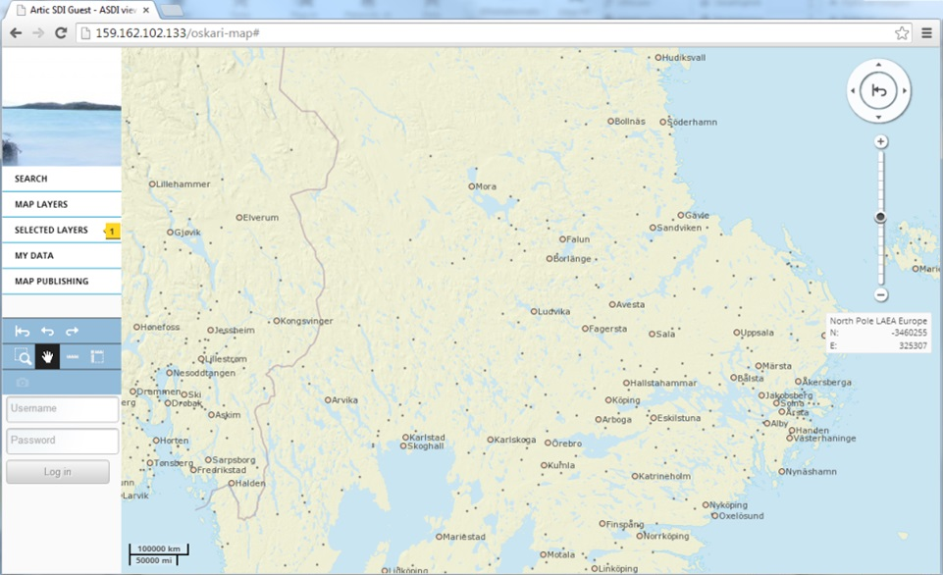
1:250k Basemap from National Mapping Agencies

Slide 10
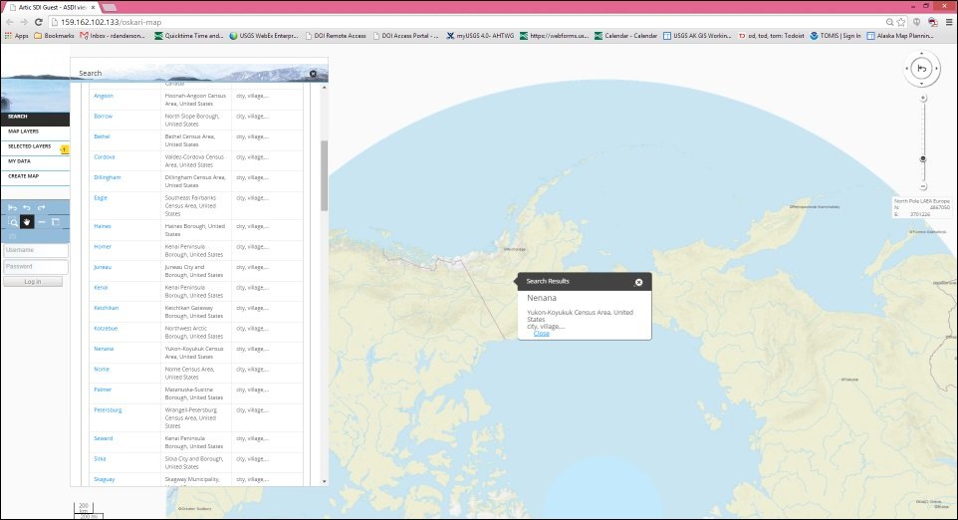
Location Search
Name
Organisation or logo

Slide 11
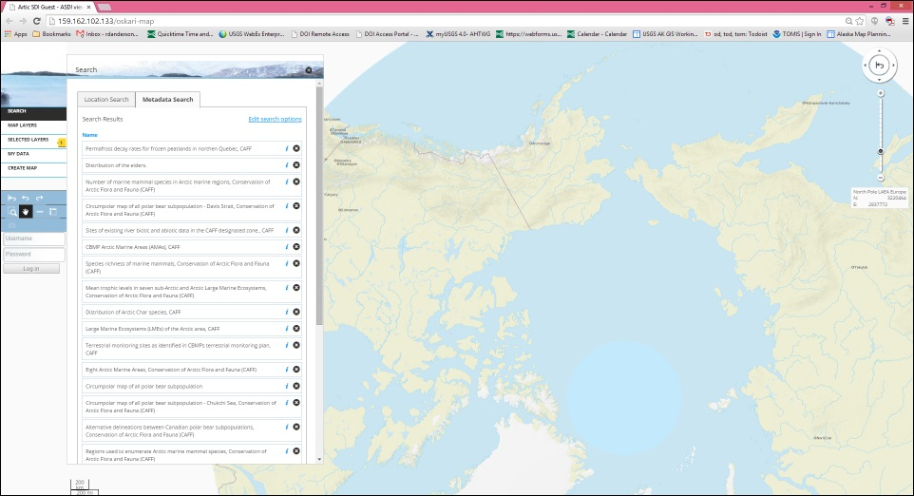
Metadata Search
Name
Organisation or logo

Slide 12
Name
Organisation or logo

Slide 13
A Short History
Arctic SDI discussions have been ongoing for a number of years
1990s GIT Barents, Finland, Norway, Russia and Sweden
2007 Yellowknife Declaration – GeoNorth I Conference
2009 Formal Arctic Council support – SAO meeting
2011 The Arctic SDI project launched by the 8 National Mapping Agencies with CAFF acting as a link to the SAOs
2014 MoU, Memorandum of Understanding signed, new governance, commitment to responsibilities & resources
Name
Organisation or logo

Slide 14
Arctic SDI Organizational Structure
Arctic SDI Board
Canada
Denmark
Finland
Iceland
Norway
Russia
Sweden
USA
National Contact Points
Strategy
2015-2020
Operational
Policies
Technical
Working Group
Cloud &
Cascading
Service
Secretariat
Communication
Geoportal
Activities
Name
Organisation or logo
USA
USA
NOR
USA
DEN
SWE
NOR
FIN
Lead Countries
CAN
DEN
CAN
FIN
CAN
DEN
CAN
DEN
CAN
CAN
DEN
FIN
NOR
Supporting
Countries
FIN
ICE
DEN
ICE
SWE
FIN
ICE
USA
FIN
ICE
SWE
SWE
NOR
RUS
USA
NOR
RUS
NOR
RUS
SWE
SWE
USA

Slide 15
Aim and Vision of Arctic SDI
Aim: To provide politicians, governments, policy makers, scientists, private enterprises and citizens in the Arctic access to geographically related Arctic data, digital maps and tools to facilitate monitoring and decision making
Vision: An Arctic SDI – based on sustainable co-operation between mandated national mapping organizations – which will provide for access to spatially related reliable information over the Arctic to facilitate monitoring and decision making
Name
Organisation or logo

Slide 16
Users, Stakeholders and Data Providers
AC Working Groups (CAFF, AMAP, EPPR, PAME)
Academic institutions in the Arctic
Government and pubic sector
Business, media, citizens, NGOs,…
Name
Organisation or logo

Slide 17
Benefits
How can the Arctic SDI serve the AC WGs?
Can be used for visualizing the work of the Arctic Council and their WGs
Supporting stakeholders in meeting their goals and objectives by using reliable, interoperable, authoritative geospatial reference data from the National Mapping Agencies of the Arctic
Provides a reference data base-map for viewing thematic datasets
Providing stakeholders with a tool for more robust management and manipulation of data thus supporting monitoring and decision making
Can be used to provide access to WG data through both the geoportal and metadata catalog
Name
Organisation or logo

Slide 18
Phases of the Arctic SDI
SDI Engagement Phase 2015/2020
Leverage Global/National SDI Communities
Stakeholder Engagement and Requirements
From Strategy to Roadmap to Projects
SDI Interoperability
Resource Allocation and Business Models
Voluntary Resource Commitment to Tasks
Performance Metrics
Standards Coordination
Operational Phase 2014/2015
Geoportal
Metadata Catalogue
Web Map Service- National Mapping Data
Thematic Data Provider Partnerships- CAFF
Establishing Phase 2011/2014
Memorandum of Understanding, 2014
Simplified Governance
Reference Model
Working Groups Established
Name
Organisation or logo
Structuring Phase 2010/2011
Arctic Council Links
Project Management
Technical Group
Steering Committee

Slide 19
2014 – Status
Geoportal
Metadata Catalogue
Web Map Reference Data Service 1:250.000
CAFF thematic data
Continued dialogue with Arctic Council Working Groups
Strategic Plan 2015 – 2020
Name
Organisation or logo

Slide 20
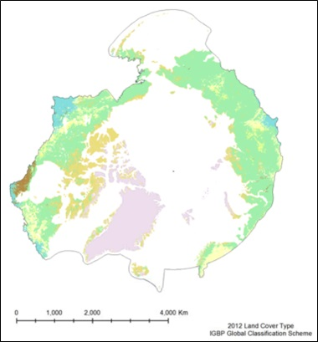
WG Example: CAFF - Earth Observation Products
CAFF commissioned Michigan Tech to develop circumpolar earth observation products from MODerate resolution Imaging Spectroradiometer (MODIS) sensor
Approximately 6,000 files across 12 products
Time-series from 2002
36 spectral bands
250, 500, 1000m resolutions
55 tiles at 250m to cover CAFF defined pan-Arctic extent
Lambert Azimuthal Equal Area Polar Projection
Name
Organisation or logo

Slide 21
Arctic SDI Role in CAFF Project
Arctic Spatial Data Infrastructure (Arctic SDI) enables geospatial data discovery and sharing through Geoportal and Metadata Catalogue
Data are housed and Web Mapping Services (WMS) are served from CAFF
WMS were added to Arctic SDI Geoportal and dataset metadata were harvested into the Arctic SDI Metadata Catalogue
Distributed Artic SDI effort supporting all project components including assistance from Canada, Denmark, Finland, Iceland, Norway & Sweden
Name
Organisation or logo

Slide 22
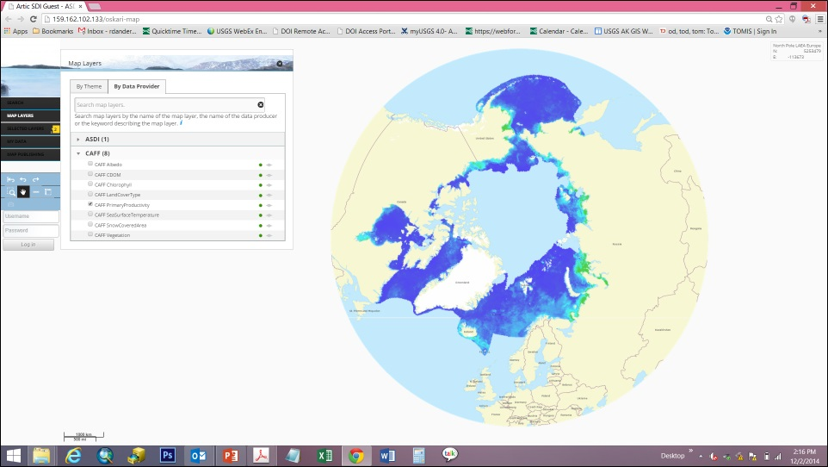
CAFF – EOP Available on Arctic SDI Geoportal
Name
Organisation or logo

Slide 23
Future Examples
Access to relevant and updated thematic geospatial information covering the entire circumpolar region
Visualizing the work of the Arctic Council and its WGs
Possibilities for governmental authorities and decision makers to always have access to receive relevant and updated information
Daily use of the project's web map services in schools and universities in the Arctic and elsewhere.
Possibilities for media and the public to receive relevant and updated information
Possibilities to foster cooperation with industry on Arctic issues
Name
Organisation or logo

Slide 24
How Can You Contribute ?
Provide digital access to your thematic data
Manage your data according to international standards for data
Demand standards to be applied by partners producing or distributing your data
Update the metadata information for your data in the metadata catalogue
Visit the Arctic SDI website to learn more
Name
Organisation or logo

Slide 25
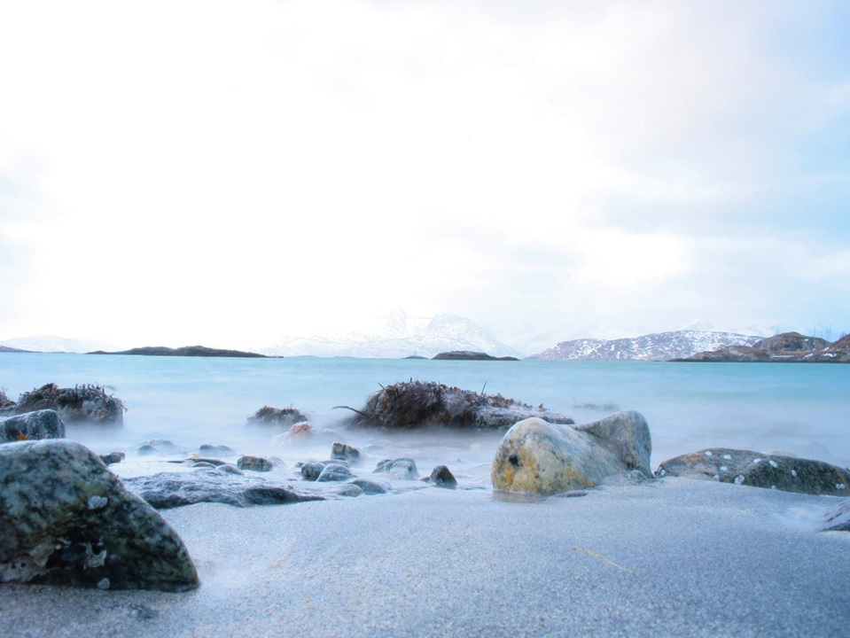
Thank you!
Name of presenter
Organization or logo
Name of presenter
Organization or logo

