Slide 1
Arctic Spatial Data Infrastructure
Polar Data Forum II & Pan-Arctic DEM Workshop
Waterloo, Canada
October 27, 2015
Lorna Schmid
Arctic SDI Lead Secretariat & NCP
Notes:
Esteemed colleagues from the Arctic SDI are here. US Chairmanship with Kevin Gallagher as Chair.

Slide 2
A Spatial Data Infrastructure
Allows sharing geospatial data in an efficient and flexible way
The Arctic SDI …
People
Important data sets are produced and distributed by many stakeholders …
…adheres to Open Data Standards
SDI
Technology
Standards
… most of it can be geographically referenced
… and its development is facilitated by the National Mapping Agencies of the eight Arctic Countries.
Policies
Notes:
Standards (Internet,WWW, Email) …

Slide 3
What are the benefits of participation in Arctic SDI?
Remember that time that you really wanted to find that dataset, or map, you had seen before?
Remember how much time you were looking and you were (or weren’t) successful?
Geospatial data and the maps you could generate (on the fly) will always be available!
Data can be used, and re-used in ways we can now only dream of!
As common data layers evolve consistent visualization becomes possible
… Promotes collaboration with access to any data provider: public & private sector data, NGOs and Academia

Slide 4
Arctic SDI: Working to Facilitate Standardized Geospatial Data Management and Sharing …
… What does that mean?
Standards help ensure that even as technology evolves data and information will continue to be available!
Connecting your computer to the Internet? Surfing the Web? Sending and Receiving Email?
Plugging your electrical device into a wall socket?

Slide 5
What’s the difference between an SDI and a Geoportal?
Spatial Data Infrastructures are like transportation infrastructures … Roads, for example
Data is like the vehicles …
Cars vs. Trucks; All-Wheel Drive vs. 4-Wheel Drive; Sedan vs. All-Terrain Vehicle
Effective delivery of different data types require different standards, or protocols
Time Series/Temporal data vs. Raster data vs. Vector data, etc.
Geoportals are tools which can access data in the infrastructure
Standards based vehicles can be driven on any standard road!
Notes:
An Analogy
Different vehicles for different needs

Slide 6
Arctic SDI Highlights
2014:
Geoportal Launched
MOU Signed
Initial work to migrate CAFF Data into the Geoportal
2015: Maturing of the Arctic SDI
Arctic SDI Fact Sheet completed
Geoportal Domain Name: geoportal.arctic-sdi.org
International Activities
Intervention at UN-GGIM in NYC (United Nations Committee of Experts on Geospatial Information Management
Open Geospatial Consortium (OGC) Pilot to Showcase Data Interoperability for the Arctic
Initial evaluations for a Pan-Arctic Digital Elevation Map
Strategic Plan Objective 1 – Gather User & Stakeholder Requirements
Arctic SDI is expanding engagement to include other Arctic Council WGs
Notes:
Part of the Arctic SDI Strategic Plan Objectives to with a goal of showcasing standards and best practices.
Geoportal: geoportal.arctic-sdi.org

Slide 7
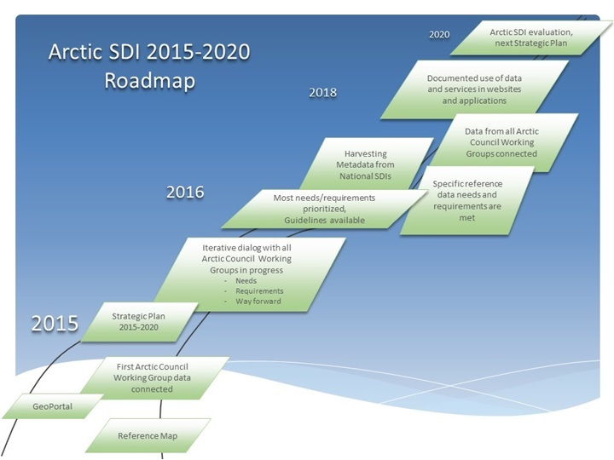

Slide 8
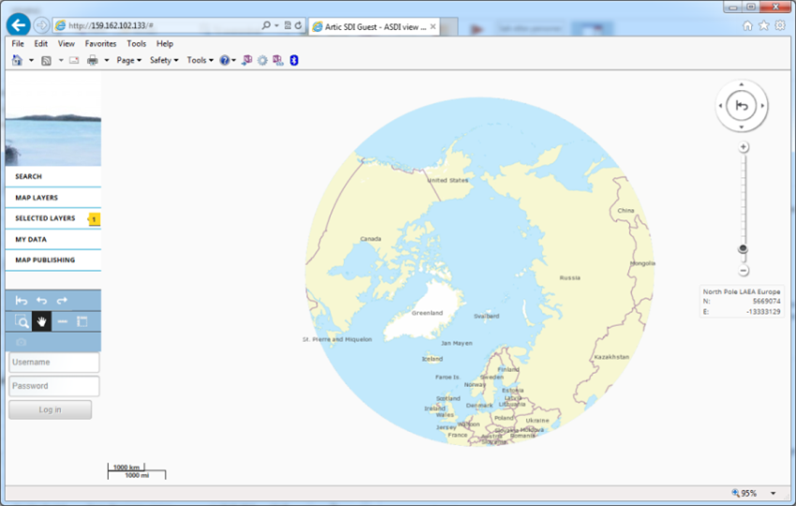
Notes:
The following pages screenshots highlight data that is being fed into the Geoportal using Web Services from each of the participating National Mapping Agencies of the Arctic nations.

Slide 9
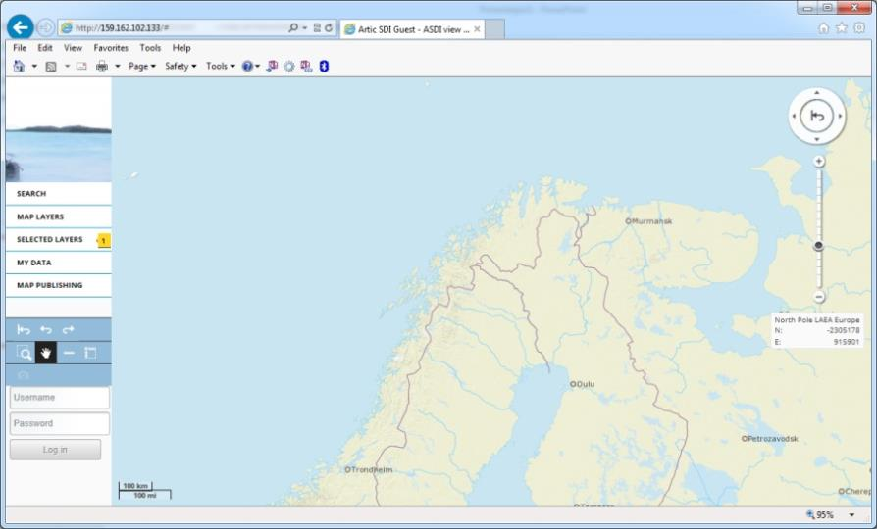
Notes:
Note as we zoom in there is a difference as you cross borders, but not nearly the difference that existed before the establishment of the basemap.

Slide 10
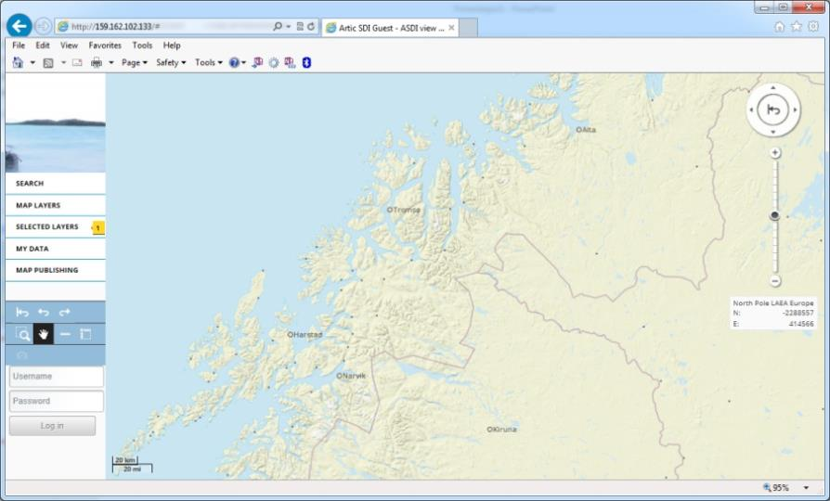

Slide 11
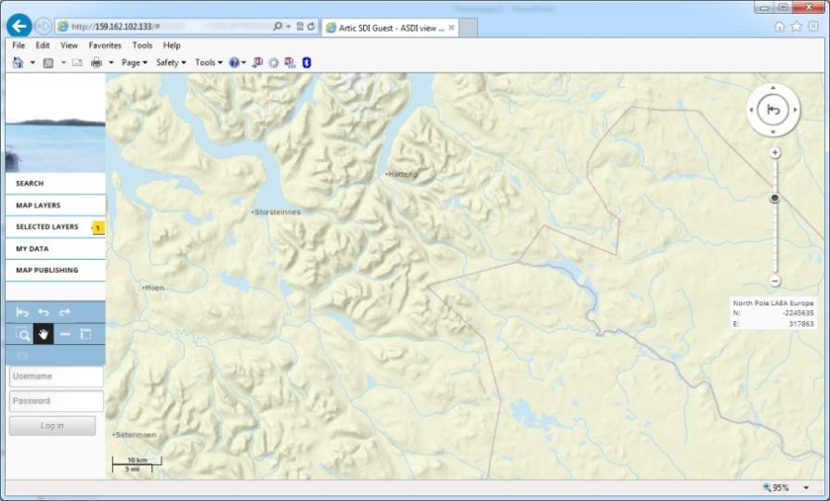

Slide 12
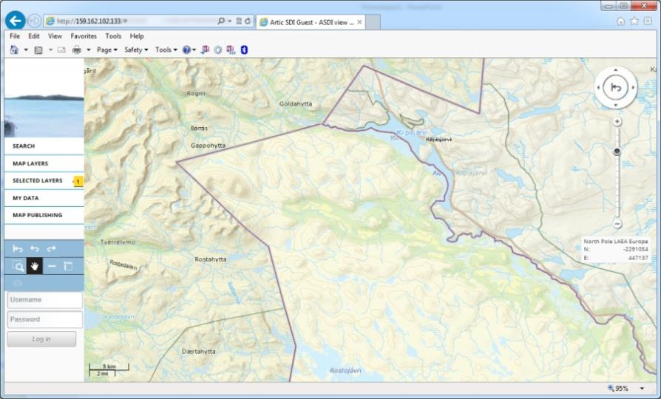

Slide 13
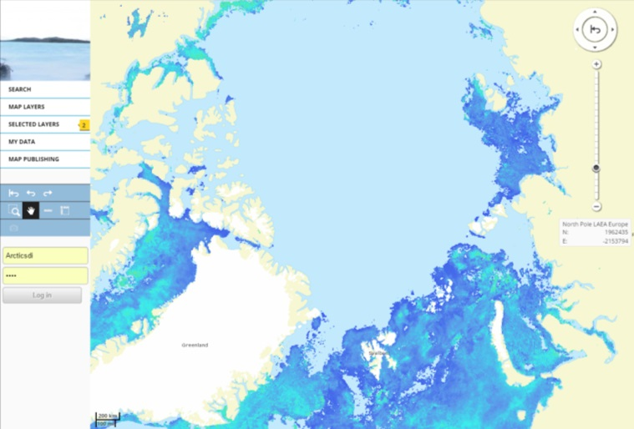
CAFF Sea Surface Temperature
Notes:
Data layer delivered by the Arctic Council Conservation of Arctic Flora and Fauna Working Group

Slide 14
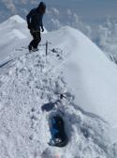
Improved access to geospatial data can help us better predict, understand and react to changes in the Arctic.
Visit arctic-sdi.org
Notes:
Got data? Contact us and we’d love to have a conversation and share our knowledge and discuss options …

Slide 15
The Arctic SDI cooperation now has a solid foundation to build upon with our stakeholders, especially the Arctic Council organization
Got data?
Contact us and we’d love to have a conversation, share our knowledge and discuss options …
Notes:
Standards (Internet,WWW, Email) …

Slide 16
And the Arctic SDI is committed to continue to work with CAFF
to pursue the implementation of a general Arctic Council Information Policy
to bridge the Arctic Council and its Working Groups and the Arctic SDI Cooperation
to report to the Senior Arctic Officials through CAFF
Notes:
Standards (Internet,WWW, Email) …

Slide 17
Arctic SDI: A Brief History
2015: Governance & 5-year Strategic Plan Approved by the Board
2014: : Geoportal Launched
MOU between the NMAs in the Arctic to support and develop an SDI for access & distribution of geospatial data
Stuff happened here …
2009: Arctic Council SAOs endorsed the Arctic SDI initiative of the NMAs
2007: Exploring possibilities for an Arctic SDI …
1990’s: Cross-Border Arctic GitBarents launched
Arctic SDI: The Results of Collaborative Efforts …REMOVE
Maturing of the Arctic SDI
Monitoring, management, emergency preparedness and decision making responses to impacts of climate change and human activities require accessible and reliable data

