Slide 1
Arctic SDI basic presentations
The standardized Arctic SDI slide show consists of 2 basic presentations of which one is technical.
Supplementary slides can be found in a separate file.
Arctic SDI standard presentation_V1.0_150311
Arctic SDI technical presentation_V1.0_20150219
Arctic SDI supplementary slides _V1.0_150311
The series are to be seen upon as gross series.
They can be used as they are but it is recommended to edit/modify/complete due to the audience
Slides from the supplementary could be used as complement
serves as a basic PowerPoint, and that, depending on the audience and the presenter, it is a PowerPoint that most likely will be altered as time goes by. It would be a great idea if we could have all these PowerPoints on the webpage
Name
Organisation or logo

Slide 2
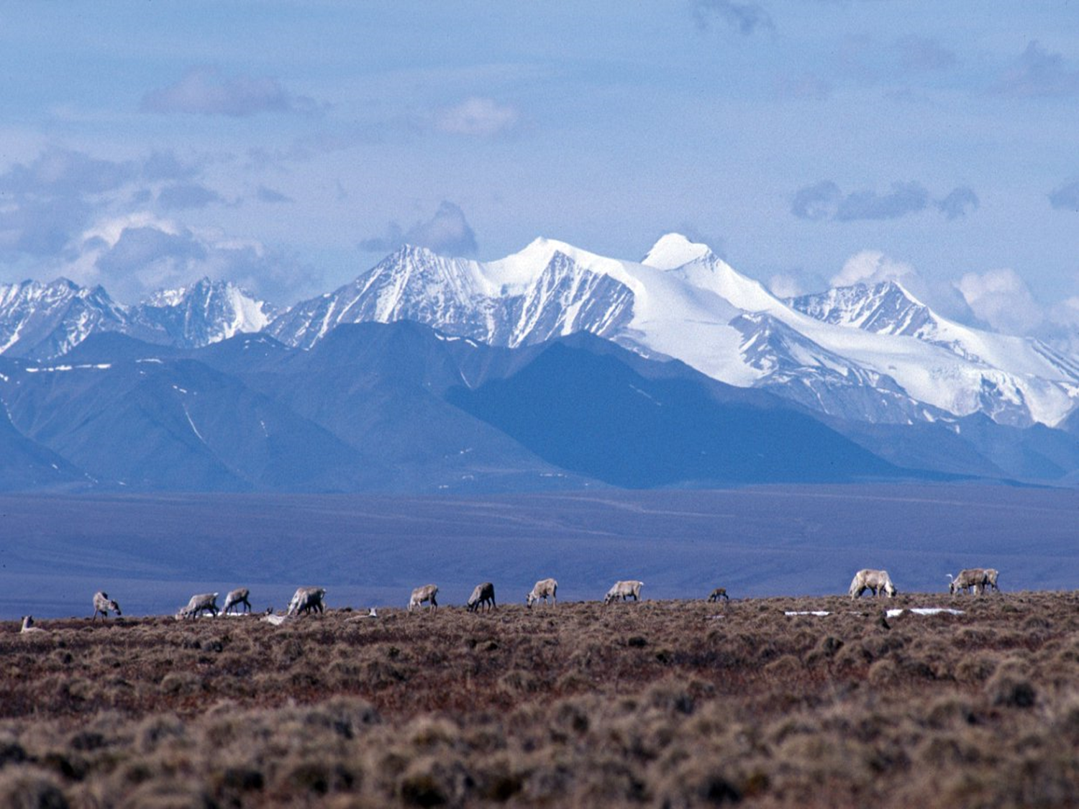
Arctic Spatial Data Infrastructure
- A circumpolar mapping initiative -
Technical presentation
Name of conference or meeting
Place
Name
Organization or logo
www.arctic-sdi.org
Name
Organisation or logo

Slide 3
What is a Spatial Data Infrastructure?
SDI is a coordinated series of agreements on technology standards, institutional arrangements, and policies that enable the discovery and use of geospatial information by users and for purposes other than
those it was created for
Kuhn, W. (2005) presentation "Introduction to Spatial Data Infrastructures".

Slide 4
Spatial Data Infrastructure Basics
Data and metadata are managed by the data originator and/or owner
Tools and services connect via computer networks to the various sources through a common end point
To achieve the objectives
coordination is necessary
standards are essential
Steiniger, S., and Hunter, A.J.S. (2012) preprint "Free and open source GIS software for building a spatial data infrastructure".

Slide 5
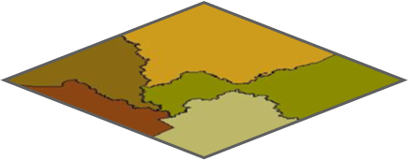
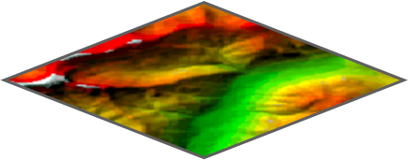
Main Content of the Artic SDI
The Arctic SDI is an infrastructure that provides a web portal with easy access to:
A geoportal for geospatial data viewing and discovery
A searchable metadata catalogue
Authoritative reference data as a Web Map Service (WMS)
Thematic data (birds, icecover, ship routes, land cover change, flora etc.)

Slide 6
Arctic SDI from a technical perspective
Easy access to updated spatial data in the Arctic
National Mapping Agencies
Thematic data producers
Use National SDI’s
Add as little overhead as possible
Some common services are needed
Cascading service
Map cache
Metadata catalogue
Geoportal
Geospatial Digital Rights Management
Authentication
Authorisation
(Payment)

Slide 7
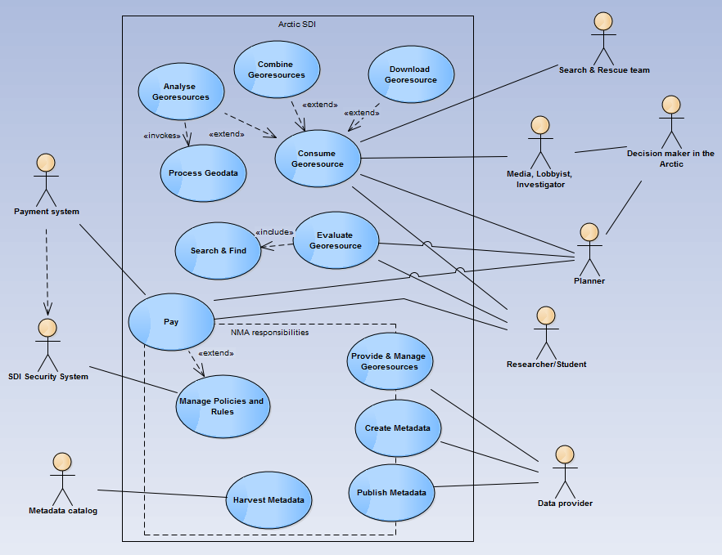
Use Cases
Actors
Decision makers
Media
Lobbyists
Investigators
Planners
Researchers/Students
Data providers
Supporting Systems
Use cases
Provide & Manage Georesources
Create Metadata
Publish Metadata
Evaluate Georesources
Consume Georesources

Slide 8
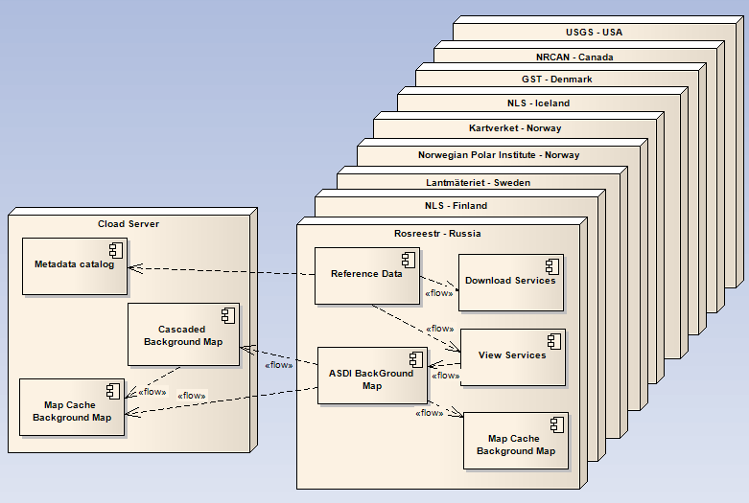
Deployment
Only covering Arctic Mapping Agencies responsibilities
Arctic SDI Components and their physical deployment environment
Points out the need of 24-7 runtime

Slide 9
Data, technology and standards
What data is provided in the SDI?
Reference data
Thematic data
Standards
Focus on WMS, CSW
ISO19115, ISO19139
WFS, REST API for download

Slide 10
Name
Organisation or logo

Slide 11
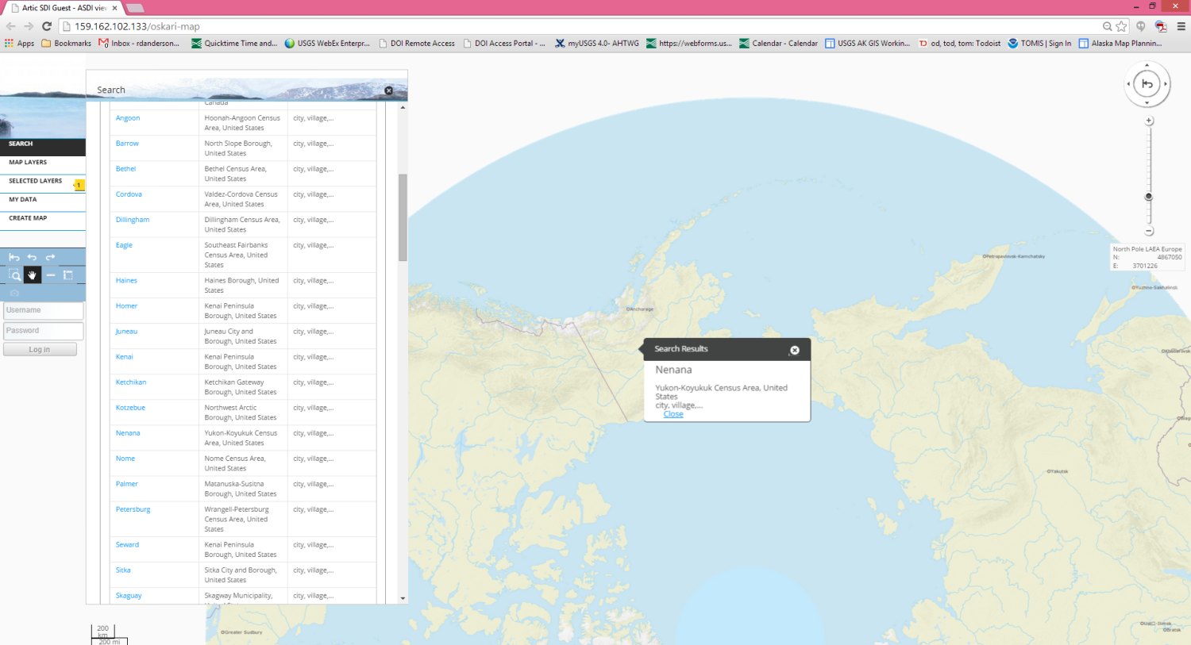
Location Search

Slide 12
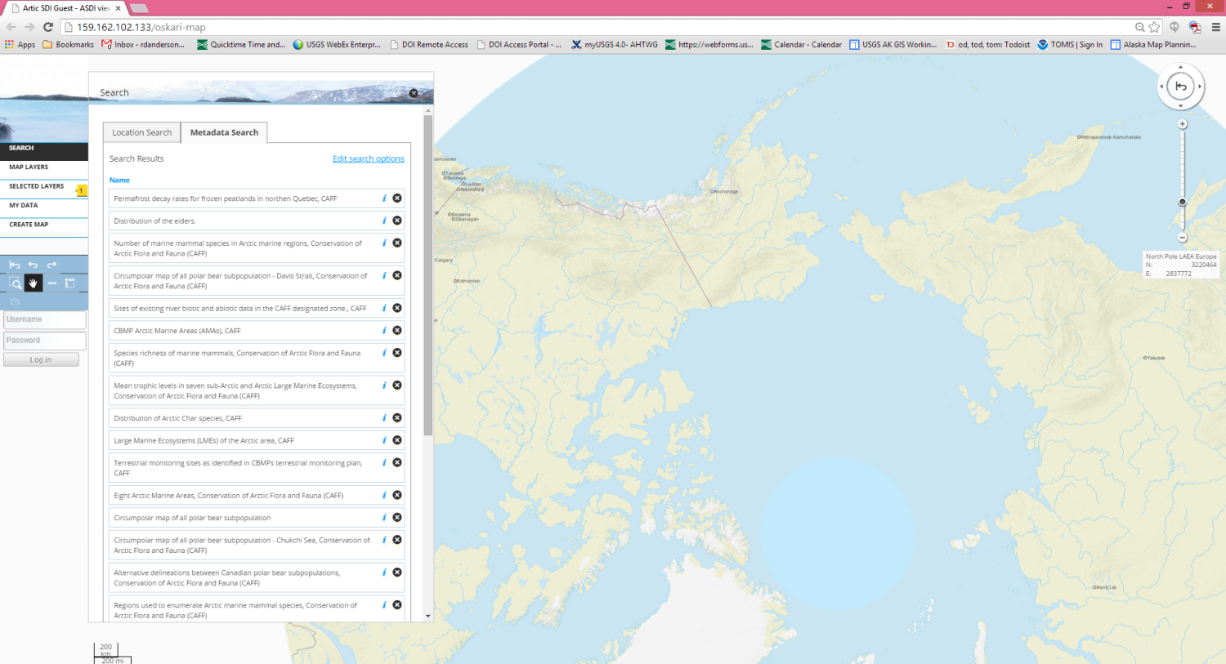
Metadata Search

Slide 14
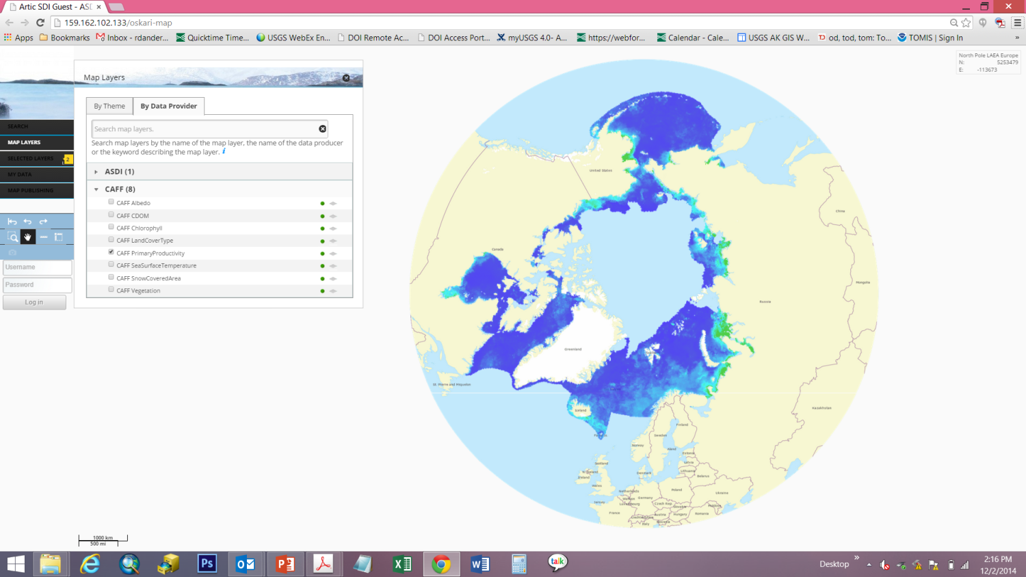
CAFF – EOP Available on Arctic SDI Geoportal

Slide 15
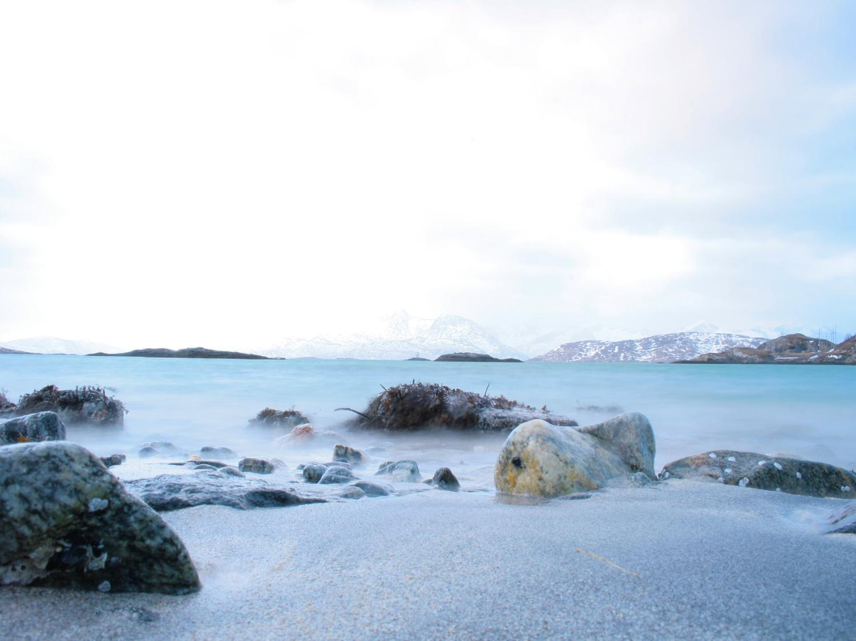
Thank you!
Name of presenter
Organization or logo
Name of presenter
Organization or logo

