Slide 2
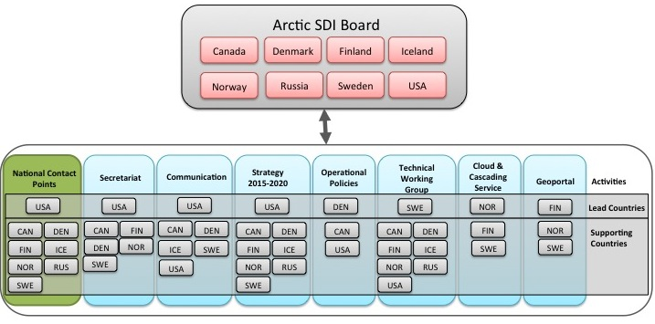
Arctic SDI Organization December 2015

